Slide 1
Class : B.Com final
Subject: Business Environment
Topic: Make in India
By: Prof.Madhvi
Department of Commerce.
I B college Panipat
Affiliated to Kurukshetra University
Kurukshetra

Slide 2
INTRODUCTION
*Though manufacturing is a significant part of the industrial sector,for over two decades its sectoral growth had ranged around 7 to 8 percent and its share in GDP had stagnated to around 16 percent.
*Recognising the multiplier effect of manufacturing sector the Government has introduced this program on 25th September,2014.

Slide 3
WHAT IS MAKE IN INDIA?
*This is an initiative to call top business investors across the world for investment in India to transform the country into a Global Business hub and to create a million of honoured jobs in the country.
*It also aims at improving India's rank in ease of doing business by eliminating unnecessary laws and regulations, making bureaucratic processes easier and Government more responsible and accountable.
*The vision of prime minister is"Come make in India.Sell any where,but make in India."
In context of this campaign Prime Minister elaborated the term FDI as "first develop India"

Slide 4
LOGO OF MAKE IN INDIA
*The logo of Make In India campaign is an elegant lion, inspired by the Ashoka Chakra and designed to represent India's success in all spheres.

Slide 5
SLOGAN
The slogan is “Zero Defect Zero Effect”which signifies two things:
*Production mechanisms wherein products have no defects.
*Production process which has zero adverse environmental and ecological effects.

Slide 6
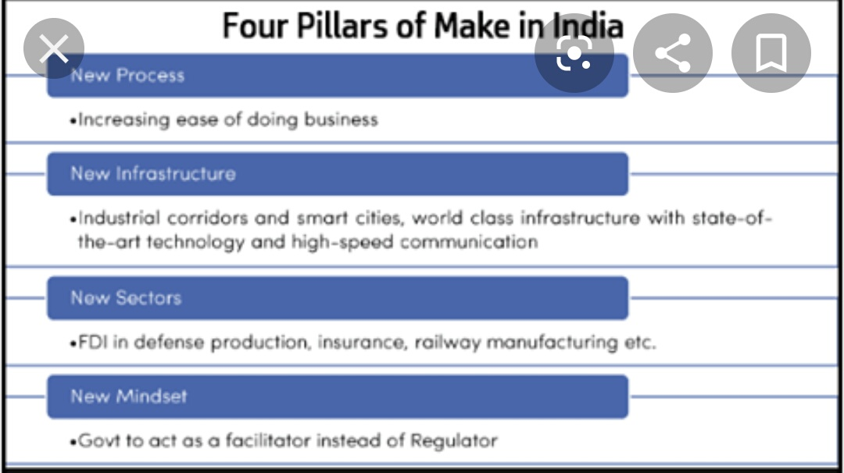
FOUR PILLARS

Slide 7
THE THREE MAJOR OBJECTIVES WERE:
a)To increase the manufacturing sector's growth rate to 12-14% per annum in order to increase the sector’s share in the economy.
b)To create 100 million additional manufacturing jobs in the economy by 2022
(c)To ensure that the manufacturing sector’s contribution to GDP is increased to 25% by 2022(revisedto2025) from the current 16%.

Slide 8
SECTORS COVERED IN PROGRAM 25 sectors have been identified under Make in India initiative viz.,
(xiii)Media and Entertainment,
(xiv)Mining,
(xv)Oil and Gas,
(xvi)Pharmaceuticals,
(xvii)Ports,
(xviii)Railways,
(xix)Roads and Highways,
(xx)Renewable Energy,
(xxi)Space,
(xxii)Textiles,
(xxiii)ThermalPower,
(xxiv)Tourism
(xxv)Wellness.
(i)Auto Components,
(ii)Automobiles,
(iii)Aviation,
(iv)Biotechnology,
(v)Chemicals,
(vi)Construction,
(vii)Defence Manufacturing,
(viii)Electrical Machinery,
(ix)Electronic System Design and Manufacturing,
(x)Food Processing,
(xi)IT and BPM,
(xii) Leather,

Slide 9
ADVANTAGES
*More Job Opportunities
*Attract More Foreign Direct Investment (FDI)
*Increase in GDP
*Ease of doing business
*BetterTechnology
*Development of backward areas

Slide 10
PROBLEMS
*Over utilisation of natural resources
*Harmful for small entrepreneurs
*Ignorance of agriculture
*Loss to other sectors of economy
*Loss of cultivable land
*Increase in pollution

Slide 11
STEPS TAKEN BY THE GOVERNMENT TO BOOST MANUFACTURING SECTOR
*The government intends to provide a robust infrastructure to business through development of various facilities and institutions.
*Government is promoting ease of doing business.Licensing procedures have been simplified & many Industries have been delicensed. Multiple returns have been replaced with single simplified return .
*Government is developing Industrial Corridors to set up quality infrastructure of International standard.
*To protect intellectual property rights of innovators, government has strengthened intellectual property regime.
Contd…..

Slide 12
*To achieve balanced regional development incentives are being provided for attracting investors in a particular geographical area.
*Various tax concessions, tax holidays and additional deductions are being provided to startups.
*Government has adopted liberal foreign investment policy to attract more capital.
*Government is strengthening banks, financial institutions and capital markets to provide stable financial system.
*Means of transport are being developed.

Slide 13
ASSESSMENT OF THE PROGRESS/CONCLUSION
*To give a boost to manufacturing sector “Make in India” campaign was launched but it has failed to achieve its objectives. There is slow growth of investment and for majority of months index of industrial production has been negative.
*This is because of many reasons like lack of policy focus, simultaneousus dealing with so many sectors, too much dependence on foreign capital,overestimation of implementation capacity.
* The Government must realise that industrialisation cannot be kick-started by a series of bills in Parliament. Enforcement of contracts is a weak area which needs to be improved.We have to focus on creation of favourable environment and must develop skills of people to ensure “zero defect zero effect”.

Slide 14
SUGGESTIONS TO STRENGTHEN MAKE IN INDIA
*FOCUS ON RESEARCH AND DEVELOPMENT
*AVAILABILITY OF MODERN MACHINES
*LABOUR REFORMS
*INFRASTRUCTURE DEVELOPMENT
*POLLUTION CONTROL
*PROMOTING INDUSTRIAL PEACE
*PROMOTING TECHNICAL EDUCATION
*EFFICIENT UTILISATION OF RESOURCES

Slide 15
Thanks

