Slide 1
I.B.(PG) College, Panipat
Class : M.Com. IVth Sem.
Subject : IT & E-Commerce

Slide 2
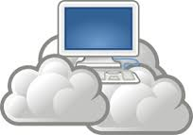
Cloud Computing

Slide 3
Cloud Computing
Introduction
What Is Cloud Computing?
History of Cloud Computing
Advantages of Cloud Computing
Disadvantages of Cloud Computing
Components of Cloud Computing
Architecture of Cloud Computing
Types of Cloud Computing
Recent Development’s of Cloud Computing
Conclusion Cloud Computing

Slide 4
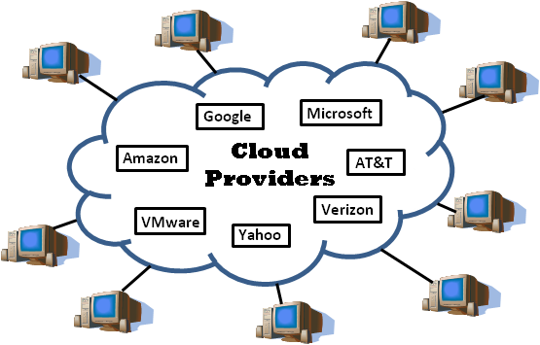
Introduction
Cloud computing is Internet-based computing, whereby shared resources, software, and information are provided to computers and other devices on demand, like the electricity grid.
Cloud computing is a paradigm shift following the shift from mainframe to client–server in the early 1980s. Details are abstracted from the users, who no longer have need for expertise in, or control over, the technology infrastructure "in the cloud" that supports them.

Slide 5
What Is Cloud Computing?
Cloud computing is Internet based computing where virtual shared servers provide software, infrastructure, platform, devices and other resources and hosting to customers on a pay-as-you-use basis.
All information that a digitized system has to offer is provided as a service in the cloud computing model. Users can access these services available on the "Internet cloud" without having any previous know-how on managing the resources involved.

Slide 6
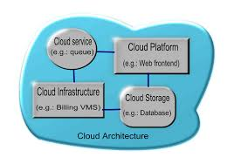
Architecture
Cloud architecture, the systems architecture of the software systems involved in the delivery of cloud computing, typically involves multiple cloud components communicating with each other over application programming interfaces, usually web services.

Slide 7
Cloud computing sample architecture
This resembles the UNIX philosophy of having multiple programs each doing one thing well and working together over universal interfaces. Complexity is controlled and the resulting systems are more manageable than their monolithic counterparts.
The two most significant components of cloud computing architecture are known as the front end and the back end.
The front end is the part seen by the client, i.e. the computer user. This includes the client’s network (or computer) and the applications used to access the cloud via a user interface such as a web browser.
The back end of the cloud computing architecture is the ‘cloud’ itself, comprising various computers, servers and data storage devices.

Slide 8
Types of Cloud Computing

Slide 9
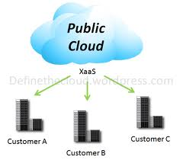
Public cloud
Public clouds are made available to the general public by a service provider who hosts the cloud infrastructure. Generally, public cloud providers like Amazon AWS, Microsoft and Google own and operate the infrastructure and offer access over the Internet. With this model, customers have no visibility or control over where the infrastructure is located. It is important to note that all customers on public clouds share the same infrastructure pool with limited configuration, security protections and availability variances.

Slide 10
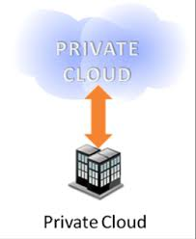
Private cloud
Private cloud is cloud infrastructure dedicated to a particular organization. Private clouds allow businesses to host applications in the cloud, while addressing concerns regarding data security and control, which is often lacking in a public cloud environment. It is not shared with other organizations, whether managed internally or by a third-party, and it can be hosted internally or externally.

Slide 11
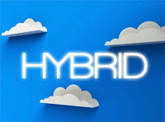
Hybrid cloud
Hybrid Clouds are a composition of two or more clouds (private, community or public) that remain unique entities but are bound together offering the advantages of multiple deployment models. In a hybrid cloud, you can leverage third party cloud providers in either a full or partial manner; increasing the flexibility of computing. Augmenting a traditional private cloud with the resources of a public cloud can be used to manage any unexpected surges in workload.

Slide 12
Components
SaaS (software as a service): SaaS refers to software that’s made available as a web-based service.
Utility computing: The predecessor of cloud computing, utility computing provides the ability to access storage and virtual servers on demand.
Cloud-based web services: Similar to Saas, web services in the cloud allow you to offer services online, such as credit card processing services, employee payroll processing or viewing an interactive map.
MSP (managed service providers): The grandfather of cloud computing, an MSP delivers applications to IT instead of end-users.
IaaS (infrastructure as a service): IaaS refers to computer infrastructure (e.g., virtualization) that’s delivered as a service.

Slide 13
Advantages of Cloud Computing
Flexibility:There is a high rate of flexibility.
Low Cost:Companies can save big by employing cloud computing as it eliminates cost for hardware and software.
Speed & Scales :Traditional methods to buy and configure hardware and software are time consuming.
Easier Management of Data and Information:Since all data are located on a centralized location, data are more organized making it easy to manage.
Device Diversity :We can access our applications and data anywhere in the world, on any system.

Slide 14
Advantages of Cloud Computing…
Increased Storage Capacity :Increased Storage Capacity is another benefit of the cloud computing, as it can store more data as compared to a personal computer.
Easy to Learn and Understand:Since people are quiet used to cloud applications like GMail, Google Docs, so anything related to the same is most likely to be understood by the users.
Automatic Updating :It saves companies time and effort to update multiples server.
Customize Setting :Cloud computing also allows you to customize your business applications.

Slide 15
Disadvantages of Cloud Computing
Dependency :One major disadvantages of cloud computing is user’s dependency on the provider.
Risk :Cloud computing services means taking services from remote servers.
Requires a Constant internet connection :The most obvious disadvantage is that Cloud computing completely relies on network connections.
Security :Security and privacy are the biggest concerns about cloud computing.
Migration Issue :Migration problem is also a big concern about cloud computing.

Slide 16
THANKS!!!

