Slide 1

WORLD TRADE ORGANISATION
(WTO)
Class : M.Com (P)
Subject : International Business
Environment
Topic : GATT/WTO
Deptt. : Commerce & Management
College : IB (PG) College, Panipat
(Affiliated to Kurukshetra
University, Kurukshetra)
By : Prof. Sukhjinder Singh

Slide 2
What is WTO?
World Trade Organisation (WTO) is a regulatory body that deals with the rules of trade between nations at a global or near-global level.
It’s a forum for governments to negotiate trade agreements.
It’s a place for them to settle trade disputes.
It operates a system of trade rules.
The WTO replaced GATT in 1995.

Slide 3
Origins of GATT
The prolonged recession before the world war 2nd & the devastation caused by the world war 2nd led to the BRETTON WOODS Conference.
In International Conference on Trade and Employment in Havana in the winter of 1947-48, fifty-three nations drew up and signed a charter for establishing an International Trade Organisation (ITO).
The US Congress did not ratify the Havana Charter with the result that the ITO never came into existence.

Slide 4
How GATT Was Formed ?
Twenty-three nations agreed to continue extensive tariff negotiations for trade concessions at Geneva, which were incorporated in a General Agreement of Tariffs and Trade. This was signed on 30th October 1947 and came into force form 1st January 1948 when other nations had also signed it.
The General Agreement on Tariffs and Trade (GATT) is neither an organisation nor a court of justice.
It is simply a multinational treaty which now covers eighty per cent of the world trade.

Slide 5
Principles of GATT
Trade without Discrimination/ Non discrimination
Protection only through tariff or Prohibition of quantitative restrictions
Stable basis of trade
Consultation- open discussions for conflict resolution
Foreign entities treated same as domestic entities

Slide 6
Objectives of GATT
To provide equal opportunities to all countries in international market for trading.
To increase the effective demand for real income growth and goods.
To minimize tariffs on trade for ensuring mutual benefit.
To provide proper solution to the disputes related to international trade.
To ensure a better living standards in the world as a whole.

Slide 7
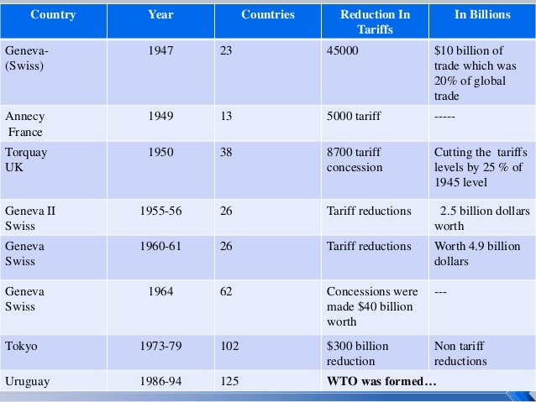
GATT Rounds (Conferences)

Slide 8
Uruguay Round Package
The Eighth Round of GATT was known as Uruguay Round, 1986-93, and 123 countries participated in this Round.
The final act was signed by 12 countries in which India was signatory. Popularly known as Dunkel agreement, It finally emerged as the World Trade Organisation (WTO) on 1st January, 1995.
“Child becomes a Parent & Parent a child”

Slide 9
Criticism of GATT
Problems in formulation of General rules
Slow dispute settlement mechanism
Less benefits for the LDC’s
No enforcement authority
Quantitative Trade Restrictions
Formation of regional groups

Slide 10
Establishment of WTO
The WTO is the embodiment of the Uruguay Round results and the successor to the General Agreement on Tariffs and Trade (GATT).
GATT is replaced by WTO.
The World Trade Organisation (WTO) was established on 1st January 1995.
India is one of the founder members of the WTO.
The World Trade Organization (WTO) is an intergovernmental organization that regulates international trade.

Slide 11
Fact File of the WTO
Formation | 1 January 1995
Type | International trade organization
Headquarters | Geneva, Switzerland
Membership | 164 member states
Official language | English, French, Spanish
Purpose | Reduction of tariffs and other barriers to trade

Slide 12
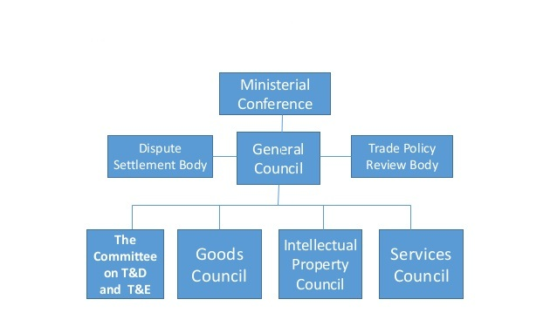
Structure of WTO

Slide 13
Objectives of WTO
To set and enforce rules for international trade
To provide a forum for negotiating and monitoring further trade liberalization
To resolve trade disputes
To increase the transparency of decision-making processes
To cooperate with other major international economic institutions involved in global economic management.
To help developing countries benefit fully from the global trading system

Slide 14
Functions of WTO
It facilitates the implementation, administration and operation of the objectives of the Agreement and of the Multilateral Trade Agreements.
It provides the framework for the implementation, administration and operation of the bilateral Trade Agreements relating to trade in civil aircraft, government procurement, trade in diary products and bovine meat.
It administers the Understanding on Rules and Procedures governing the Settlement of Disputes of the Agreement.

Slide 15
Contd…Functions
It shall be responsible for the settlement of differences and disputes among its member countries.
It cooperates with the IMF and the World Bank and its affiliated agencies with a view to achieving greater coherence in global economic policy-making.
It shall be responsible for carrying out periodic reviews of the trade policies of its member countries.

Slide 16
WTO Agreement
GATS - General Agreement on Trade in Services
TRIPs - Trade Related Intellectual Property Rights
AOA – Agreement on Agriculture
TRIMs - Trade Related Investment Measures
Dispute Settlement
Anti Dumping

Slide 17
GATS
It is a General Agreement on Trade in Services.
It covers 4 modes of international delivery of services:
Cross border flow (Trans border data flows, transportation services)
Commercial presence (Provision of services abroad thru FDI , etc..)
Consumption abroad
Movement of personnel (Entry & temporary stay of foreign consultants)

Slide 18
TRIPs
Trade Related Aspects of Intellectual Property Rights
IPR are the rights given to persons over the creation of their minds.
1. Copy rights & related rights
2. Trademarks
3. Geographical indications
4. Industrial design
5. Patents

Slide 19
AOA
Agreement on Agriculture
There are 3 principal commitments..
Market Access :- no import restrictions & limitations
Domestic support :- Elimination of govt. support to domestic company’s.
Export subsidies :- phase out support given to exporters ..
Other important aspects are:-
a) Tariffication :- means removal of tariff quotas.
b) Tariff binding :- means fixing the max rate of import duty, above which a country does not raise the duty unilaterally.

Slide 20
TRIMs
It is Trade Related Investment Measures
No country shall apply TRIMS which is inconsistent with WTO articles . The following are inconsistent :-
Local content requirement
Trade balancing requirement
Trade & foreign exchange
Domestic sales requirement.

Slide 21
Dispute Settlement
Dispute settlement or dispute settlement system (DSS) is regarded by the World Trade Organization (WTO) as the central pillar of the multilateral trading system, and as the organization's "unique contribution to the stability of the global economy".
It has a fixed dead line in settlement of disputes .
The first ruling does not extend beyond 1 year.
The appeal is generally disposed off before 60 days.

Slide 22
Anti-Dumping Measures
Meaning- It means selling the product at below the on going market price or at the price below the cost of production.
Anti-Dumping laws is applicable if the margin of dumping is more than 2% of the export price or the volume of dumped products is more than 3% of the product.
Anti-Dumping duty shall not exceed the margin of dumping .
Anti-Dumping action may be suspended or terminated if the exporter agrees to remove the dumping or the injurious effect of it.

Slide 23
Distinction between GATT and WTO
GATT
WTO
The GATT had no status.
The GATT dispute settlement system was dilatory and not binding on the parties.
The GATT rules applied to trade in goods.
GATT WAS an agreement.
The WTO has a legal status.
The WTO dispute settlement mechanism is faster and binding on all parties.
The WTO covers both trade in goods and trade in services.
WTO is an organization.

Slide 24
India and WTO
India is a founding member of the GATT (1947) as well as of the WTO, which came into effect from January 1, 1995. By virtue of its WTO membership, India automatically avails of Most Favoured Nation Treatment (MFN) and National Treatment (NT) from all WTO members for its exports and vice versa.
India has fulfilled its commitment by reducing tariff and eliminating QR.
The Indian economy has grown rapidly over the past decade, with real GDP growth.

Slide 25
Criticism of WTO
The WTO serves the interest of multinational corporations and wealthy nations.
Barriers are lowered by developing countries whilst developed world still maintains barriers in agriculture.
The WTO is increasing inequality.
Fundamental principles and aims of the WTO are not beneficial for all parties involved.
The WTO undermines local development and penalizes poor countries.
Free trade means local cultures are replaced with Coca Cola, Starbucks and McDonalds.

Slide 26
Conclusion
It is the place where the member country comes and talks together and shares their grievance in order to resolve their problem related to International trade.
The countries make their decisions through various councils and committees, whose membership consists of all WTO members.
The system helps promote peace, by handling Dispute of member countries. It provides free trade which cuts the costs of living and provides more choice of products and qualities and stimulates economic growth.

Slide 27
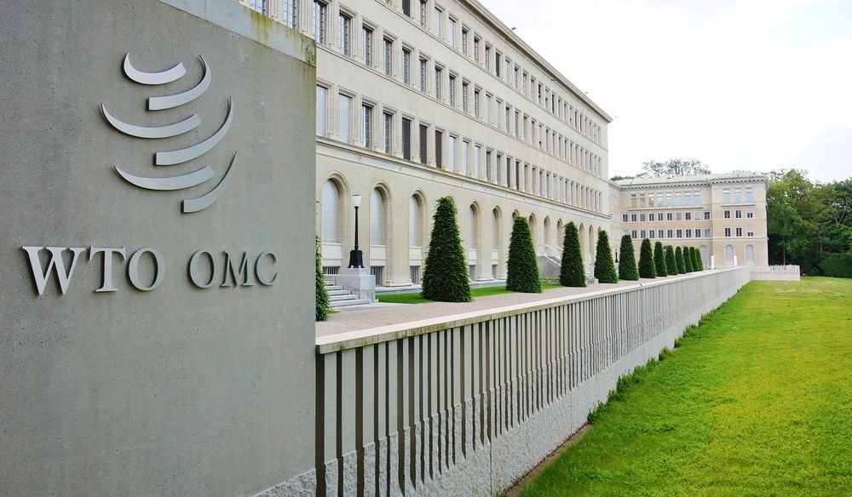
Thank You…!
“WTO is an International body designed to play the role of a watchdog in spheres of trade in Goods, services foreign investments, IPR etc.”

