Slide 1
I.B.(PG) College, Panipat
Class : M.Com. IVth Sem.
Subject : IT & E-Commerce

Slide 2
Security Issues In E-Commerce

Slide 3
Introduction
E-Commerce is defined as the buying and selling of products or services over electronic systems such as the Internet and to a lesser extent, other computer networks. It is generally regarded as the sales and commercial function of e-Business. There has been a massive increase in the level of trade conducted electronically since the widespread penetration of the Internet. A wide variety of commerce is conducted via e-Commerce, including electronic funds transfer, supply chain management, Internet marketing, online transaction processing, electronic data interchange (EDI), inventory management systems, and automated data collection systems. This massive increase in the uptake of e-Commerce has led to a new generation of associated security threats, but any e-Commerce system must meet four integral requirements:

Slide 4
Security Issues in E-Commerce
Essential security requirements for safe electronic payments are:
Confidently – Information should be protected from eyes of unauthorized internal users, hackers ,and from being intercepted during transmission on communication networks by making it unintelligible to the attackers.
Integrity – Ensuring that information will not be accidentally or maliciously altered or destroyed during transmission.
Authentication – Both sender and recipient must prove their identities to each other .
Non-Repudiation – Proof is required that the exchanged information was indeed received.

Slide 5
Online Frauds
There are many words used to describe fraud, for example scam, confidence trick, extortion, double-cross, cheat, hookwink etc.
Online fraud can be perpetrated via spyware and other malware or sometimes more elaborately in conjunction with other channels such as email, telephone calls or letters.
Types of Online Frauds:
Account takeover
Bank card and cheque fraud
Business opportunity fraud
Click fraud
Identity fraud
Internet auction fraud
Loan Fraud
Land banking fraud
Vehicle matching frauds

Slide 6
Privacy Issues
The privacy in E-Commerce means the protection of privacy of the parties involved in trading through e-commerce.
While doing trading in e-commerce people are disclosing their personal information and those information are being proliferated and reaching to the hand of undesirable parties, and thereby increasing concern about privacy.
B2B Privacy Issues.
B2C Privacy Issues.
C2C Issues .

Slide 7
Security Schemes (or Security Solution)
Main security schemes for electronic payment systems are:
Encryption and Decryption
Digital Signature
Security Certificate

Slide 8
Encryption
Encryption is the process of translating plain text data (plaintext) into something that appears to be random and meaningless (ciphertext).
Decryption
Decryption is the process of converting ciphertext back to plaintext.

Slide 10
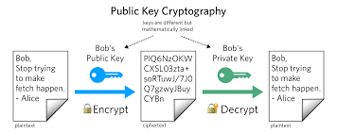

Slide 11
Digital Signature
A digital signature is a mathematical technique used to validate the authenticity and integrity of a message, software or digital document. As the digital equivalent of a handwritten signature or stamped seal, a digital signature offers far more inherent security, and it is intended to solve the problem of tampering and impersonation in digital communications.
Digital signatures can provide the added assurances of evidence of origin, identity and status of an electronic document, transaction or message and can acknowledge informed consent by the signer.
In many countries, including the United States, digital signatures are considered legally binding in the same way as traditional document signatures.

Slide 14
Security Certificate
Just as a passport is a universal way to establish your identity and gain entry to another country, a digital or security certificate provides identification in the electronic world. Certificate authorities (CAs) are organizations that issue security certificates. Much like the role of the passport office, the role of the CA is to validate the certificate holder’s identify and to “sign” the certificate so that it cannot be forged or tempered with. Once a CA has signed a certificate, the holder can present the certificate to people, web sites, and network resources.
A certificate is a unique digital ID that can be used to verify the identity of an individual. The certificate always includes a public key, the name of the entity it identifies, an expiration date, the name of the certificate authority (CA) that issued the certificate, the digital signature of the CA, and a serial numbers as shown in figure.

Slide 15
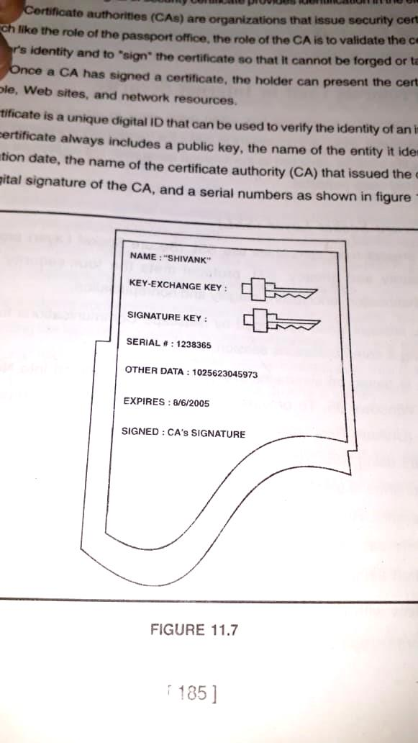

Slide 16
Thanks

