Slide 1
I. B. (PG) College, Panipat

Slide 2
Presented by
Sheela Malik
Assistant Professor
Department of English
I. B. PG College, Panipat

Slide 3
Summary of Poem-The Lady Shalott

Slide 4
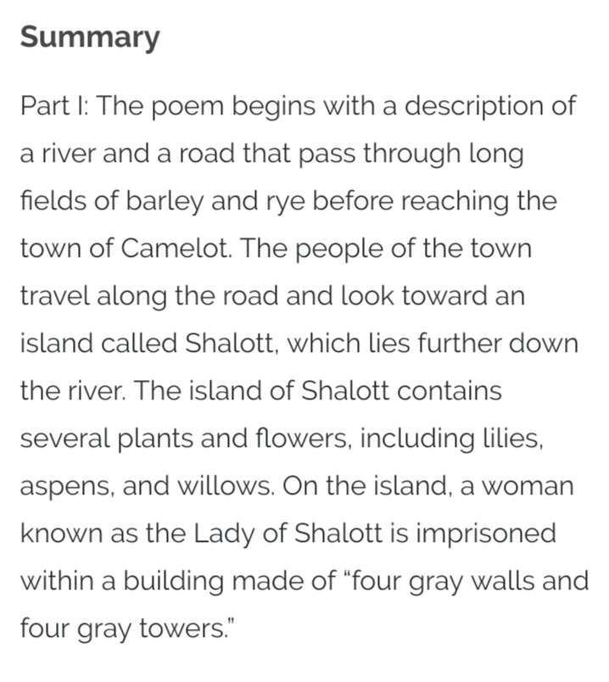

Slide 5
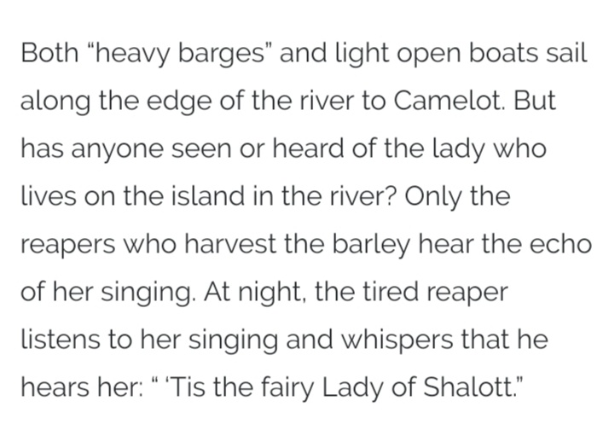

Slide 6
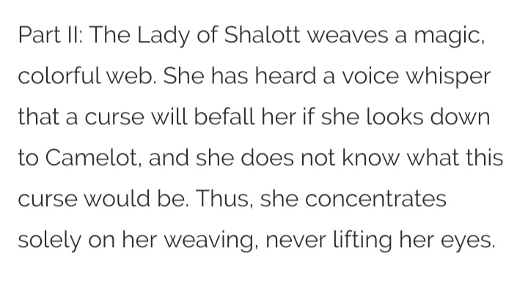

Slide 7
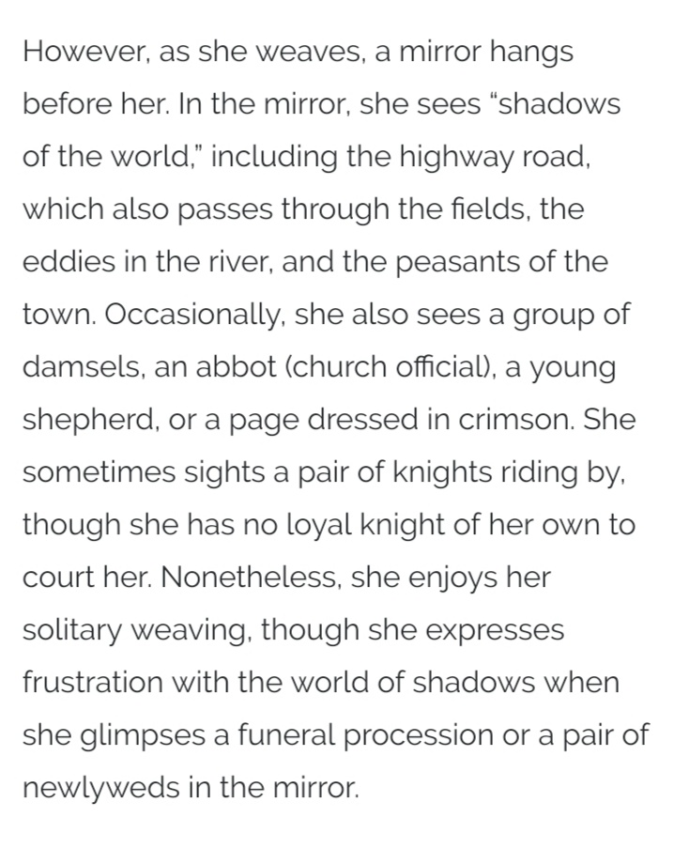

Slide 8
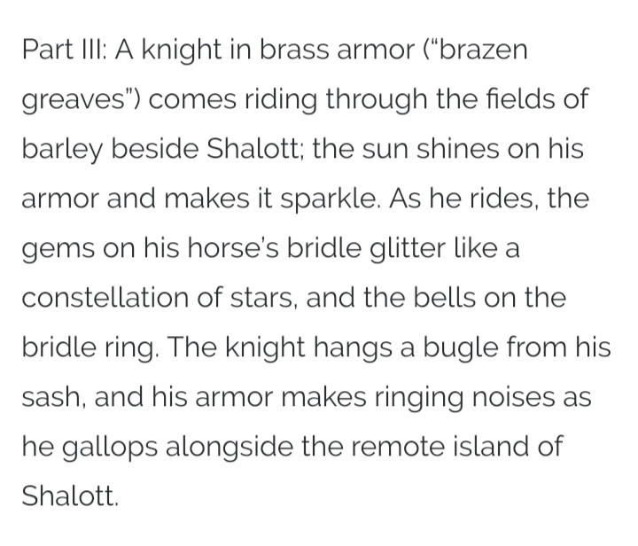

Slide 9
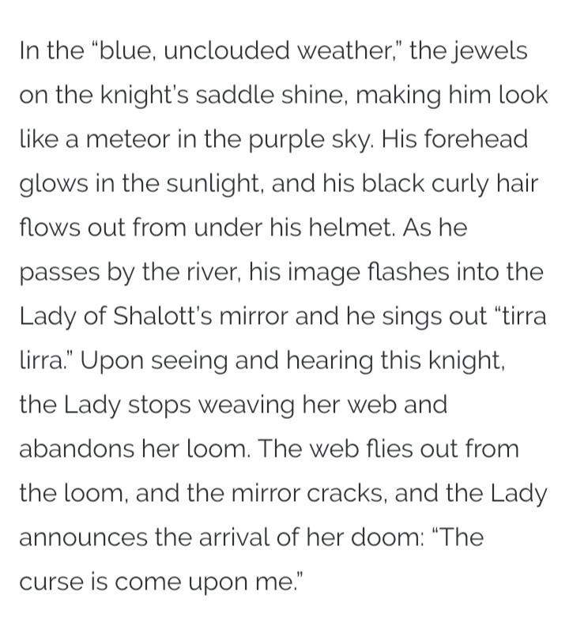

Slide 10
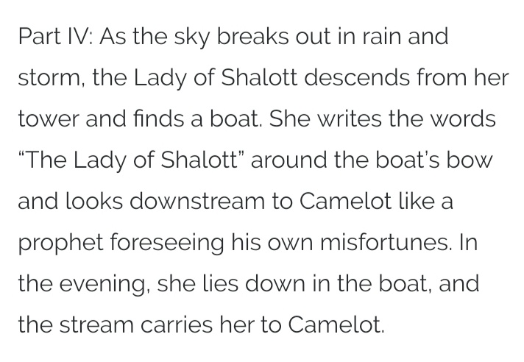

Slide 11
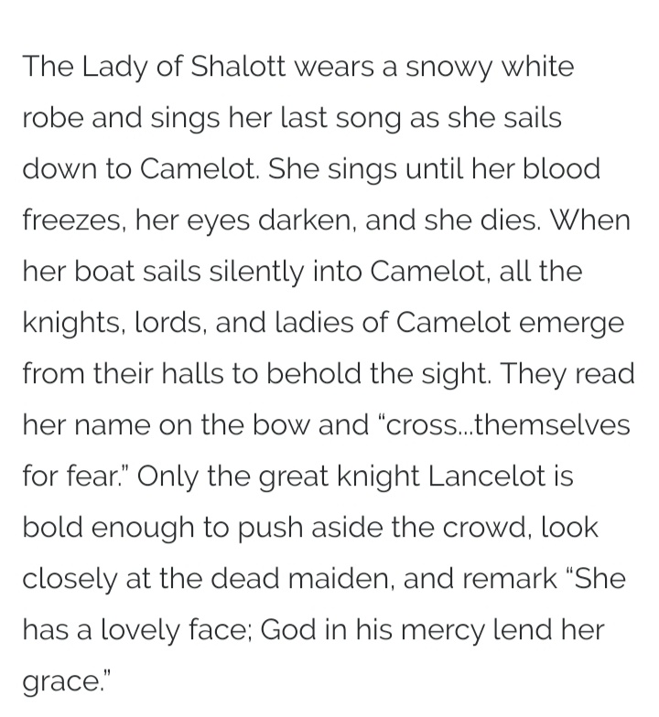

Slide 12
Thank you

