Slide 1
CLASS : MCOM( PREVIOUS)
SUBJECT: STRATEGIC MARKETING
TOPIC: PORTFOLIO ANALYSIS
PROF. RAJESH BALA ( ASSISTANT PROFESSOR )
DEPARTMENT: COMMERCE & MANAGEMENT
COLLEGE : I.B ( P.G ) COLLEGE, PANIPAT
KURUKSHETRA UNIVERSITY KURUKSHETRA

Slide 2
PORTFOLIO ANALYSIS
Portfolio analysis is an examination of the components included in a mix of products with the purpose of making decisions that are expected to improve overall return. The term applies to the process that allows a manager to recognize better ways to allocate resources with the goal of increasing profits. Strategic portfolio analysis involves identification and evaluation of all products or service groups offered by company on the market (so called product mix) and preparing specific strategies for every group according to its relative market share and actual or projected sales growth rate.

Slide 3
DEFINITION
Portfolio Analysis is the process of reviewing or assessing the elements of the entire portfolio of securities or products in a business. The review is done for careful analysis of risk and return. Portfolio Analysis conducted at regular intervals helps the investor to make changes in the portfolio allocation and change them according to the changing market and different circumstances. The analysis also helps in proper resource/asset allocation to different elements in the portfolio.

Slide 4
IMPORTANCE OF PORTFOLIO ANALYSIS
The analysis is done in large multinationals with multiple product portfolios. A company should be aware of the financial health of the portfolios and their wellbeing. To know the top performers and strategies to maintain them the profit makers is the primary objective of Portfolio’s analysis.
No company will have all product profit. There will be few products or product lines which may be loss makers. These are the cash consuming portfolios and the company should be aware of them so that they can either be discontinued or revamped. The idea is to make them less costly and more profit making.

Slide 5
IMPORTANCE (CONTD.)
Portfolio’s analysis helps the company to stay in sync with the vision, mission and objectives. At times it may happen that a certain portfolio may be loss-making and the company may have been unknowingly being financing the dead weight for a long time. In these cases, the analysis will give a clear picture of the scenarios.

Slide 6
TOOLS OF PORTFOLIO ANALYSIS
There are several tools for portfolio’s analysis, these are:
BCG MATRIX
GE NINE CELL MATRIX
SWOT ANALYSIS
PESTLE ANALYSIS
CRITICAL QUESTION ANALYSIS
BALANCED SCORECARD
VRIO ANALYSIS ,ETC.

Slide 7
TOOLS (CONTD.)
There are several tools for portfolio’s analysis but we are describing the main:
BCG Matrix for Portfolio Matrix:
The Boston Consulting Group Matrix (BCG) is the most common tool for performing a portfolio analysis. Considers products and services according to two dimensions: market growth and relative market share. According to the BCG Matrix, products and services with high growth and high market share are the most desirable, while those with low growth and low market share are undesirable.

Slide 8
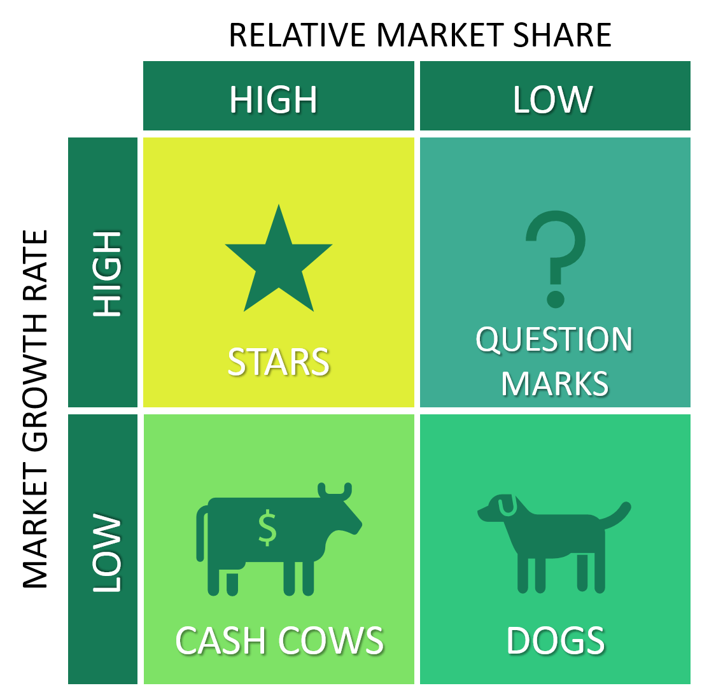
BCG MATRIX

Slide 9
BCG MATRIX(CONTD.)
The BCG Matrix is a graph which has four quadrants plotted on Market Share vs the Market growth or Relative Market Share vs Relative Market Growth. There are four components of BCG Graph as follows:
Cash Cows
Cash cows are the ones which generate the excess cash necessary for the survival of other portfolios as well along with itself. Cash cows are generally mature with relatively low market growth but higher market share. Cash cows have low market share compared to competitors but yield much higher returns as cash hence the term Cash Cow. A company will always try to push Cash cows to Star in terms of market growth. Cash cows require low investment and are usually do not cost much. The cash returns generated by cash cows are much higher than their expenses

Slide 10
BCG MATRIX(CONTD.)
Stars
Like their names, Star is the portfolio which has a higher market share and highest growth compared to all other product portfolios. They are fast growing products with the highest market share close to monopoly but they also require high funding compared to others since they have to maintain their market share and growth, which can be generated from cash cows. If a star declines in market share, it becomes a Cash Cow and if it declines in growth, it becomes a question mark. Star products are very tricky to maintain their position and company has to invest a lot to keep that position. A company’s brand image and brand recognition is enhanced because of the Star products.

Slide 11
BCG MATRIX(CONTD.)
Question Mark:
These are also known as Problem Child or Wildcat. They operate with a lower market share compared to others in a high growth market. They have the potential to become Star as their market share increases and they already have a high growth rate as much as Star. When they increase their market share, they become Star and if they lose their share, they turn into Dog.

Slide 12
BCG MATRIX(CONTD.)
Dogs
Dog is a category which has a low market share and low market growth. They take a long time simply to break even and generate a nominal business barely necessary for survival in the market. They have a low return on investments and they are usually sold off or running or closed down since eventually they become cash eating centers only. In very few cases it may be possible to increase their market share and convert them into cash cows or increase their growth rate and push them to Question Mark which eventually is converted to Star.

Slide 13
ADVANTAGES OF PORTFOLIO ANALYSIS
Management is encouraged to evaluate each of its businesses individually, allowing them to set goals and allocate resources for each.
Use of external oriented data is used to supplement management's intuitive judgment.
Issues of cash flow are raised, so availability of cash for use in expansion and growth can be examined.

Slide 14
DISADVANTAGES OF PORTFOLIO ANALYSIS
Product/market segments are not easily defined.
It provides an illusion of scientific rigor when some subjective judgements are involved.

Slide 15
THANKYOU

