Slide 1
WELCOME

Slide 2
CLASS : - M.COM [PREVIOUS] (2ND SEM) SUBJECT :- BUSINESS STATISTICS
TOPIC :- NORMAL DISTRIBUTION
DEPT. :- DEPT. OF COMMERCE AND MANAGEMENT
COLLEGE :- I.B. (PG) COLLEGE, PANIPAT
BY:- PROF. VANITA REHANI

Slide 3
NORMAL DISTRIBUTION

Slide 4
MEANING :-
Normal distribution, also known as the Gaussian distribution, is a probability distribution that is symmetric about the mean, showing that data near the mean are more frequent in occurrence than data far from the mean.
The normal distribution is a continuous probability distribution that is symmetrical on both sides of the mean, so the right side of the center is a mirror image of the left side.

Slide 5
GRAPH OF NORMAL DISTRIBUTION:

Slide 7
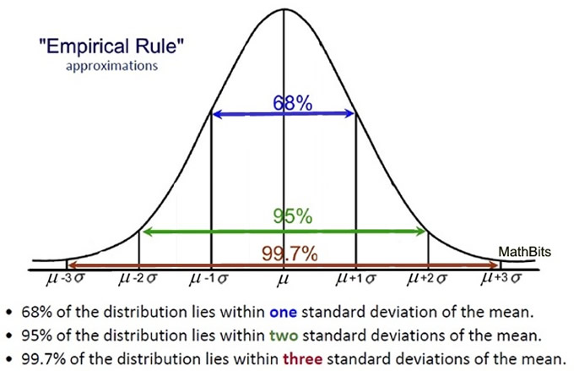
EMPIRICAL RULE

Slide 8
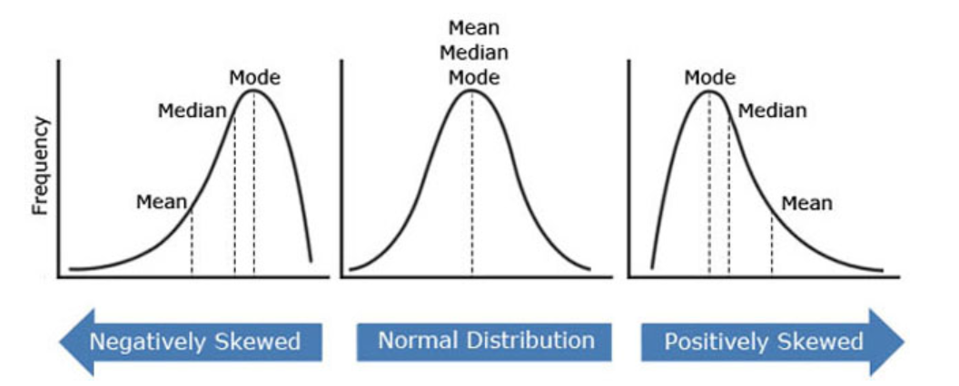
If mean = median = mode, the sample shows a perfectly normal distribution If mean < median < mode, the sample shows a negatively skewed distribution If mean > median > mode, the sample shows a positively skewed distribution

Slide 9
PROPERTIES OF NORMAL DISTRIBUTION:
The shape is symmetric.
The distribution has a mound in the middle, with tails going down to the left and right.
The mean is directly in the middle of the distribution. (The mean of the population is designated by the Greek letter μ.)
The mean and the median are the same value because of the symmetry.

Slide 10
It is Unimodal.
It is also the continuous distribution with the maximum entropy .
The area under the curve and over the x -axis is unity (i.e. equal to one). for a specified mean and variance.
It is symmetric around the point x = μ , which is at the same time the mode , the median and the mean of the distribution.
Normal curve extends to the infinity on either side.
Asymptotic to the Base Line.

Slide 11
IMPORTANCE OF NORMAL DISTRIBUTION:
Normal Distribution is widely used in the study of natural phenomenon.
In case the sample size is large the normal distribution serves as good approximation.
It is used in statistical quality control in setting up of control limits.
The whole theory of sample tests t, f and chi-square test is based on the normal distribution.
Due to its mathematical properties it is more popular and easy to calculate.

Slide 12
HOW TO MEASURE AREA UNDER NORMAL CURVE:

Slide 15
EXAMPLE:-
Average lactation yield for 1000 cows at a farm is 1700 kg and their standard deviation is 85 kg. A cow is considered as high yielder if it has a lactation yield greater than 1900 kg and poor yielder if it has lactation yield less than 1600 kg. Find the number of high yielding and poor yielding cows.

Slide 16
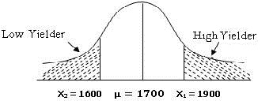
SOLUTION:-
Here, µ=1700 kg and σ = 85 kg and let X denote the lactation milk yield

Slide 17
(A) we first compute the value standard normal variate i.e. Z₁ and then find area under shaded region using normal tables:
P(X₁ > 1900 kg) = P (Z₁ >2.353) =0.5­0.49069=0.00931,
Number of high yielder cows = N x P(z₁ > 2.353) = 0.00931 ×1000 = 9.31 = 9 cows.
(B) , we first compute the value standard normal variate i.e. Z₂ and then find area under shaded region using normal tables:
P(X₂ < 1600) = P (Z₂ < -1.18)=0.5 ­0.38109=0.119
Number of low yielder cows = N x P(X₂ < 1600) = 0.119 × 1000 = 119 cows

Slide 18
EXAMPLE (II) :-

Slide 19
THANK YOU…

