Slide 1
CLASS: M.COM(PREVIOUS) SEMESTER-2
SUBJECT: STRATEGIC MARKETING
TOPIC: MARKET SEGMENTATION, TARGETING AND POSITIONING.
PROF. RAJESH BALA ( ASSISTANT PROFESSOR)
DEPARTMENT OF COMMERCE & MANAGEMENT
IB PG COLLEGE, PANIPAT
KURUKSHETRA UNIVERSITY, KURUKSHETRA

Slide 2
MARKET SEGMENTATION
Introduction:
Division of market into several segments is called market segmentation. This concept is based on the assumption that two buyers are not identical in all respect. They may differ on the basis of income, sex, age, education, profession, religion, social class and family, etc.

Slide 3
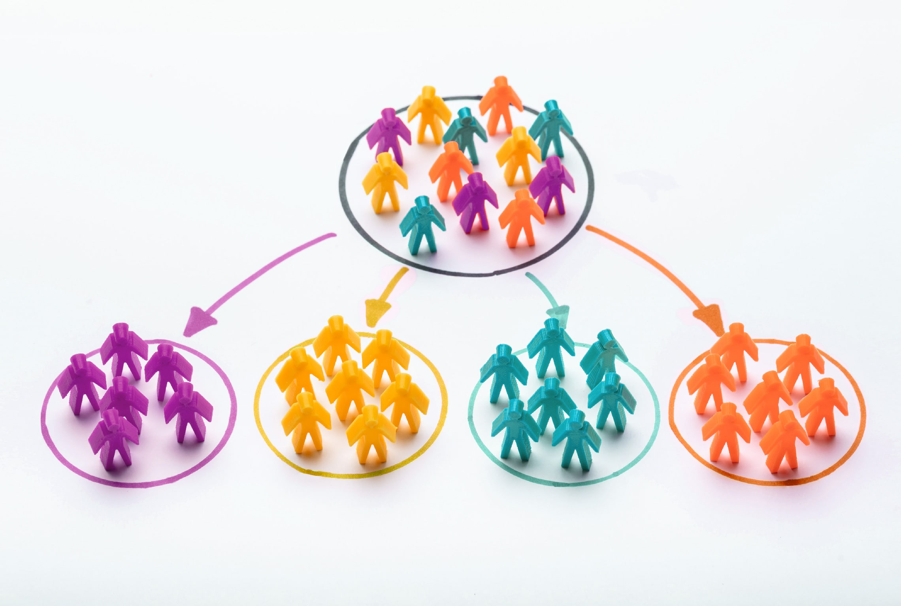
MARKET SEGMENTATION

Slide 4
MARKET SEGMENTATION
Definition:
According to Phillip Kotler: Market segmentation is the subdividing of market into homogeneous subset of customers, where any subset may conceivably be selected as a market target to be reached with a distinct marketing mix.

Slide 5
MARKET SEGMENTATION
Example:
Suppose we divide the whole market into two parts:
MALE FEMALE
Suppose MALE segment is selected, which can further be segmented on the basis of Age:
INFANT YOUNG ADULT OLD
Suppose YOUNG Sub-Segment is selected, then further we can categorize it on the basis of Income:
HIGH INCOME GROUP MIDDLE INCOME GROUP LOW INCOME GROUP
So, It is concluded that our target customer are the Young Males with Middle Income Group and the process is called Market Segmentation.

Slide 6
MARKET SEGMENTATION
Objectives of Market Segmentation:
• Grouping of customer on the basis of their homogenous characteristics, such as nature, tastes, habits, income, behavior, qualities and needs etc.
• To locate or identify the tastes, buying motives, needs, priorities and preference of the customer
• To determine marketing strategies, target and goals
• To make the activities of the firm customer-oriented. Customer orientation makes marketing segment an important pillar of the marketing concept
• To identify the areas or sectors where the customer may be created.

Slide 7
MARKET SEGMENTATION
Reasons for development of Market Segmentation:
Wiiliam J. Stanton has described the following reasons for development of Market Segmentation:
Customer Orientation
Technological Advancements
Use of the Cost-Reducing techniques
Increase in Purchasing power
Increase in Competition

Slide 8
MARKET SEGMENTATION
Requirement/Criteria for effective segmentation:
For Effective Market Segmentation, the following requirements must be considered:
Identifiable
Measurable
Accessible
Responsiveness
Significant
Substantiable.

Slide 9
MARKET SEGMENTATION
Methods of Market Segmentation:
Therefore, The market can be divided in different segments on the basis of such differences, as under:
Each Buyer : A separate Market: It is based on the assumption that every buyer in himself is a market because of different necessities and preferences. Such Classification is possible for the goods whose buyers are limited. For example: Ships, Aircrafts, refineries, etc.
Framing Broad Groups of Buyers: Under this, Customers with similar characteristics are grouped under one segment and each segment is treated as a separate market. Especially when the number of customers is large. For eg: Ladies wear, Children wear, Gents wear, etc.

Slide 10
MARKET SEGMENTATION
Concept/Approaches to market segmentation:
The marketeers adopt several approaches to segmenting a market:
Approaches
Mass Marketing
Product dffferentiation Markeingi
Target Marketing
Market Segmentation
Market Targeting
Product Positioning

Slide 11
MARKET SEGMENTATION
These approaches can be defined as follows:
Mass Marketing: In this total market, It is considered as one-segment. Under mass-marketing, only one quality of product is produced and sold in market for all customers with the help of common marketing program. For eg: CocaCola.
Product Differentiation Marketing: When Marketeer tries to provide different sizes, colours, shapes, features and qualities in his product as per the need and wants of customers of different segments. For eg: Maruti Udyog Limited manufactures Car in different models, colours and price range.
Target Marketing: The target market is defined as a set of actual potential buyers of a product, service, or an idea. Target marketing helps the marketeer to correctly identify the markets: The groups of consumers for whom the product is designed. It has three steps:
1.Market Segmentation 2.Market Targeting 3. Product Positioning

Slide 12
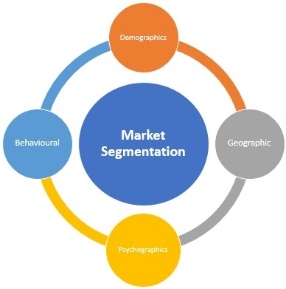
MARKET SEGMENTATION
Basis of Market Segmentation:

Slide 13
MARKET SEGMENTATION
The most common and popular criteria basis or factors for market segmentation which are used by marketing managers are as follows:
Geographic: Segmenting by country, region, city or other geographic basis.
Demographic: Segmenting based on identifiable population characteristics, such as age, occupation, marital status and so on.
Psychographic: This segmentation approach involves an understanding of a consumer’s lifestyle, interests, and opinions.
Behavioral: Segmenting the market based on their relationship with the product or the firm. Examples include: heavy or light users, brand loyal or brand switchers, and so on.

Slide 14
TARGETING
Introduction:
Targeting is the actual selection of the segment you want to serve. I t is the second stage of segmenting, Targeting and positioning.(STP) approach.
Targeting is an act of evaluating and selecting one or few market segments that have been identified, the marketeer must choose the most attractive option for their marketing efforts.

Slide 15
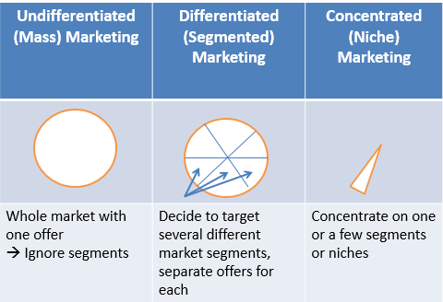
MARKET SEGMENTATION
Market Segmentation Strategies:

Slide 16
MARKET SEGMENTATION
The three types of marketing strategies are as follows:
Undifferentiated marketing strategy: There may be no strong differences in customer characteristics. Alternatively, the cost of developing a separate marketing mix for separate segments may outweigh the potential gains of meeting customer needs more exactly. Under these circumstances a company will decide to develop a single marketing mix for the whole market. There is absence of segmentation. For eg: Salt, kerosene oil, etc.
Differentiated marketing or multi-segment targeting: When market segmentation reveals several potential target segments that the company can serve profitably, specific marketing mixes can be developed to appeal to all or some of the segments. A differentiated marketing strategy exploits the differences between marketing segments by designing a specific marketing mix for each segment.

Slide 17
MARKET SEGMENTATION
The car market is most clearly segmented. There are segments for small cars, luxury cars, sports utility vehicles, etc. Most car makers like General Motors, Ford, Toyota, Honda and others offer cars for all the segments. Though Toyota entered the US market with small cars, it eventually chose to operate in most of the segments.
Concentrated marketing strategy: Several segments may be identified but a company may not serve all of them. Some may be unattractive or out of line with the company’s business strengths. A company may target just one segment with a single marketing mix. It understands the needs, and motives of the segment’s customers and designs a specialized marketing mix. For eg: Lakme cosmetics for females, Johnson&Johnson products for babies.

Slide 18
POSITIONING
Introduction:
Positioning refers to the process by which marketeer try to create an image or an identity in the mind of their target market for its product, brand or an organization. The main objective of positioning is to convince customer to believe the marketeers offers are different in some way from its competitors on an important benefit sought by the market. For eg: Dell Company has a good position in the mind of customers for laptop.

Slide 19
MARKET SEGMENTATION
Types of Positioning Strategies:
There are several types of positioning strategies. A few examples are positioning by:
Product attributes and benefits: Associating your brand/product with certain characteristics or with certain beneficial value
Product price: Associating your brand/product with competitive pricing
Product quality: Associating your brand/product with high quality
Product use and application: Associating your brand/product with a specific use
Competitors: Making consumers think that your brand/product is better than your competitors

Slide 20
MARKET SEGMENTATION
How to Create an Effective Market Positioning Strategy?:
To Create a positioning statement that will serve to identify your business and how you want the brand to be perceived by consumers, The steps are as follows:
Determine company uniqueness by comparing to competitors: Compare and contrast differences between your company and competitors to identify opportunities. Focus on your strengths and how they can achieve these opportunities.
Identify current market position: Identify your existing market position and how the new positioning will be beneficial in setting you apart from competitors.
Competitor positioning analysis: Identify the conditions of the marketplace and the amount of influence each competitor can place on each other.
Develop a positioning strategy: Through the preceding steps, you should achieve an understanding of what your company is, how your company is different from competitors, the conditions of the marketplace, opportunities in the marketplace, and how your company can position itself.

Slide 21
MARKET SEGMENTATION
What is Market Repositioning?:
Market repositioning is when a company changes its existing brand or product status in the marketplace. Repositioning is usually done due to declining performance or major shifts in the environment.

Slide 22
THANK YOU & BE SAFE

