Slide 1
I.B. P.G. COLLEGE PANIPAT
CLASS : M.A. (ENGLISH) FINAL YEAR
UNIT : T.S. ELIOT
TRADITION AND INDIVIDUAL TALENT
TOPIC : CONCEPT OF TRADITION

Slide 2
PRESENTED BY PREETI PAL ASSISTANT PROFESSOR ENGLISH DEPARTMENT

Slide 3
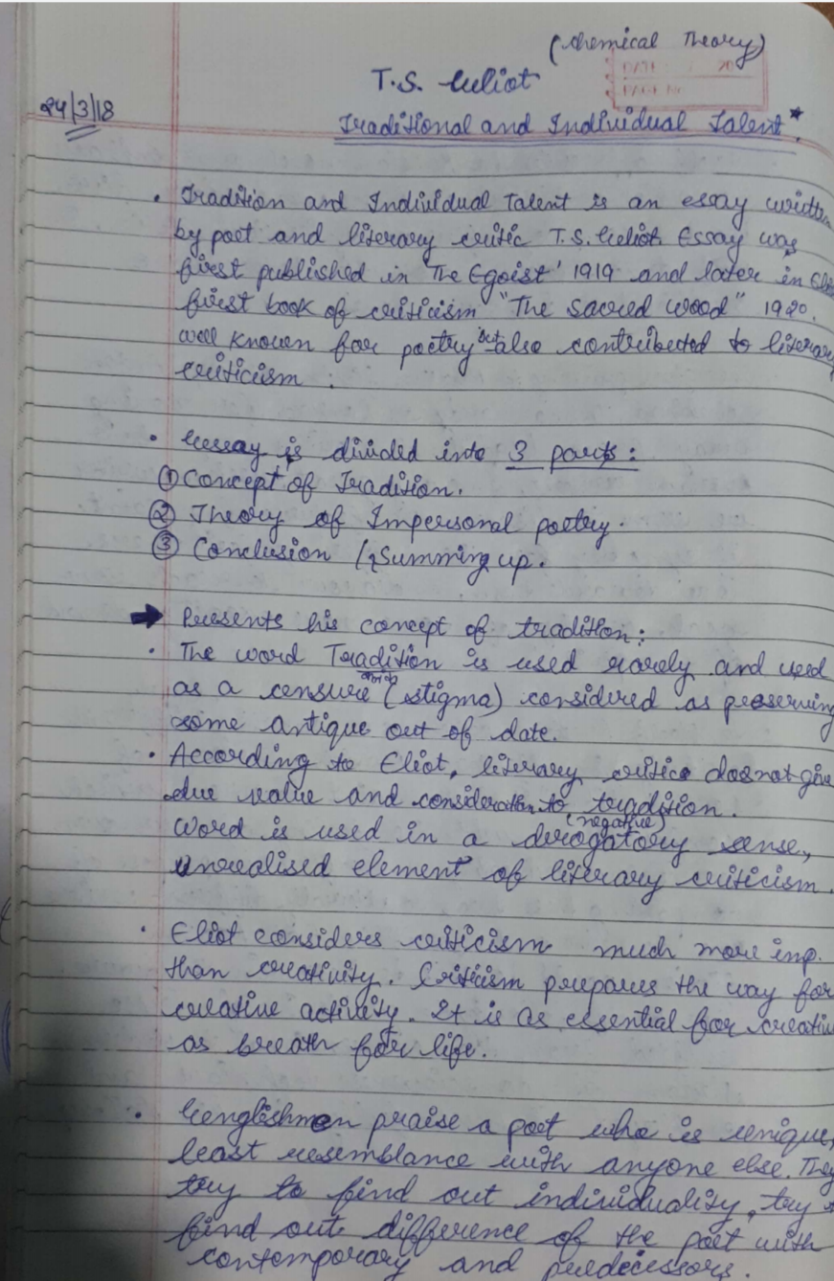

Slide 4
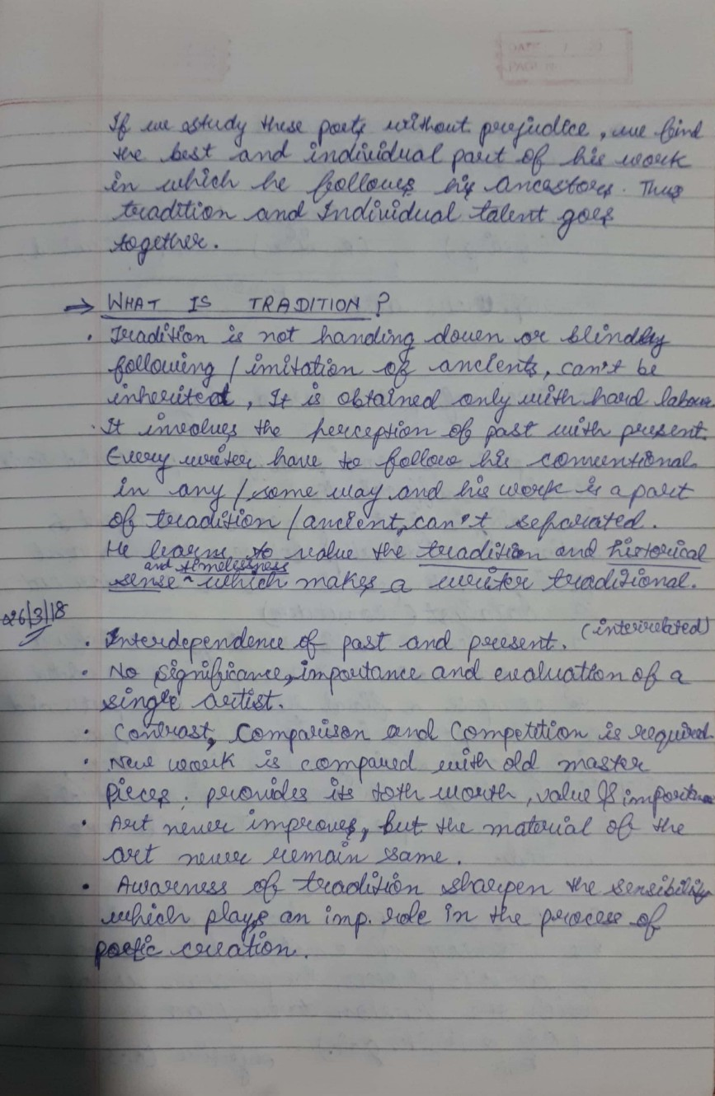

Slide 5
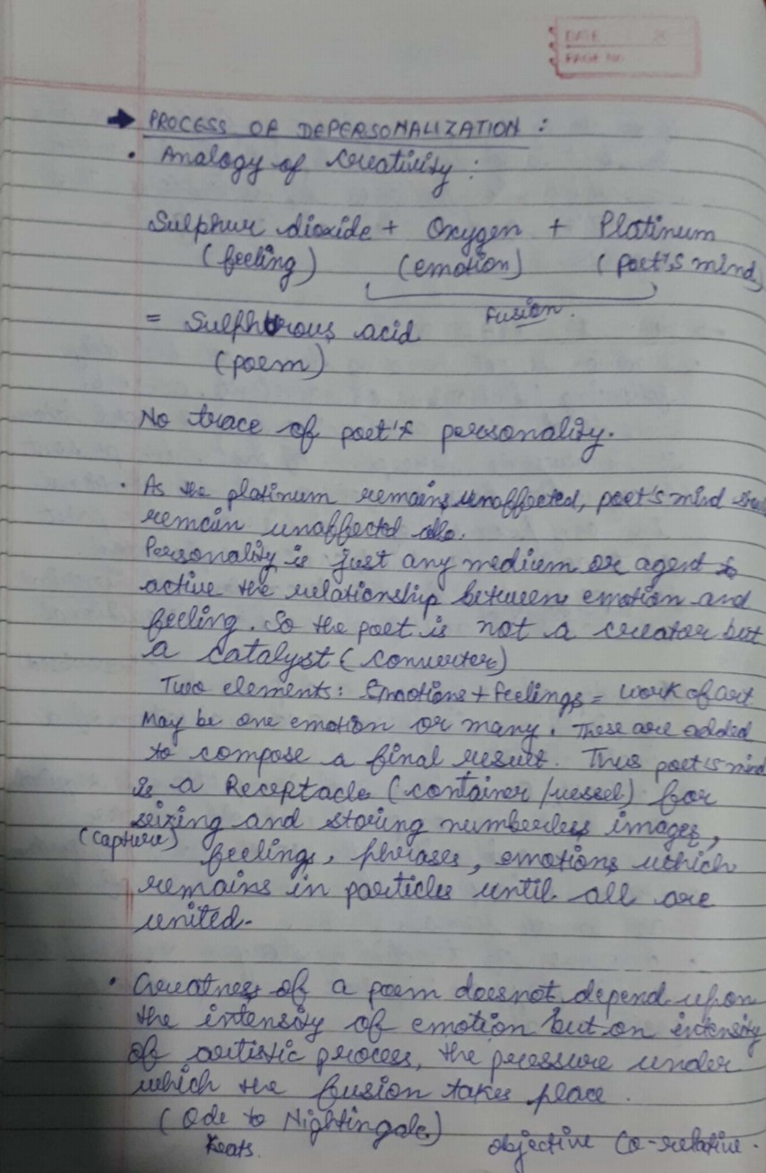

Slide 6
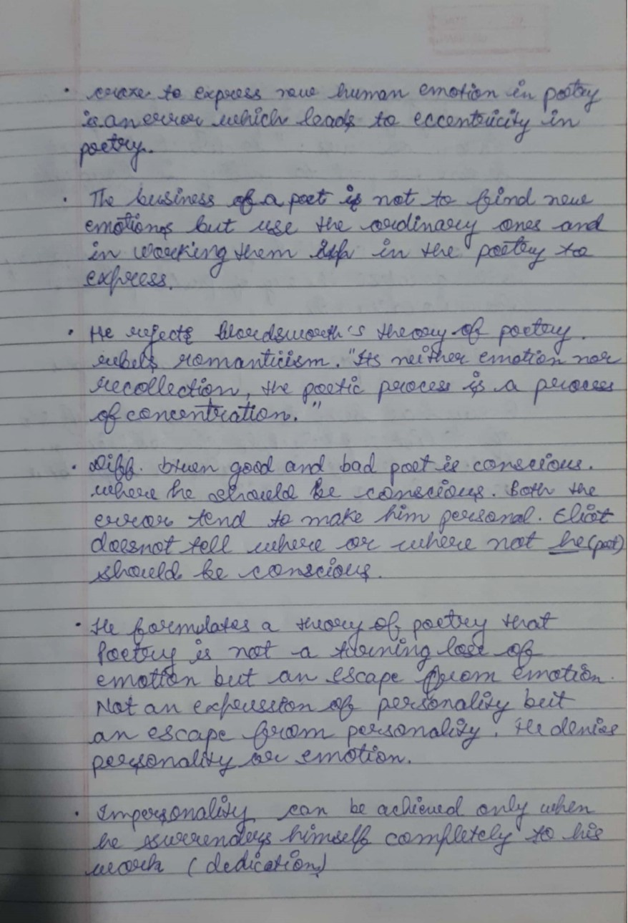

Slide 7
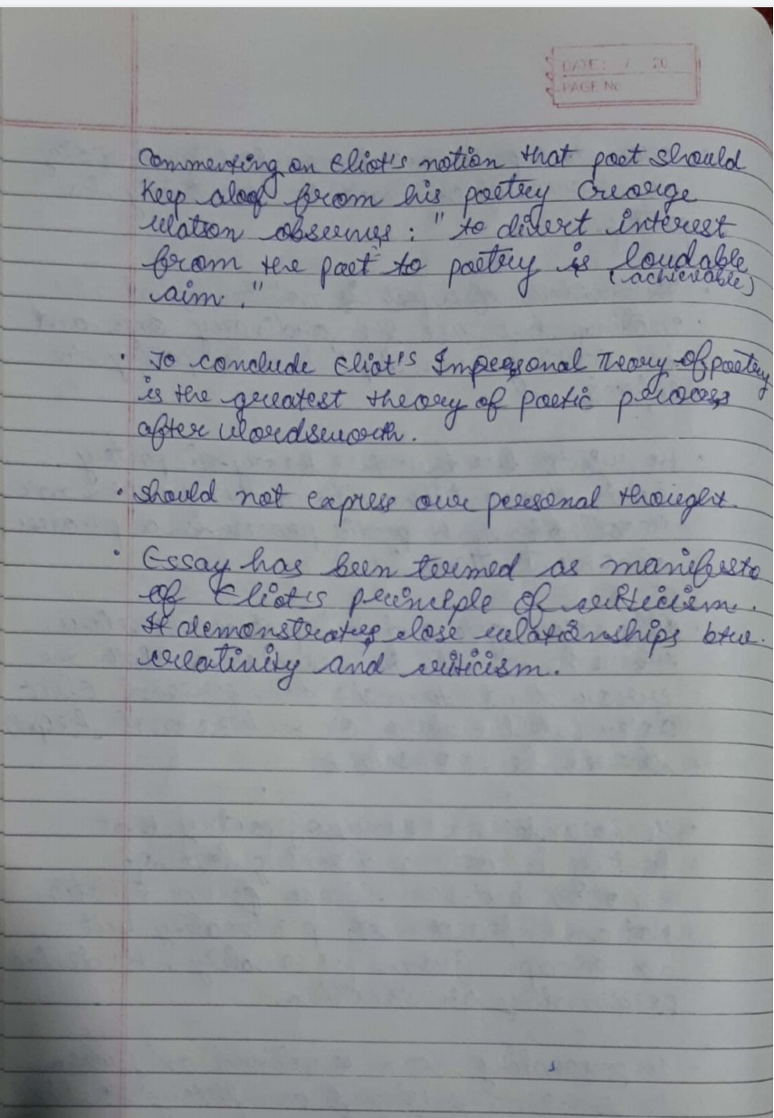

Slide 8
THANKS FOR WATCHING

