Slide 1
HIRE PURCHASE SYSTEM AND INSTALMENT PAYMENT SYSTEM
Subject:-Financial Accounting
Class:- B.com ist (Sem:-2nd)
College:-IB(PG)College,panipat
(Affiliated to kurukshetra university)
Submitted by:- Reeta (Dept of Commerce)

Slide 2
HIRE PURCHASE AGREEMENT…
Hire Purchase Agreement means an agreement under which goods are let on hire and under which the hirer has an option to buy the goods as per terms of
agreement.
It includes few stipulations…

Slide 3
AND THE STIPULATIONS ARE….
Possession of goods is delivered by the owner thereof to a person on condition that such person pays agreed amount in periodical instalments.
The property in the goods is to be transferred to the hirer on payment of the last instalment Such a person has a right to terminate the
agreement at any time before the property is so transferred.

Slide 4
FEATURES OF HIRE PURCHASE SYSTEM…
The Agreement
2. Possession of goods
3.Payment in instalments
4.The ownership of the goods
5.Right of the hirer to purchase with rebate.

Slide 5
METHODS OF HIRE PURCHASE SYSTEM…
The Asset Accrual Method
Total Asset value Method

Slide 6
MERITS OF HIRE PURCHASE SYSTEM….
Facility of buying Savings
Higher Sales
Boon to small producers

Slide 7
DEMERITS OF HIRE PURCHASE SYSTEM….
Higher Prices Risks to bad debts Large Investment

Slide 8
DIFFERENCE BETWEEN SALE AND HIRE PURCHASE

Slide 9
INSTALMENT PURCHASE SYSTEM…
Under Installment Purchase system, the possession as well as ownership passes from the seller to the buyer immediately on entering the agreement but the buyer agrees to pay the total price in installments. If the buyer makes any default in the payment of any installment, the seller has no right to repossess the goods. The seller can file a suit in the court of law for recovery of the price.

Slide 10
FEATURES OF INSTALLMENT PURCHASE SYSTEM
The Agreement Price in Instalments
Possession and ownership of goods If any default in payment
Disposal of goods

Slide 11
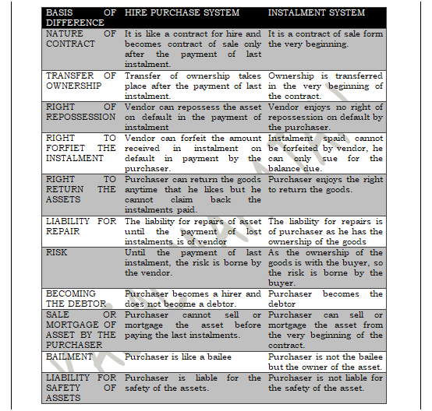
DIFFERENCE BETWEEN HIRE PURCHASE AND INSTALLMENT PURCHASE SYSTEM…

