Slide 1
HEALTH , HYGIENE AND APPLIED SCIENCE B.A.-I, Sem.II Dr SEEMA H.Sc. Deptt. I.B PG College Panipat

Slide 2
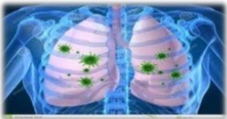
Infection

Slide 25
Thank you

