Slide 1
I. B. (PG) College, Panipat

Slide 2
Presented by
Sheela Malik
Assistant Professor
Department of English
I.B.PG College, Panipat

Slide 3
Summary of poem – The Lotus Eaters

Slide 4
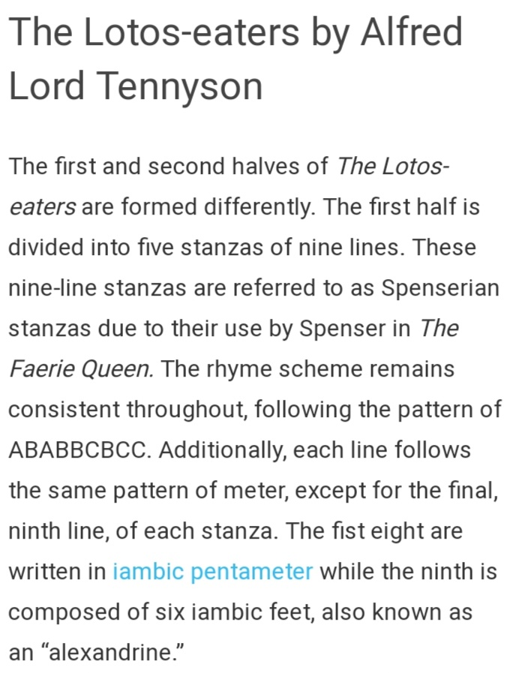

Slide 5
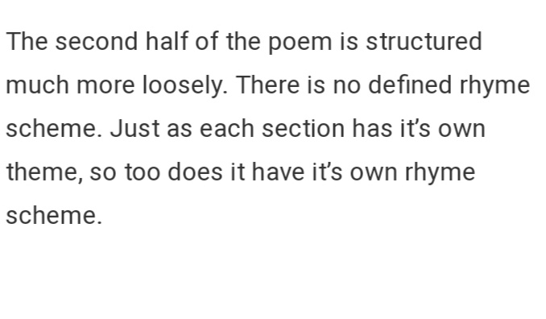

Slide 6
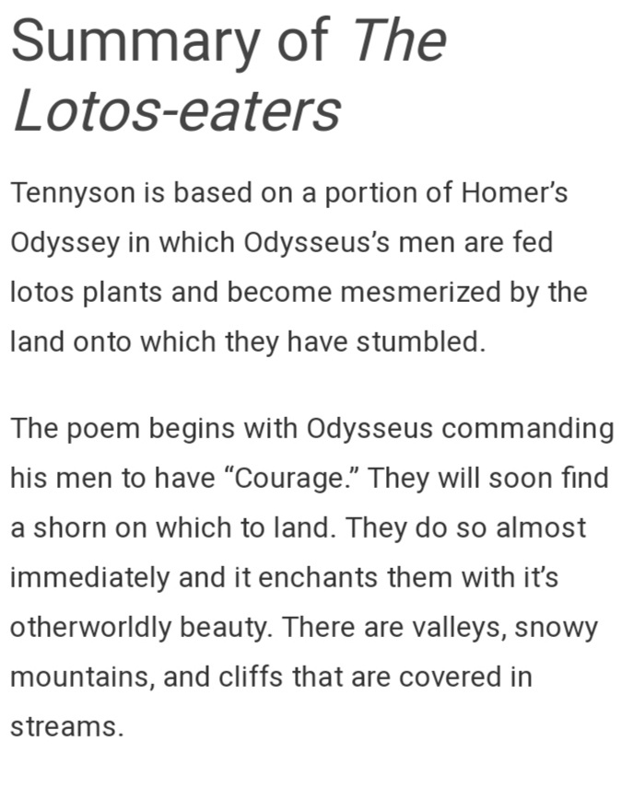

Slide 7
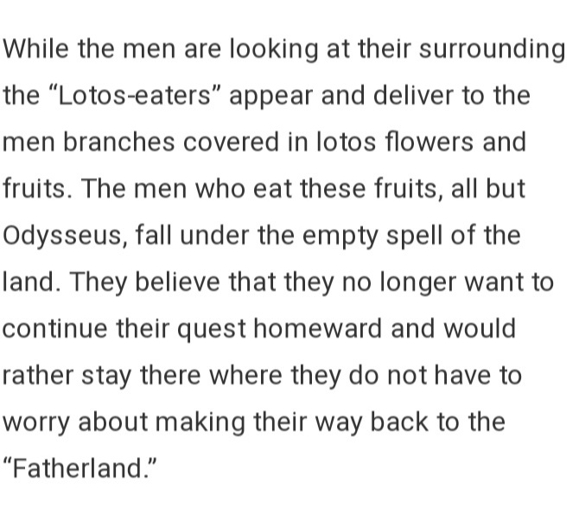

Slide 8
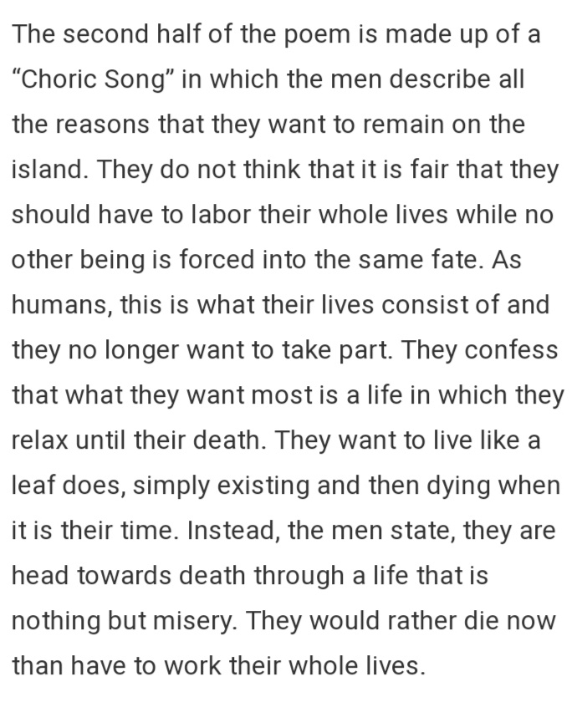

Slide 9
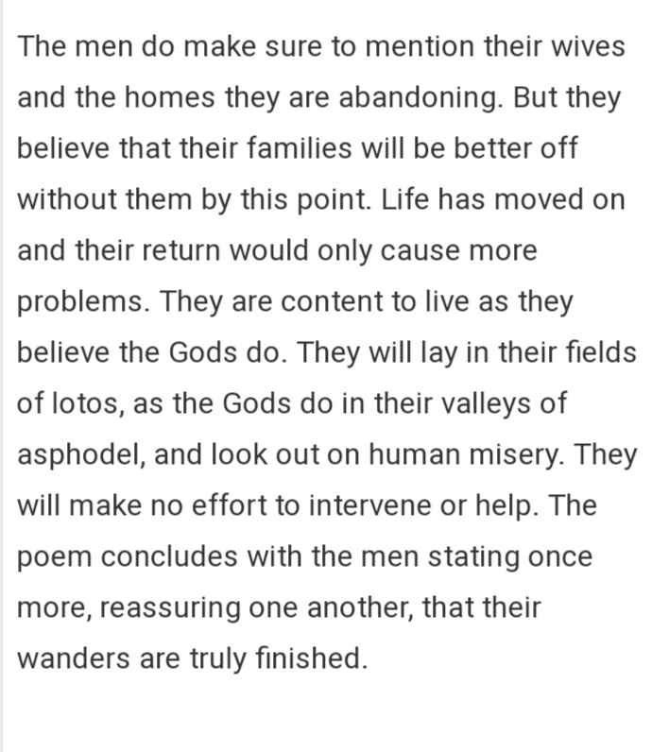

Slide 10
Thank you

