Slide 1
SUBJECT : BUSINESS ENVIRONMENT
Class: B.com (Final)
SEMESTER: 6TH
TOPIC : FORGIEN EXCHANGE MANAGEMENT ACT:1999
COLLEGE: I.B( P.G) COLLEGE, PANIPAT AFFILIATED BY KURUKSHETRA UNIVERSITY ,KURUKSHETRA
FROM- PROF.RIYA

Slide 2
INTRODUCTION
The Government of India formulated FEMA or Foreign Exchange Management Act to encourage the external payments and across the border trades in India. It was formulated in the year 1999 while it replaced FERA (Foreign Exchange Regulation Act). This was meant to close all the loopholes and drawback of FERA and hence major economic reforms were introduced under this act. It was primarily formulated to de-regularize and have liberal Indian economy.

Slide 3
INTRODUCTION
FEMA is applicable to all parts of India and was primarily formulated to utilize the foreign exchange resources in efficient manner. It is also equally applicable to the offices and agencies which are located outside India however is managed or owned by an Indian Citizen. FEMA head office is known as Enforcement Directorate and is situated in heart of city of Delhi.

Slide 4
OBJECTIVES OF THIS ACT
The main objective of FEMA was to help facilitate external trade and payments in India.
It was also meant to help orderly development and maintenance of foreign exchange market in India.
It defines the procedures, formalities, dealings of all foreignexchange transactions in India. These transactions are mainly classified under two categories -- Current Account Transactions and Capital Account Transactions.

Slide 5
APPLICABILITY OF THIS ACT
exports of any foods and services from India to outside, foreign currency, that is any currency other than Indian currency,
foreign exchange,
foreign security,
Imports of goods and services from outside India to India,
securities as defined in Public Debt Act 1994,
banking, financial and insurance services,
sale, purchase and exchange of any kind (i.e. Transfer),
any overseas company that is owned 60% or more by an NRI (Non Resident Indian) and
any citizen of India, residing in the country or outside (NRI

Slide 6
IMPORTANT DEFINITIONS:
Adjudicating Authority" means an officer authorized under sub-section (1) of section 16
• "Appellate Tribunal" means the Appellate Tribunal for Foreign Exchange established under section 18;
• "authorized person" means an authorized dealer, money changer, off-shore banking unit or any other person for the time being authorized under subsection (1) of section 10 to deal in foreign exchange or foreign securities;
• "Bench" means a Bench of the Appellate Tribunal;
• "capital account transaction" means a transaction which alters the assets or liabilities, including contingent liabilities, outside India of persons resident in ndia or assets or liabilities in India of persons resident outside India, and includes t ansactions referred to in sub-section (3) of section 6;

Slide 7
IMPORTANT DEFINITIONS
capital account transaction" means a transaction which alters the assets or liabilities, including contingent liabilities, outside India of persons resident in India or assets or liabilities in India of persons resident outside India, and includes t ansactions referred to in sub-section (3) of section 6;
• "Chairperson" means the Chairperson of the Appellate Tribunal; "chartered accountant" shall have the meaning assigned to it in clause (b) of sub-section (1) of section 2 of the Chartered Accounts Act, 1949 (38 of 1949);
• "currency" includes all currency notes, postal notes, postal orders, money orders, cheques, drafts, travelers cheques, letters of credit, bills of exchange and promissory notes, credit cards or such other similar instruments, as may be notified by the Reserve Bank;
• "currency notes" means and includes cash in the form of coins and bank notes;

Slide 8
DEFINITIONS
person" includeso an individual,
a Hindu undivided family,
a company,
a firm,
an association of persons or a body of individuals, whether
incorporated or not,
every artificial juridical person, not falling within any of the preceding
sub-clauses, and any agency, office or branch owned or controlled by such person;

Slide 9
DEFINITIONS
Reserve Bank" means the Reserve Bank of India constituted under subsection (1) of section 3 of the Reserve Bank of India Act, 1934 (2 of 1934); security" means shares, stocks, bonds and debentures, Government securities as defined in the Public Debt Act, 1944 (18 of 1944), savings certificates to which the Government Savings Certificates Act, 1959 (46 of 1959) applies, deposit receipts in espect of deposits of securities and units of the Unit Trust of India established under sub-section (1) of section 3 of the Unit Trust of India Act, 1963 (52 of 1963) or of any mutual fund and includes certificates of title to securities, but does not in lude bills of exchange or promissory notes other than Government promissory notes or any other instruments which may be notified by the Reserve Bank as security for the purposes of this Act;
"service" means service of any description which is made available to potential users and includes the provision of facilities in connection with banking, financing, insurance, medical assistance, legal assistance, chit fund, real estate, transport, processing, supply of electrical or other energy, boarding or lodging or both, entertainment,

Slide 10
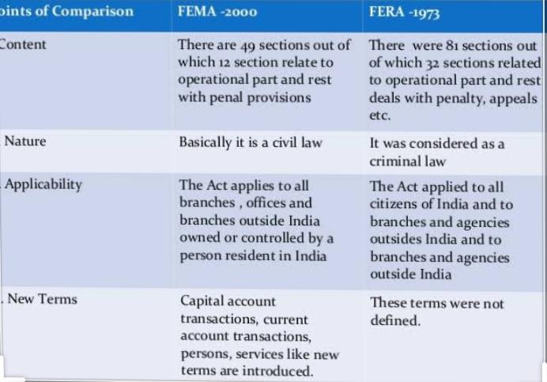
DIFFERENCE BETWEEN FERA AND FEMA

Slide 11
PROVISIONS OF THIS ACT
Here are major provisions that are part of FEMA (1999) –
Free transactions on current account subject to reasonable restrictions that may be imposed.
RBI controls over capital account transactions.
Control over realization of export proceeds.
Dealing in foreign exchange through authorized persons like authorized dealer or money changer etc.
Appeal provision including Special Director (Appeals)
Directorate of enforcement
Any person can sell or withdraw foreign exchange, without any prior permission from RBI and then can inform RBI later.

Slide 12
PROVISIONS OF THIS ACT
Enforcement Directorate will be more investigative in nature
FEMA recognized the possibility of Capital Account convertibility.
The violation of FEMA is a civil offence.
FEMA is more concerned with the management rather than regulations or control.
FEMA is regulatory mechanism that enables RBI and Central Government to pass regulations and rules relating to foreign exchange in tune with foreign trade policy of India.

Slide 13
CONCLUSION:
As per Section 3 of FEMA, all the current account transactions are free; however central government at any time could impose reasonable instructions by issuing special rules. As per Section 6 of FEMA, Capital Account Transactions are permitted only to the extent as specified by RBI in its issued regulations. As per Section 10 of FEMA, RBI have controlling role in its management however RBI cannot directly handle foreign exchange transaction and must authorize a person to deal with it as per directions set by RBI. FEMA also have provisions of various enforcement, penalties, adjudication and appeals in this area.

