Slide 1
BRANCH ACCOUNTS
Subject:- Financial accounting
Class:-B.com 1st(sem 2)
College:-IB(PG)College,Panipat
(Affiliated to kurukshetra university)
Submitted by:- Reeta ( Dept. of commerce)

Slide 2
MEANING OF BRANCH
The aim of every business is to grow and increase its sales so as to earn more and more profits.To achieve objective the strategy is to make market its products over a large territory,which is only possible only if the bussiness decide to split its business into certain divisions.These are called “Branches”.

Slide 3
MEANING OF BRANCH ACCOUNTING
Branch accounting is a system of book-keeping in which separate accounts are maintained for each branch or operating location of an organization.

Slide 4
OBJECTIVES OF BRANCH ACCOUNTING
To ascertain the profit or loss of each branch .
To exercise a proper degree of control on the operations.
To keep a proper record of goods supplied.
To coordinate the operations of various branches.

Slide 5
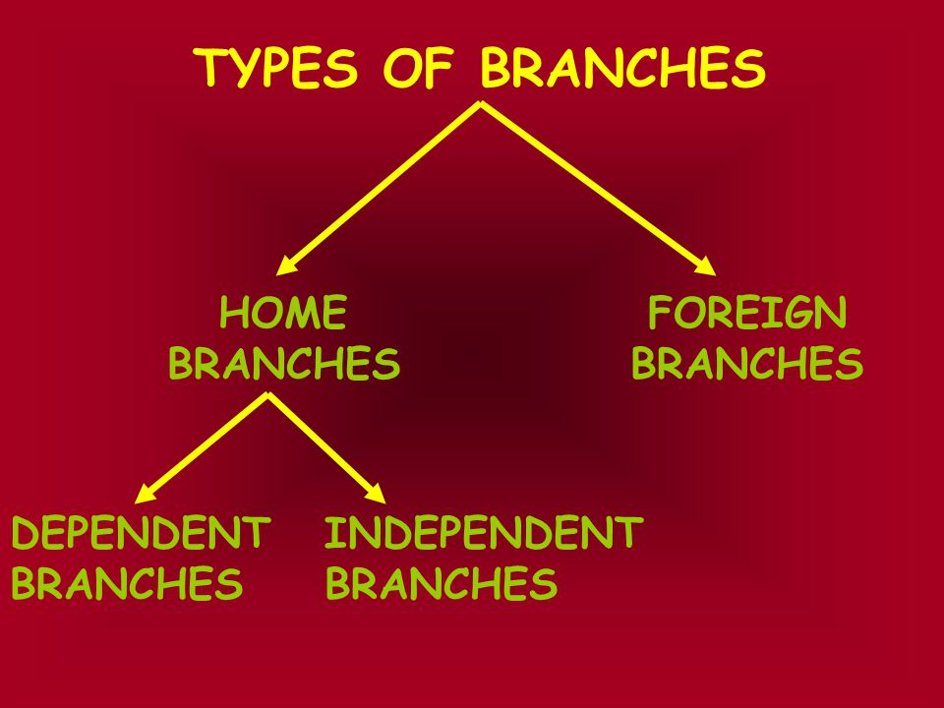
TYPES OF BRANCHES

Slide 6
DEPENDENT BRANCHES
These branches sell only those goods which are supplied by the Head office .
All expenses of regular nature are paid directly by the head office.
Such branches are instructed to deposit the amount of cash sales and collection from debtors to the credit of head office.

Slide 7
METHODS OF RECORDING
1.Debtors or direct method
2.Final Accounts method
3. Stock and debtors method
4.Wholesale branch method

Slide 8
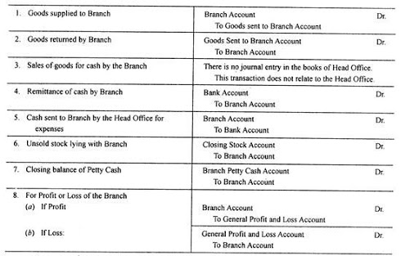
DEBTORS OR DIRECT METHOD

Slide 9
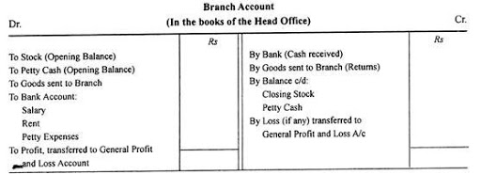
FINAL ACCOUNTS METHOD

Slide 10
STOCK AND DEBTORS METHOD
Under this method following accounts will be opened:-
1.Branch stock Account
2.Branch Debtors Account
3.Branch Adjustment Account
4.Branch Expenses Account
5.Branch Profit & Loss Account

Slide 11
WHOLESALE BRANCH METHOD
In order to ascertain the true profit at retail branches ,the head office charges the branches with wholesale price.
In head office trading account ,goods sent to branches are recorded at wholesale price .
Wholesale price is treated as cost price by the branch.

Slide 12
INDEPENDENT BRANCHES
They are allowed to have their own purchases,sales and other transactions.
It keeps a complete set of double entry books.
These types of branches do not required to remit all daily cash to Head office.
These branches doesn’t limited to goods supplied by head office only,these trade in other goods also.

Slide 13
GOODS IN TRANSIT
When head office sends goods to branch and such goods are not received by the branch till the end of the period ,the goods are known as “goods in transit”.
Entry:-
Goods in transit Dr
To Branch

Slide 14
CASH IN TRANSIT
Sometimes cash is remitted by the branch ,but not yet received by the head office.Hence,The branch account and head office show different balances.
ENTRY:- Cash in Transit Dr
To Head office

Slide 15
THANK- YOU

