Slide 1
B.SC (III) Year Organic chemistry TOPIC: CANNIZZARO REACTION IB PG COLLEGE PANIPAT ERA GARG ASST. PROFESSOR(CHEMISTRY)

Slide 2
CANNIZZARO REACTION
An important self oxidation reduction reaction of aldehydes and ketones.

Slide 3
Aldehydes not containing an α h atom undergo this reaction
Aldehyde is treated with concentrated alkali solution.

Slide 4
Two molecules of same aldehyde are involved –one is reduced to the corresponding alcohol at the cost of the other which is oxidized to the corresponding to the carboxylic acid.

Slide 6
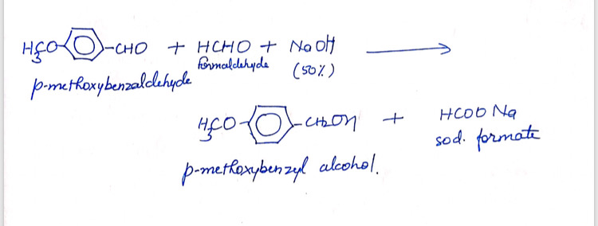
Crossed Cannizzaro Reaction

Slide 7
It takes place between two different aldehydes giving all the possible products.

Slide 8
This reaction is useful for the synthesis only when one aldehyde used is formaldehyde since it exclusively gives sodium formate and the alcohol corresponding to the other aldehyde.

Slide 9
THANKYOU

