Slide 1
B.Sc 3rd (6th Sem)
Organic chemistry
Topic: Beta pleated structure–Proteins
I.B. (PG) College, Panipat
Era Garg
Asstt. Professor (Chemistry)

Slide 2
Secondary structure–b- pleated sheet structure of protein
A protein may or may not have the same secondary structure throughout its length . Some part may have α−helix structure ,while others may have β –pleated sheet structure.

Slide 3
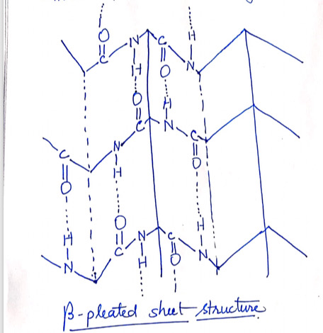
Peptides chain lies side by side to form FLAT SHEET. Each chain is held by H-bonds to the two neighbouring chains may be either parallel or antiparallel.

Slide 4
KERATIN : The protein present in hair has parallel
FIBROIN : The silk protein has antiparallel β pleated sheet structure
SYNTHETIC POLYGLYCINE : Because of the presence of no side chains is expected to have β flat sheet structure.

Slide 5
Denaturation/Renaturation of proteins
Action of heat, mineral acids , alkalis etc. brings about coagulation of proteins. For example:
1.On heating an egg (boiling hard) the soluble globular protein (albumin) present in it,is denatured resulting in the formation of insoluble fibrous protein.

Slide 6
2.When milk is heated with an acid (lemon juice/tartaric acid)cheese is formed. During the denaturation,the globular milk protein (lactalbumin) becomes fibrous.
This coagulation also results in loss of biological activities of protein. The coagulated protein so formed are called denatured protein.

Slide 7
Chemically, denaturation has no effect on primary structures but secondary and tertiary structures are changed. Denaturation involves breaking of many of the weak linkages , or bonds(example: H bonds)within a protein molecule that are responsible for highly ordered structure of protein in its natural state.
Denatured protein has a looser ,more random structure.

Slide 8
RENATURATION
The original structure of some proteins can be regenerated upon removal of the denaturing agent and restoration of favourable conditions. Proteins subject to renaturation includes serum albumin from blood,haemoglobin,ribonuclease(enzymes).
The denaturation of many proteins,like egg white is irreversible.

Slide 9
THANKS

