Slide 1
SERIES AND PARALLEL RESONANCE CIRCUITS
By:- Dr. Ajay Garg

Slide 2
CONTENTS
SERIES L-C-R CIRCUIT
PARALLEL L-C-R CIRCUIT
QUALITY FACTOR AND RESONANT FREQUENCY
OBJECTIVE OF THE EXPERIMENT ,APPARATUS AND FORMULA
CIRCUIT DIAGRAM
WORKING OF SERIES L-C-R CIRCUIT
WORKING OF PARALLEL L-C-R CIRCUIT
OSERVATIONS,CALCULATIONS AND RESULT

Slide 3
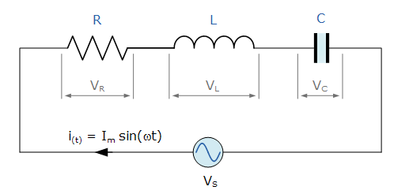
SERIES L-C-R CIRCUIT
Consider a RLC circuit in which resistor, inductor and capacitor are connected in series across a voltage supply. This series RLC circuit has a distinguishing property of resonating at a specific frequency called resonant frequency.
In this circuit containing inductor and capacitor, the energy is stored in two different ways.
When a current flows in an inductor, energy gets stored in magnetic field.
When a capacitor is charged, energy gets stored in static electric field.

Slide 4
Since the inductive and capacitive reactance’s X_{L} and X_{C} are a function of the supply frequency, the sinusoidal response of a series RLC circuit will therefore vary with frequency, ƒ. Then the individual voltage drops across each circuit element of R, L and C element will be “out-of-phase” with each other as defined by:
i_{(t)} = I_{max} sin(ωt)
The instantaneous voltage across a pure resistor, V_{R} is “in-phase” with current
The instantaneous voltage across a pure inductor, V_{L} “leads” the current by 90º
The instantaneous voltage across a pure capacitor, V_{C} “lags” the current by 90º
Therefore, V_{L} and V_{C} are 180º “out-of-phase” and in opposition to each other.

Slide 5
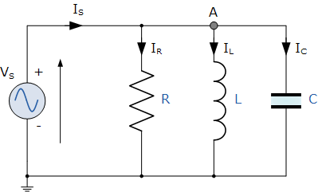
PARALLEL L-C-R CIRCUIT
Consider a RLC circuit in which resistor, inductor and capacitor are connected in parallel to each other. This parallel combination is supplied by voltage supply, V_{S}. This parallel RLC circuit is exactly opposite to series RLC circuit.
In series RLC circuit, the current flowing through all the three components i.e the resistor, inductor and capacitor remains the same, but in parallel circuit, the voltage across each element remains the same and the current gets divided in each component depending upon the impedance of each component. That is why parallel RLC circuit is said to have dual relationship with series RLC circuit.

Slide 6
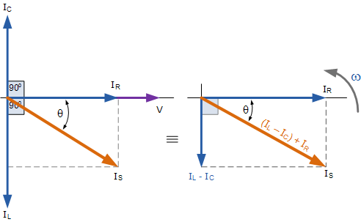
Phasor Diagram for Parallel L-C-R Circuit id given as:-

Slide 7
TOTAL IMPEDANCE
SERIES L-C-R CIRCUIT
PARALLEL L-C-R CIRCUIT

Slide 8
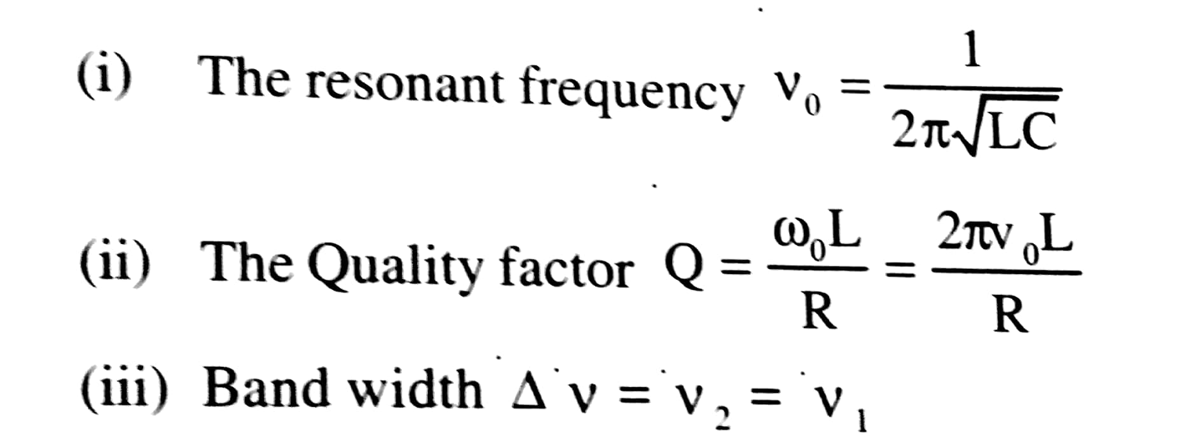
OBJECTIVE ,APPARATUS AND FORMULA USED
OBJECTIVE :-
To study series and parallel resonance circuit.
APPARATUS :-
An audio frequency oscillator or a function generator, a non-inductive resistance box, an a.c. milliammeter, inductors ,capacitors, connecting wires and a voltmeter.
FORMULA USED FOR SERIES L-C-R CIRCUIT :-

Slide 9
FORMULA USED FOR PARELLEL L-C-R CIRCUIT :-

Slide 10
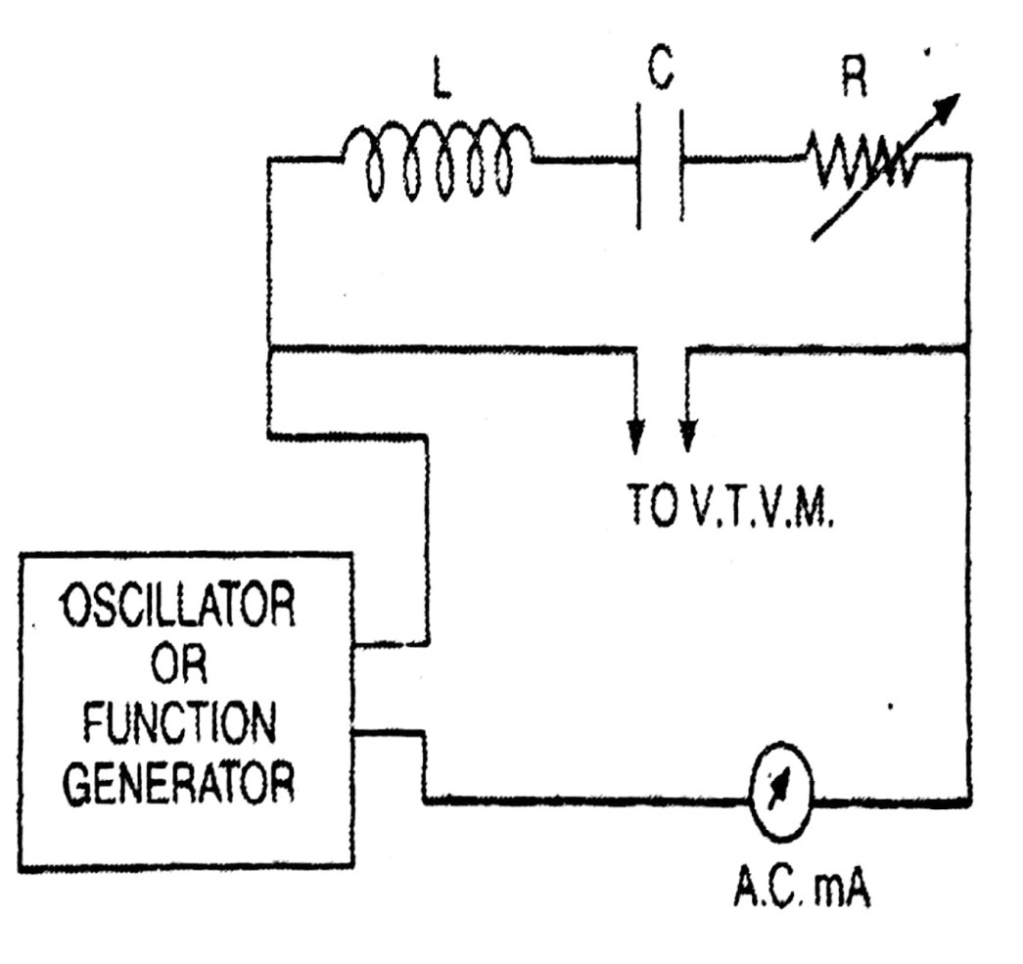
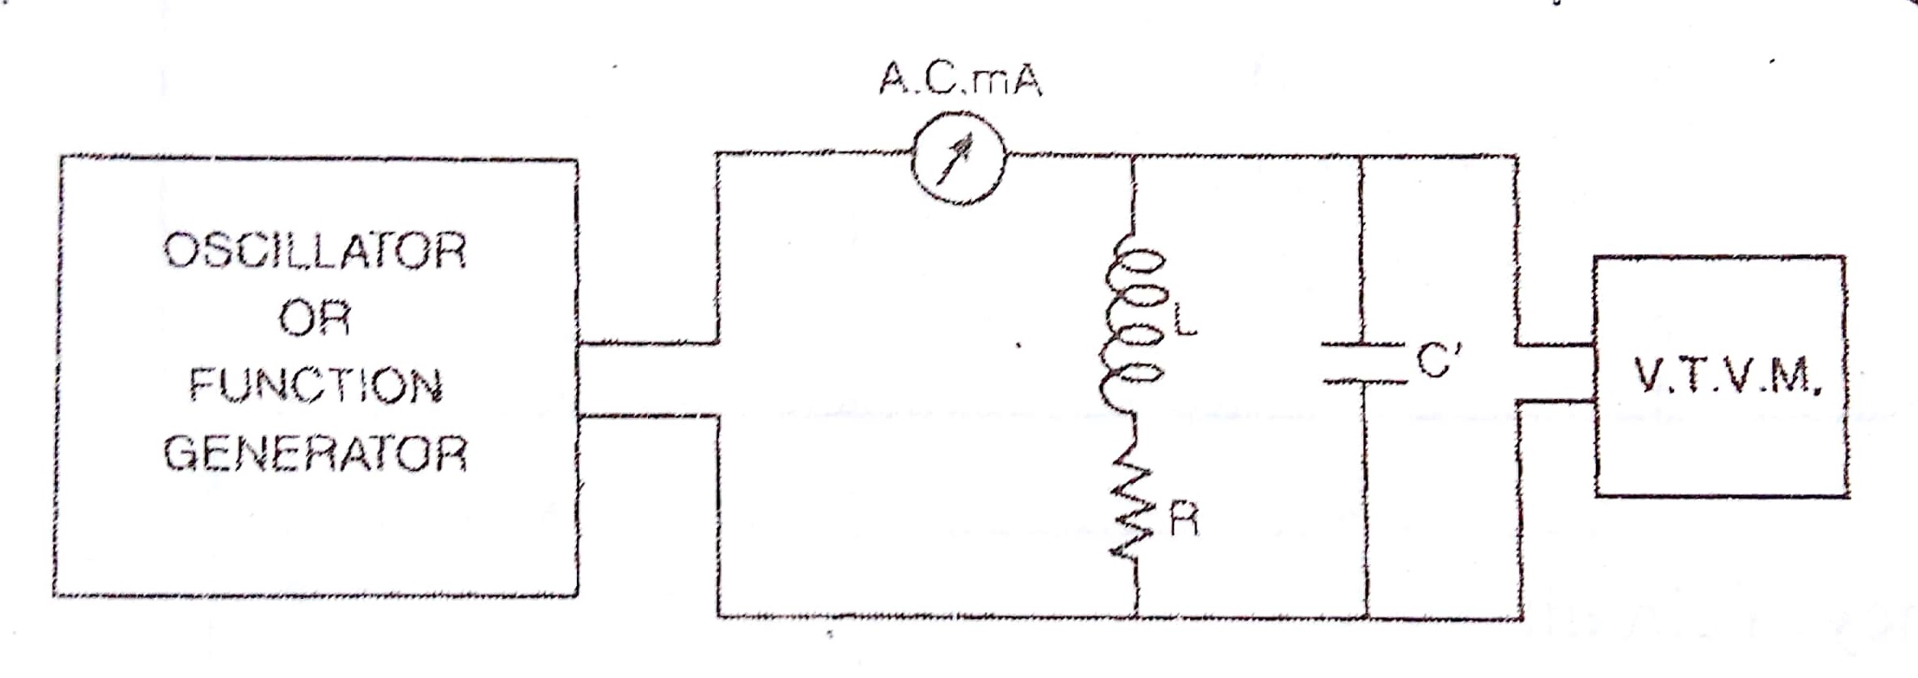
CIRCUIT DIAGRAM
SERIES RESONANCE CIRCUIT:-
PARALLEL RESONANCE CIRCUIT :-

Slide 11
WORKING of SERIES L-C-R CIRCUIT

Slide 12
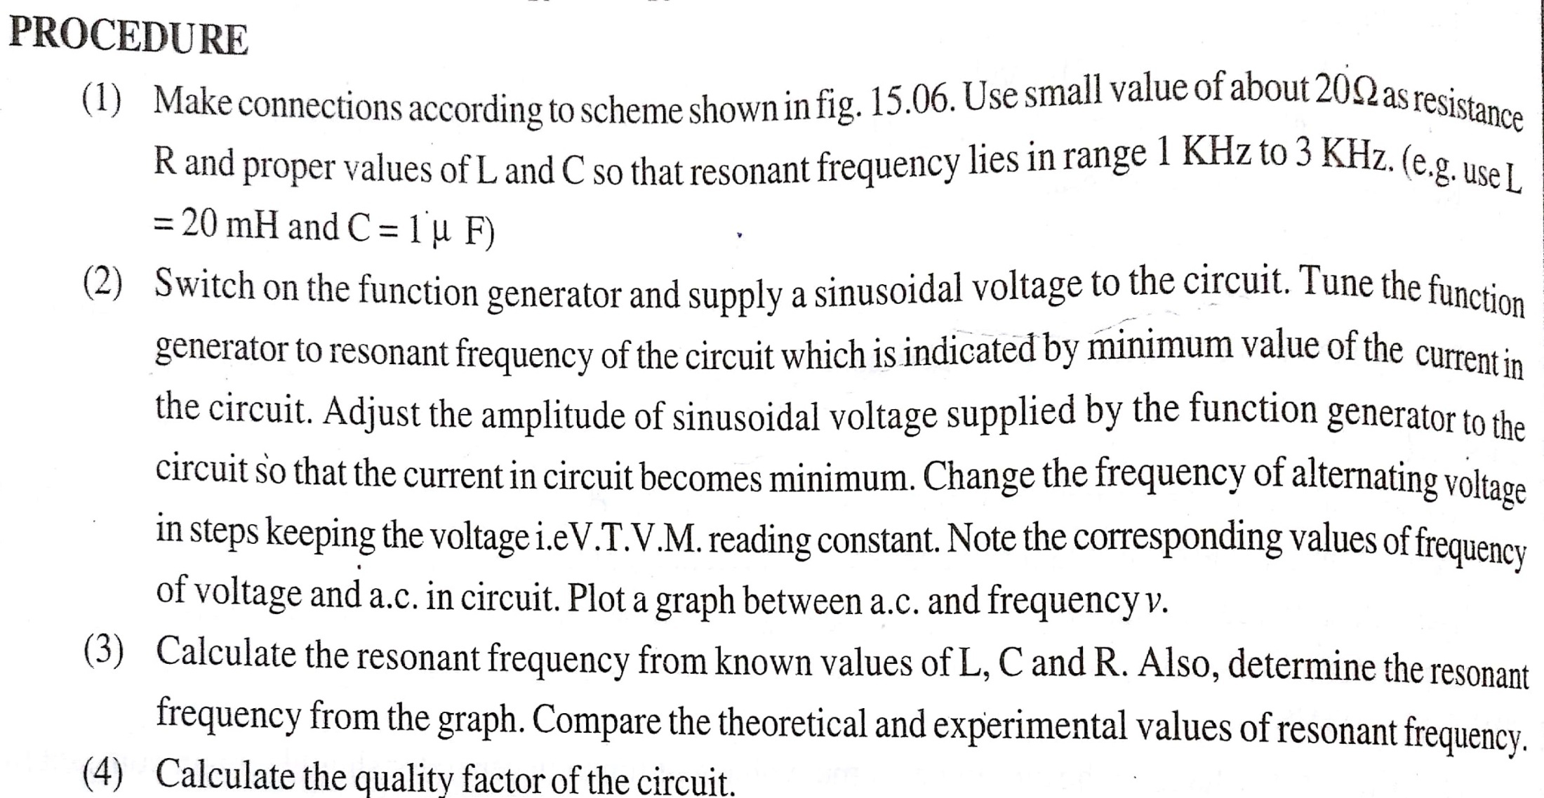
WORKING of Parallel L-C-R CIRCUIT

Slide 13
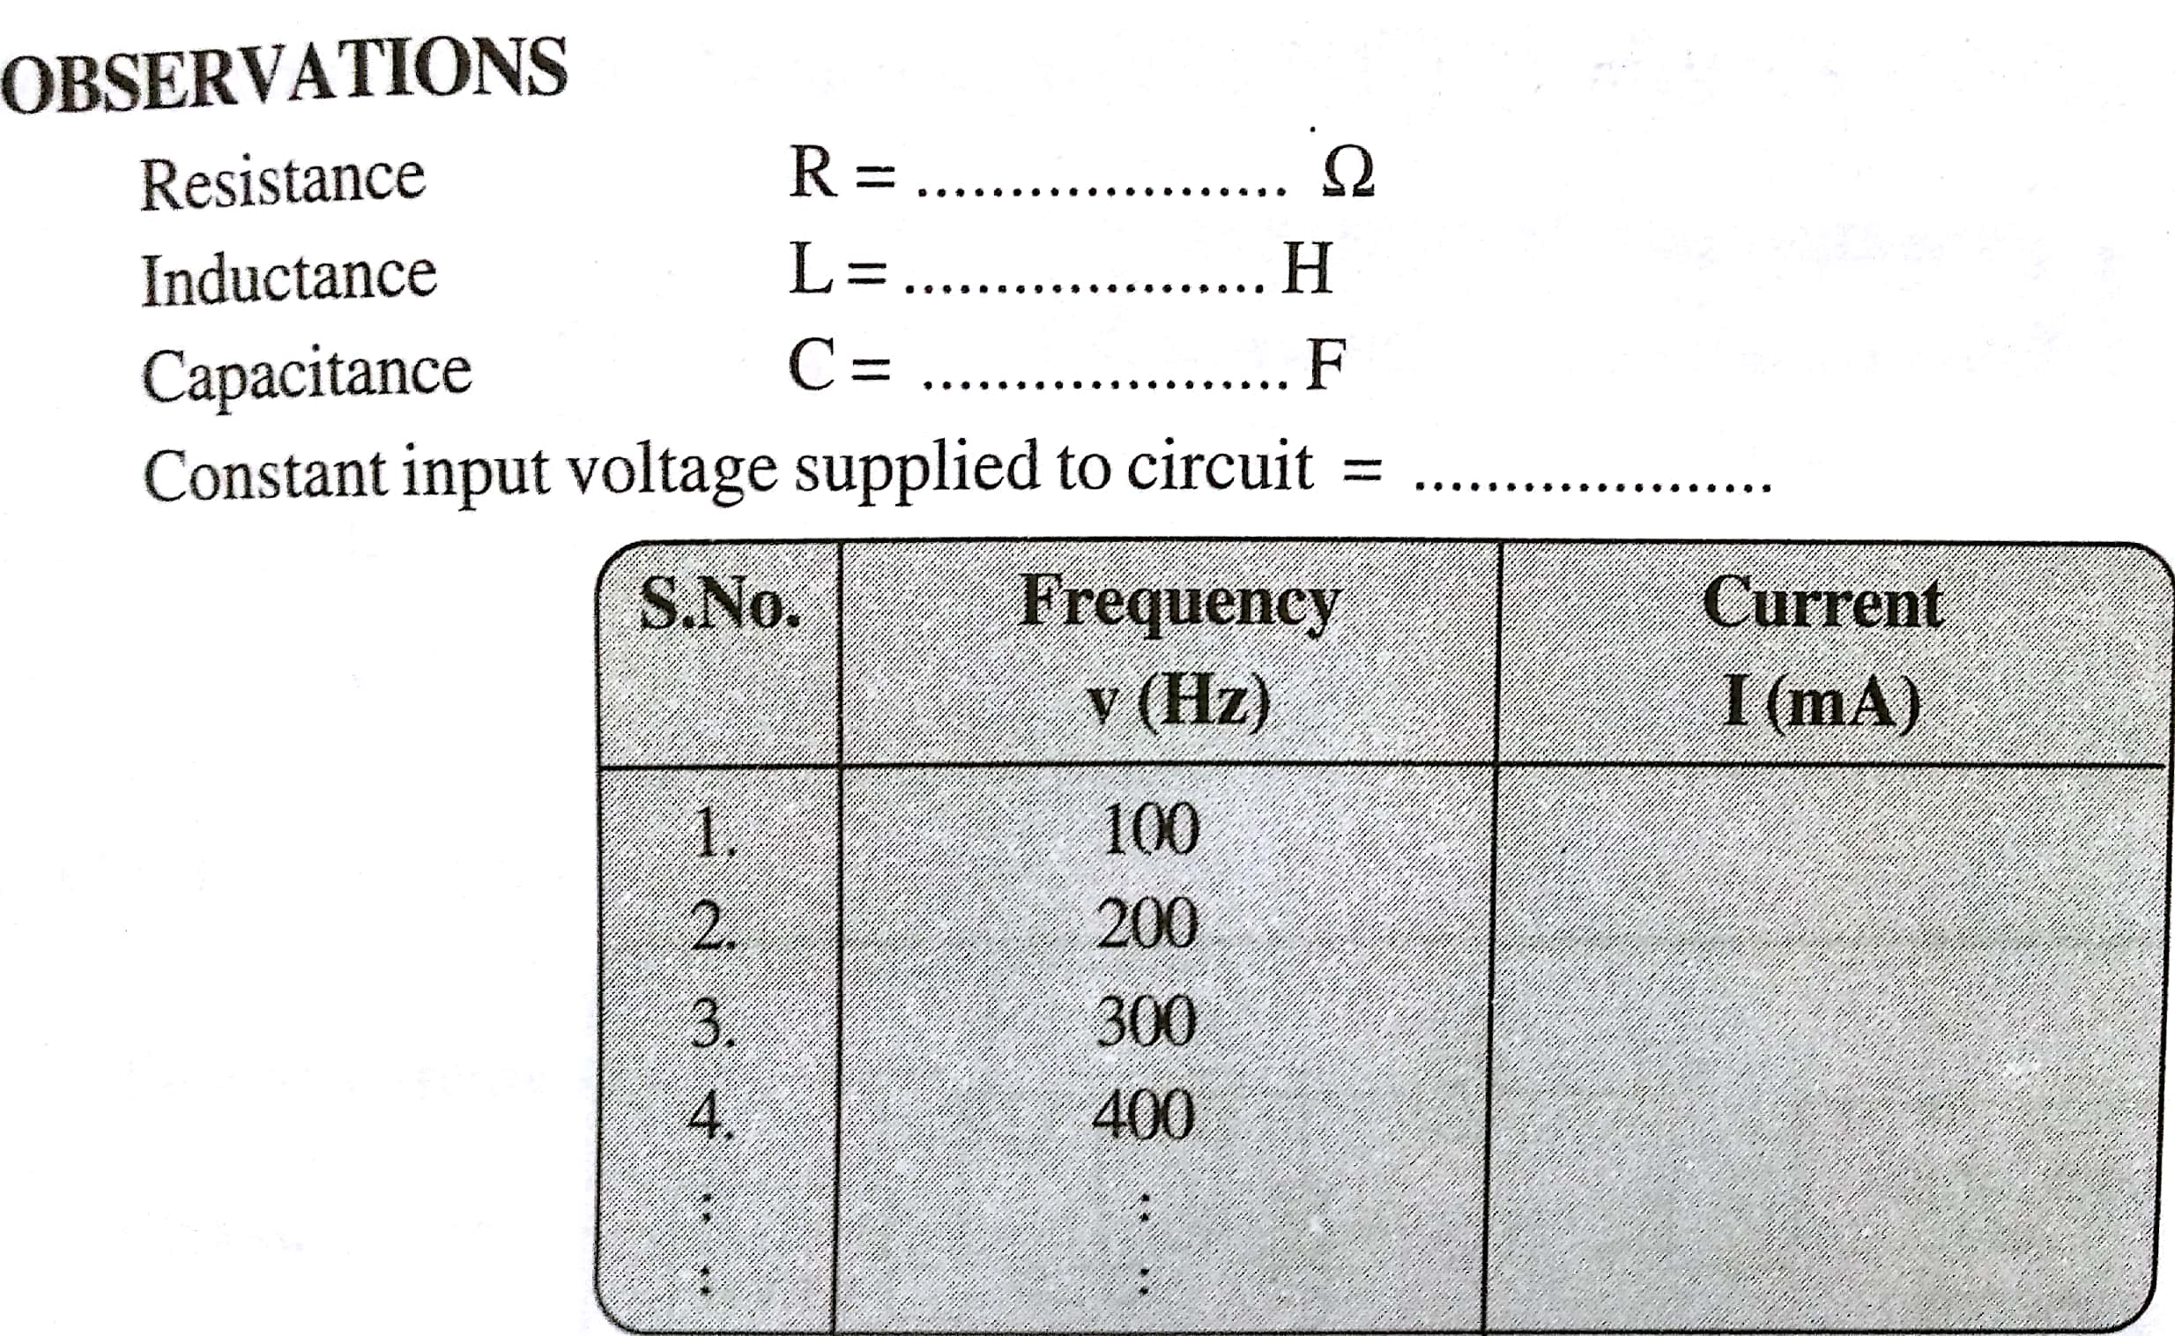
OBSERVATIONS FOR SERIES AND PARALLEL L-C-R CIRCUIT

Slide 14
CALCULATIONS
SERIES RESONANCE CIRCUIT
PARALLEL RESONANCE CIRCUIT

Slide 15
RESULT
RESULT :-
Theoretical value of resonant frequency vₒ = …….. Hz
Experimental Determined value of resonant frequency vₒ = …….. Hz
Quality Factor of the circuit Q = …………
PRECAUTIONS :-
1. The input voltage supplied to the parallel resonant circuit should be kept constant.
2. The d.c. resistance of inductor should be included to resistance R for calculations of quality factor.
3. If a resistance box is used in place of R then its plug which are not taken out should be tight.

