Slide 1
TO DETERMINE THE ORDINARY AND EXTRAORDINARY REFRACTIVE INDICES OF CALCITE OR QUARTZ FOR SODIUM LIGHT
By:- Dr. Ajay Garg

Slide 2
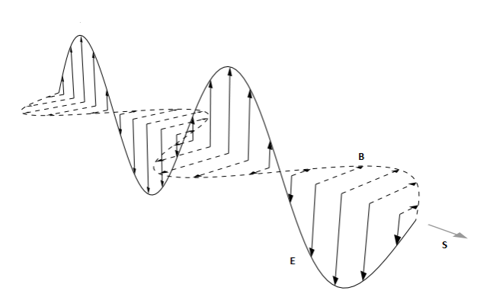
CONTENTS
Polarization of light
Ordinary and Extra-Ordinary Rays
Spectrometer
Least Count of the Instrument
Objective of the Experiment, Apparatus and Formula Used
Working
Observations
Calculations and Result

Slide 3
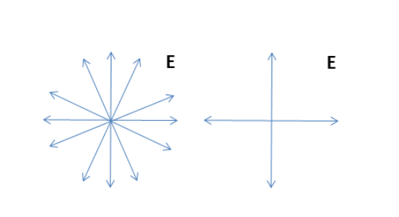
POLARIZATION
The phenomenon of interference and diffraction show that light travels in the form of waves.
Polarization is a property of light when applied to transverse waves, it specifies the geometrical orientation of the oscillation.
Transverse waves are waves i.e. movement of the particles in the wave is perpendicular to the direction of motion of the wave. For exam the ripples when you throw a stone in water.
Longitudinal waves are when the particles of the medium travel in the direction of motion of the waves. For example, the motion of sound waves through the air.
The electric field can be said to be oscillating along a plane perpendicular to Poynting Vector. However, there are infinitely many such planes and light that contains fields randomly distributed along all these planes are said to be unpolarized. As shown in the figure below:-

Slide 4
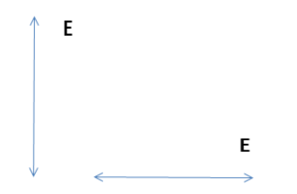
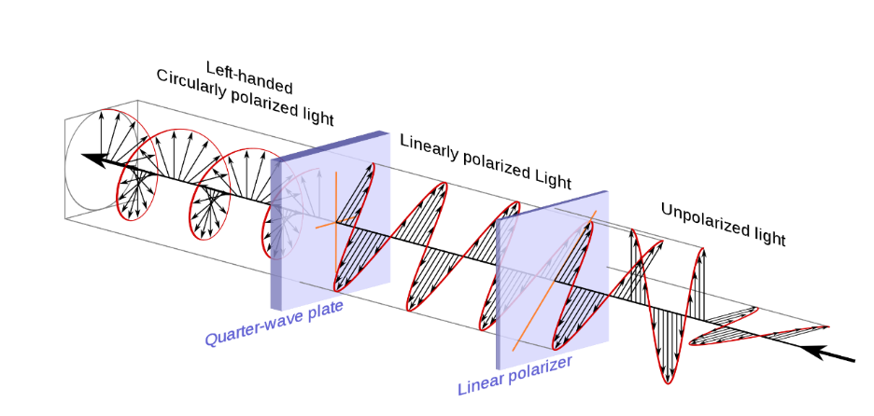
Plane Polarized light, on the other hand, contains light with the electric field (and hence the magnetic field) along only one plane as shown below:
A polarizing filter(These sheets contain long chain molecules that are aligned to allow electric field oscillations along only one direction) produces polarized light from unpolarized light by selectively allowing electric fields (and thus magnetic fields) along a single plane known as the Plane of Polarization.

Slide 5
Ordinary and extra-ordinary rays
From Polarization we can obtain details whether the vibrations of are linear, circular, elliptical or torsional.
Plane Polarized Light can be obtained by following methods:-
Polarization by Reflection
Polarization by Refraction
Polarization by Double Refraction
Polarization by Selective Absorption
Polarization by Scattering
We will be discussing Polarization by Double Refraction here. This kind of Polarization is obtained by Nicol Prism which is made from calcite crystal. Light passing through a calcite crystal is split into two rays. This process, first reported by Erasmus Bartholinus in 1669, is called double refraction.
The two rays of light are each plane polarized by the calcite such that the planes of polarization are mutually perpendicular. For normal incidence (a Snell’s law angle of 0°), the two planes of polarization are also perpendicular to the plane of incidence.

Slide 6
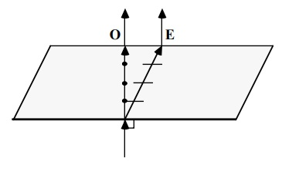
For normal incidence (a 0° angle of incidence), Snell’s law predicts that the angle of refraction will be 0°. In the case of double refraction of a normally incident ray of light, at least one of the two rays must violate Snell’s Law as we know it. For calcite, one of the two rays does indeed obey Snell’s Law; this ray is called the ordinary ray (or O-ray). The other ray (and any ray that does not obey Snell’s Law) is an extraordinary ray (or E-ray).
For ordinary rays the vibration direction, the electric vectors, is perpendicular to the ray path. For extraordinary rays, the vibration direction is not perpendicular to the ray path
In Uniaxial crystal, the ordinary ray has same velocity along all directions. Thus, refractive index µₒ is constant for ordinary rays. On the other hand, the velocity of the extraordinary ray depend upon its direction. Therefore, refractive index for extraordinary ray is different along different directions. We will be using calcite crystal, for this the refractive index’s are given by µₒ =1.658 and µₑ =1.468.

Slide 7
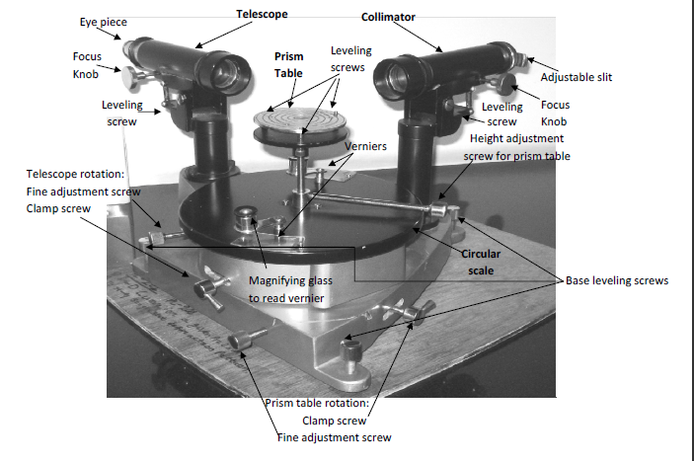
spectrometer
Spectrometer is an instrument for studying the optical spectra

Slide 8
LEAST COUNT
The spectrometers consist of a table, a collimator, and a telescope, each of which rotates with respect to the base, but can be fixed in place by tightening a radial clamping screw. The collimator and telescope can also be rotated through small angles (when clamped) by using the slow motion (or tangent) screws. For this experiment you will leave the collimator clamped and will only need to move the table and the telescope, but please bear in mind: Always move the telescope by pushing on its clamping screw. Never push on the telescope itself
To Determine least count, we firstly determine the smallest main scale division is (1/2)⁰ or 30’. Which implies from the fact that 20 divisions of a Main Scale measures 10⁰.
Whereas, for Vernier Scale we find the no. of main scale divisions coinciding with that of vernier scale divisions and which turns out to 29 M.S.D coinciding with that of an 30 V.S.D. Which implies that the Least Count(L.C) is given by:-
L.C.= 1 M.S.D. – 1 V.S.D.
= 1 M.S.D. – (29/30)M.S.D.
= (1/30)M.S.D.
= (1/30) x (1/2)⁰
= (1/60)⁰ or 1’.

Slide 9
OBJECTIVE,APPARATUS AND FORMULA USED
OBJECTIVE :-
To Determine the ordinary and extraordinary refractive indices of calcite or quartz for sodium light.
APPARATUS :-
A spectrometer, sodium vapor lamp, calcite prism, spirit level, a magnifying glass, electric lamp.
FORMULA USED :-
The refractive index of calcite for extraordinary and ordinary light is given by
AND
Where A = angle of prism
(δm)ₒ and (δm)ₑ are angle of minimum deviation for ordinary and extraordinary rays respectively.

Slide 10
WORKING

Slide 11
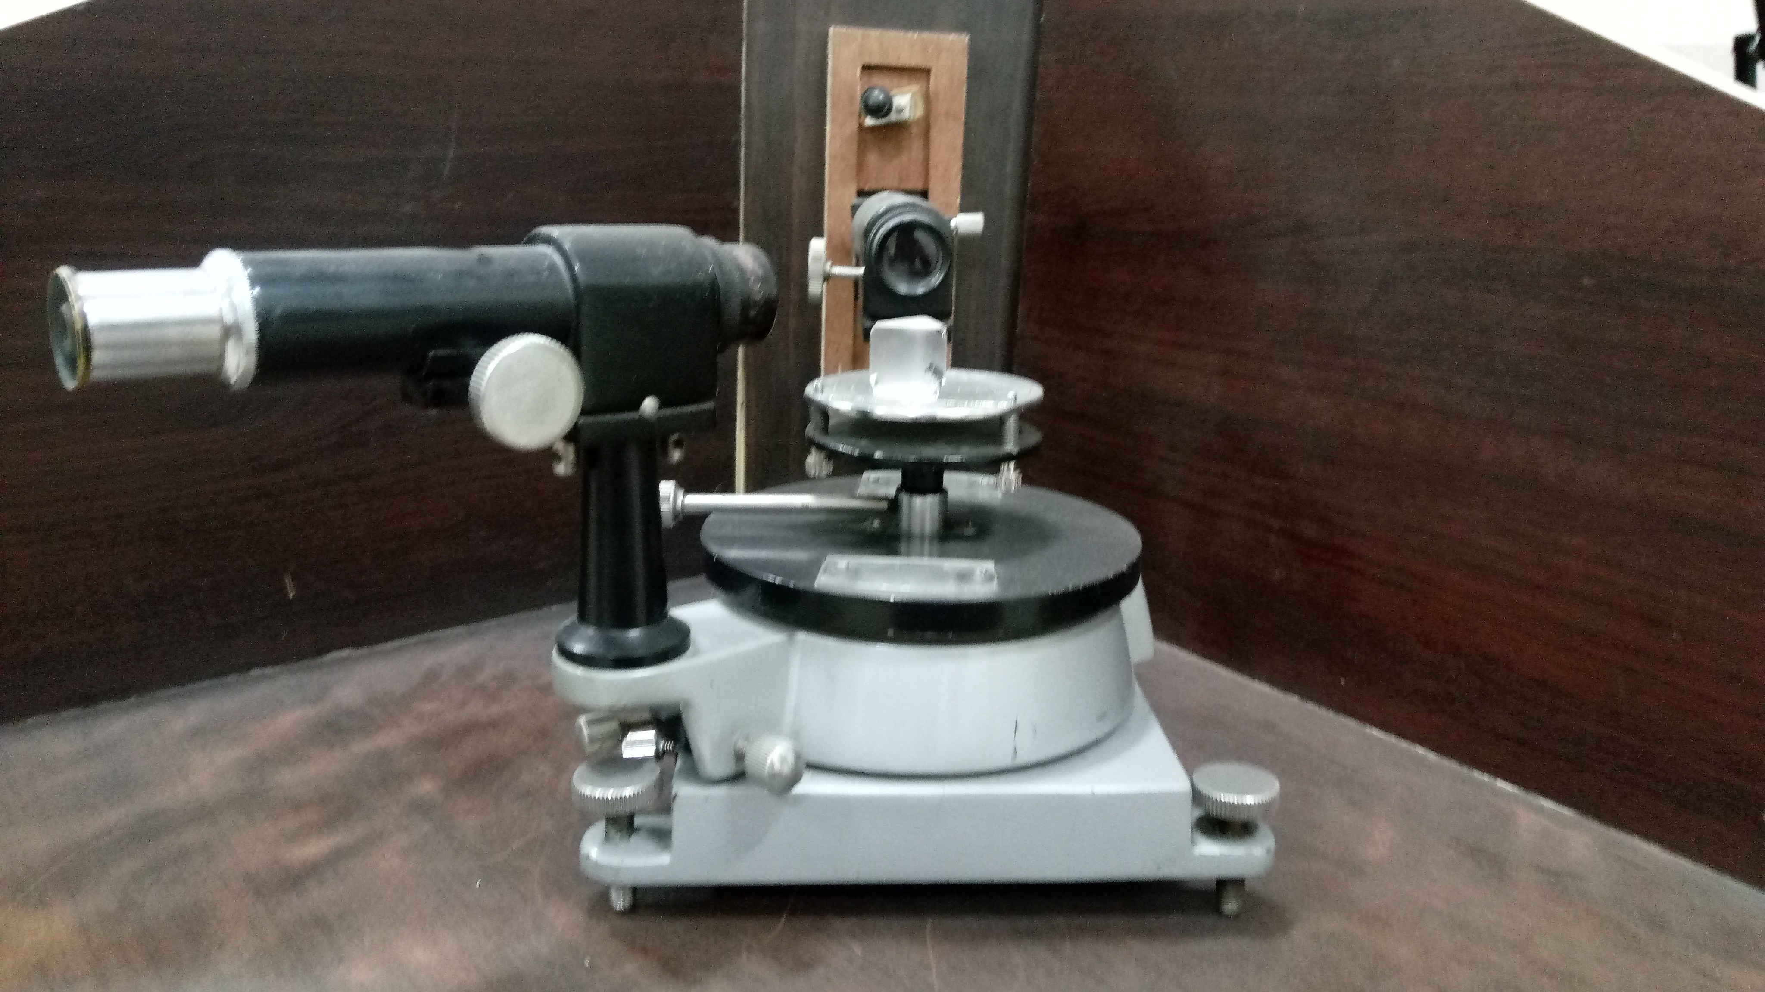
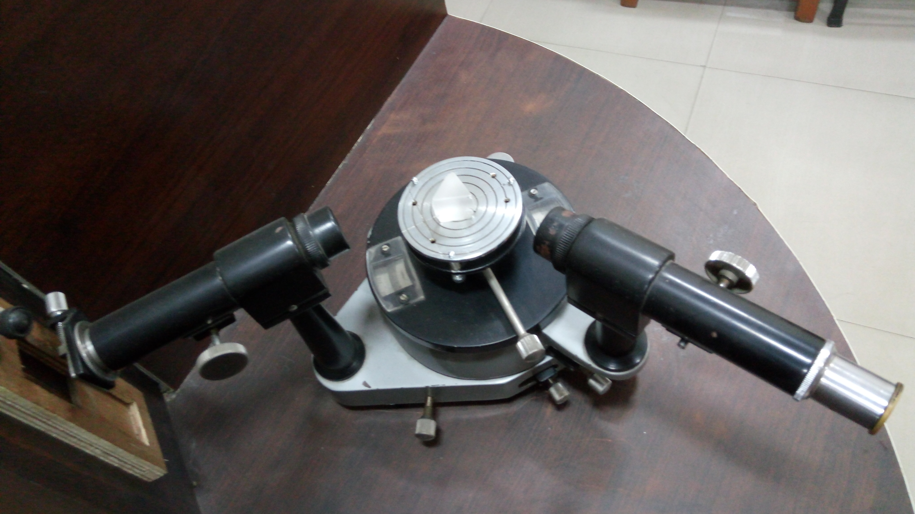
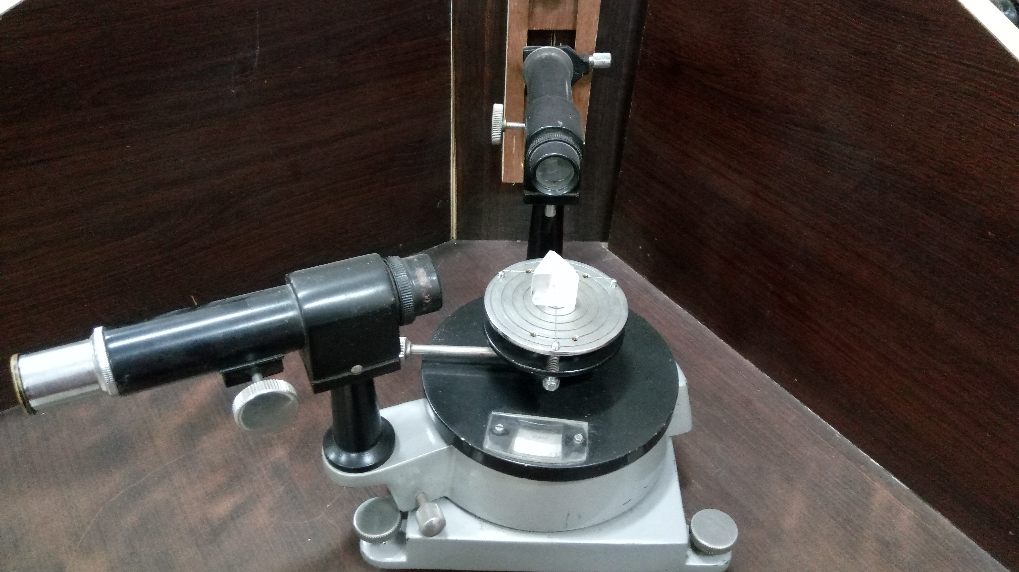
HOW IT ACTUALLY LOOKS?
1.
1.For angle of prism keep rough surface in front of telescope.
2.For minimum deviation keep plane surface in front of telescope.
3.Rotate the telescope to side of rough surface to see two slits.
2.
3.

Slide 12
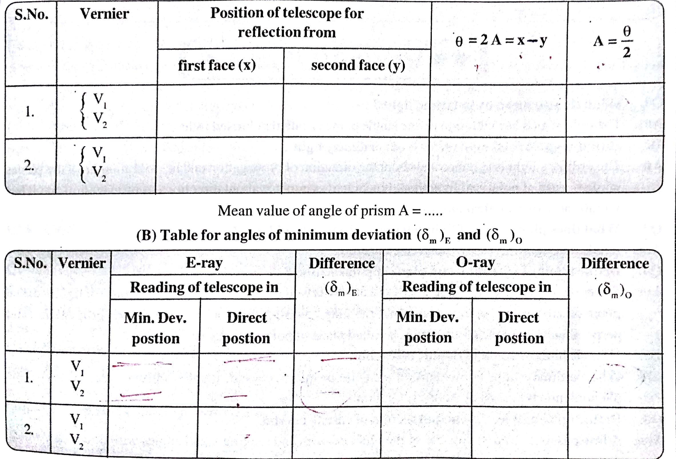
Observations
(A) Table for angle of prism A

Slide 13
CALCULATIONS AND RESULTS
CALCULATIONS are carried by following formula for E- ray and 0- ray respectively:
AND

