Slide 1
To measure the area of a given rectangular window using a sextant
Dr. Ajay Garg

Slide 2
CONTENTS
Sextant
Least Count of the Instrument
Objective of the Experiment, Apparatus and Formula Used
Procedure
Observations and Result

Slide 3
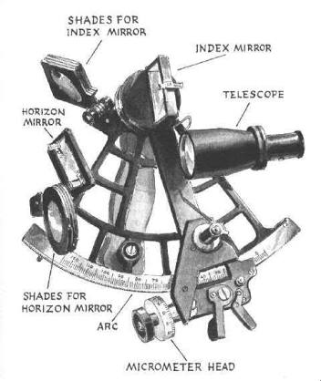
SEXTANT
A Sextant is a doubly reflecting navigation instrument that measures the angular distance between two visible objects, which may distant and inaccessible.
It works on a simple principle that “when a plane mirror is rotated through an angle of θ then the reflected ray gets rotated through twice the angle i.e. 2θ
The sextant relies on the optical principle that if a ray of light is reflected from two mirrors in succession then the angle between the first and last direction of the ray is twice the angle between the mirrors.
The primary use of a sextant is to measure the angle between an astronomical object and the horizon for the purposes of celestial navigation. A sextant can also be used to measure the lunar distance between the moon and another celestial object (such as a star or planet) in order to determine GMT and Longitude.

Slide 4
Least count of the instrument
Sextant’s are provided with micrometer screw, the micrometer circular scale is divided into 60 equal parts and one complete rotation of the screw changes the reading on the main scale by 1’’.
Hence, each division on circular scale of the micrometer is 1’ and 5 divisions of the vernier attached to the screw coincide with 4 divisions on circular scale i.e.
5 V.S.D.= 4 M.S.D.
1 V.S.D. = (4/5) M.S.D.
Therefore, vernier constant = 1 C.S.D.-1.V.S.D.
=(1-(4/5)) C.S.D.
=(1/5) C.S.D or 1’
=(60’’/5)
=12’’

Slide 5
Objective, Apparatus and formula used
OBJECTIVE :-
To Measure the area of a given rectangular window using a sextant.
APPARATUS :-
A Sextant along with its stand, spirit level, a colored chalk and a measuring tape.
FORMULA USED :-
The length of the window, l= d tanθ
The Breadth of the window is given by, b= d’ tanθ’. Where, d=perpendicular distance of the index mirror of sextant from the plane of the window and θ = angle made by the side AD and BC of the window at the index of the sextant.
The Area of the given rectangular window is given by,
A= l x b

Slide 6
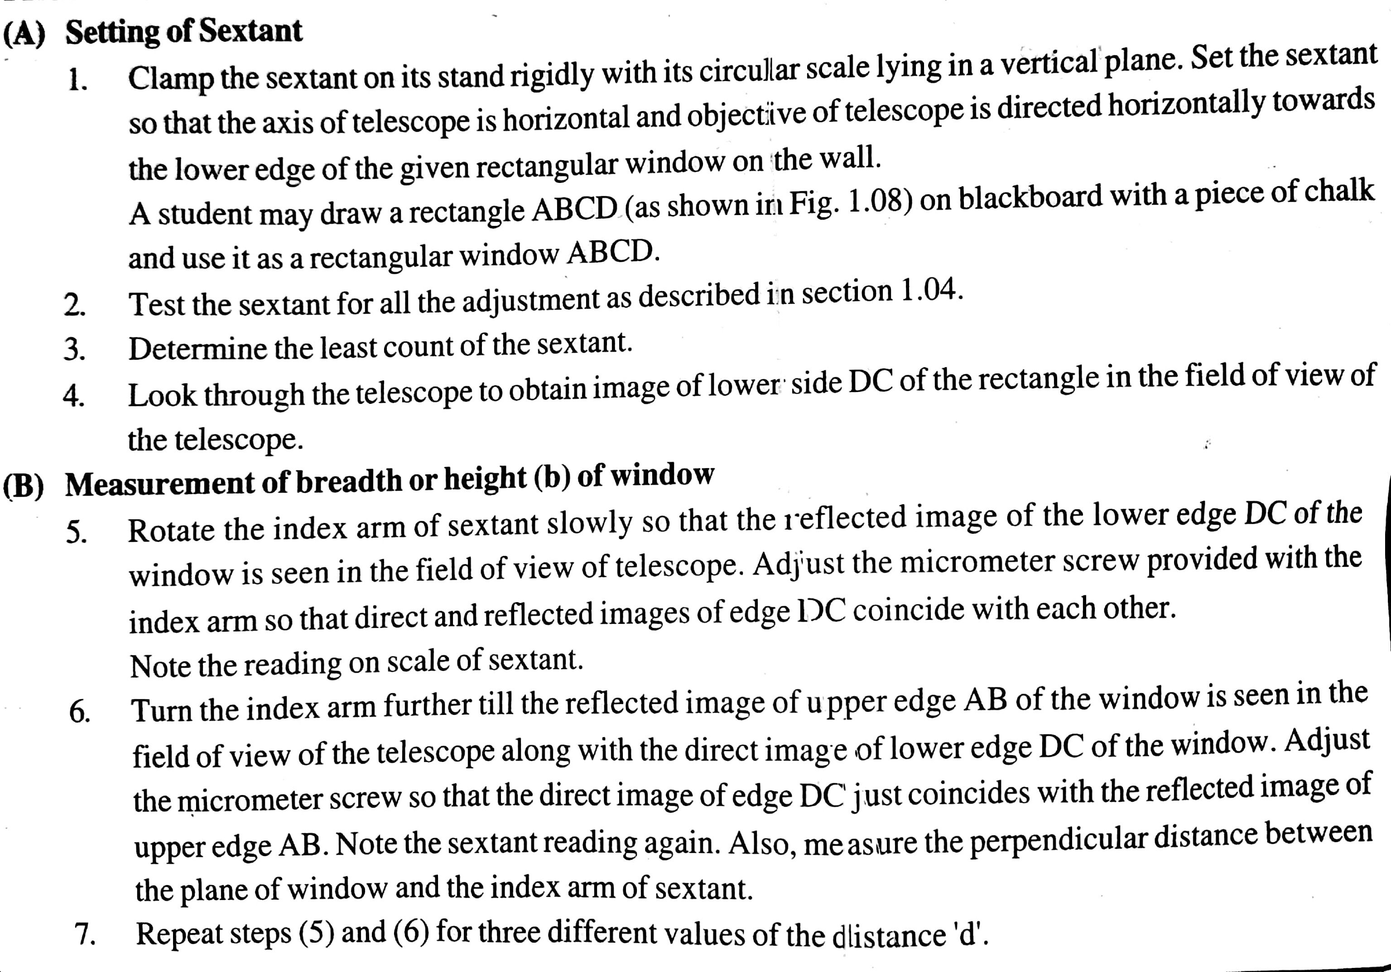
WORKING

Slide 7
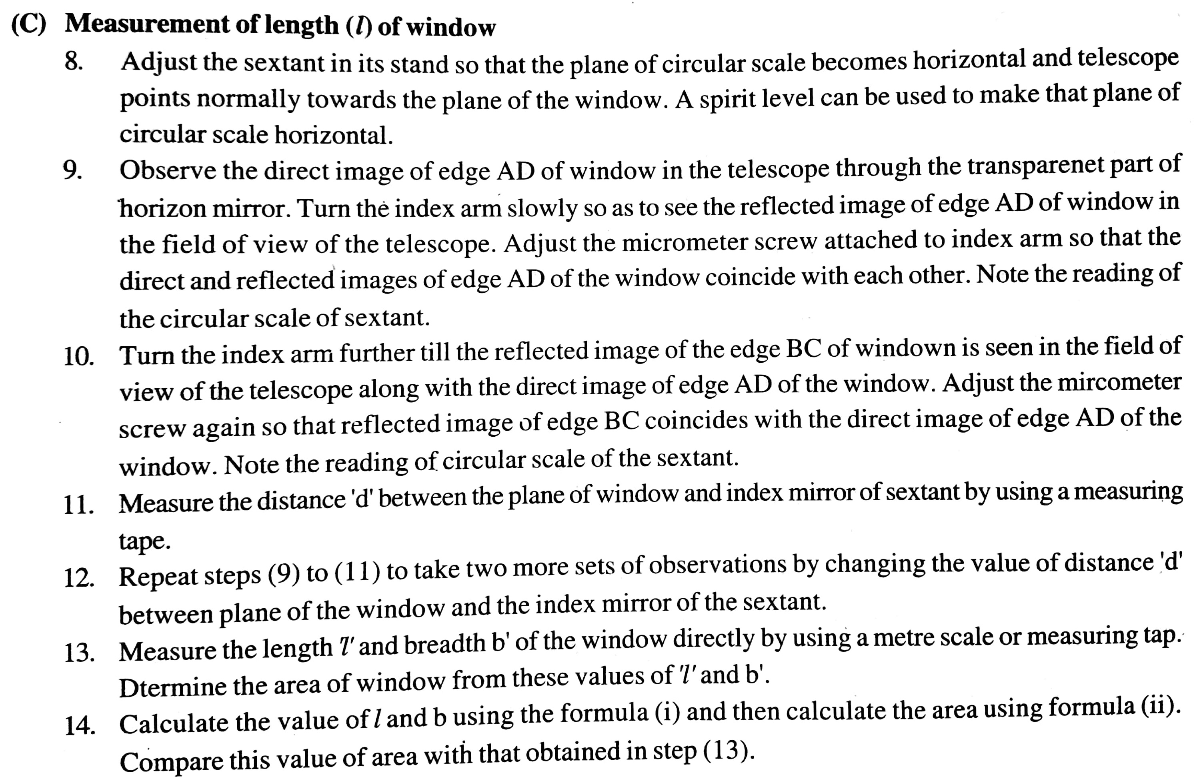

Slide 8
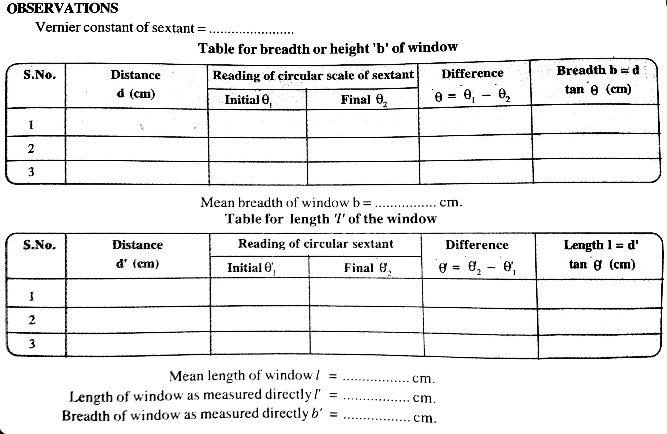
OBSERVATION Table

Slide 9
Calculations:-
1. Area of window determined by using sextant, A= l x b =……cm^2
2. Area of window determined directly A’= l’ x b’ = ……..cm^2
Percentage Error:-
Precautions:-
The plane of the mirror and that of the horizon mirror should be perpendicular to the plane of circular scale of sextant.
The Axis of the telescope of sextant should be parallel to the plane of circular scale.
When the sextant is used for measuring ‘B’ of the window, the plane of circular scale should be vertical
When the sextant is used for measuring ‘L’ of the window, the plane of circular scale should be horizontal.
Reading of the circular scale of the sextant should be noted when the direct and reflected images coincide with each other.

