Slide 1
TRANSISTORS
I B (PG) COLLEGE, PANIPAT
DEPARTMENTS: PHYISCS

Slide 2
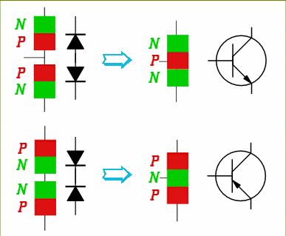
Bipolar Transistors
Base
Collector
Emitter
Two PN junctions joined together
Two types available – NPN and PNP
The regions (from top to bottom) are called the collector (C), the base (B), and the emitter (E)

Slide 3
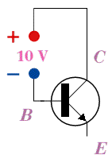
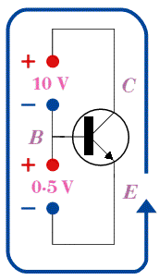
Operation
Begin by reverse biasing the CB junction
Here we are showing an NPN transistor as an example
Now we apply a small forward bias on the emitter-base junction
Electrons are pushed into the base, which then quickly flow to the collector
The result is a large emitter-collector electron current (conventional current is C-E) which is maintained by a small E-B voltage
Some of the electrons pushed into the base by the forward bias E-B voltage end up depleting holes in that junction
This would eventually destroy the junction if we didn’t replenish the holes
The electrons that might do this are drawn off as a base current

Slide 4
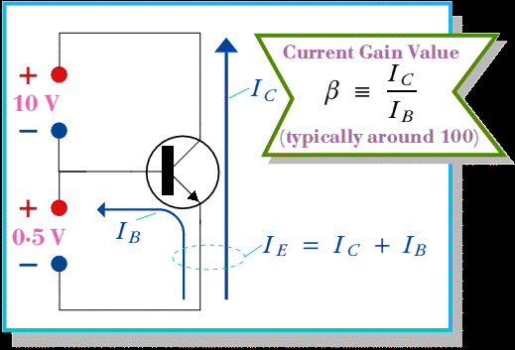
Currents

Slide 5
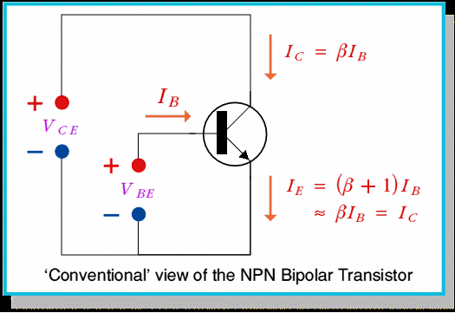
Conventional View

Slide 6
Origin of the names
the Emitter 'emits' the electrons which pass through the device
the Collector 'collects' them again once they've passed through the Base
...and the Base?...

Slide 7
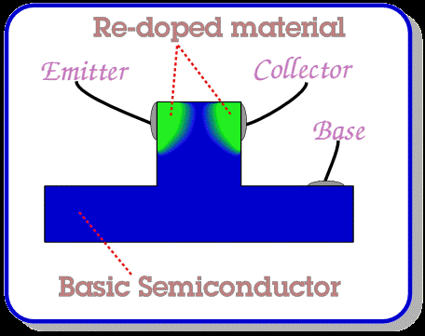
Original Manufacture

Slide 8
Base Thickness
The thickness of the unmodified Base region has to be just right.
Too thin, and the Base would essentially vanish. The Emitter and Collector would then form a continuous piece of semiconductor, so current would flow between them whatever the base potential.
Too thick, and electrons entering the Base from the Emitter wouldn't notice the Collector as it would be too far away. So then, the current would all be between the Emitter and the Base, and there'd be no Emitter-Collector current.

Slide 9
Amplification Properties
The C-B voltage junction operates near breakdown.
This ensures that a small E-B voltage causes avalanche
Large current through the device

Slide 10
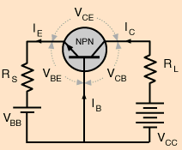
Common Base NPN

Slide 11
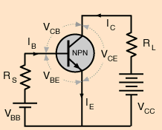
Common Emitter NPN

Slide 12
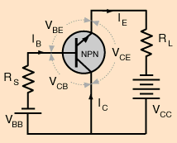
Common Collector NPN
How does I_{C} vary with V_{CE} for various I_{B}?
Note that both dc sources are variable
Set V_{BB} to establish a certain I_{B}

Slide 13
Collector Characteristic Curve
If V_{CC} = 0, then I_{C} = 0 and V_{CE} = 0
As V_{CC} ↑ both V_{CE} and I_{C} ↑
When V_{CE}  0.7 V, base-collector becomes reverse-biased and I_{C} reaches full value (I_{C} = βI_{B})
I_{C} ~ constant as V_{CE} ↑. There is a slight increase of I_{C} due to the widening of the depletion zone (BC) giving fewer holes for recombinations with e¯ in base.
Since I_{C} = βI_{B}, different base currents produce different I_{C} plateaus.

Slide 14
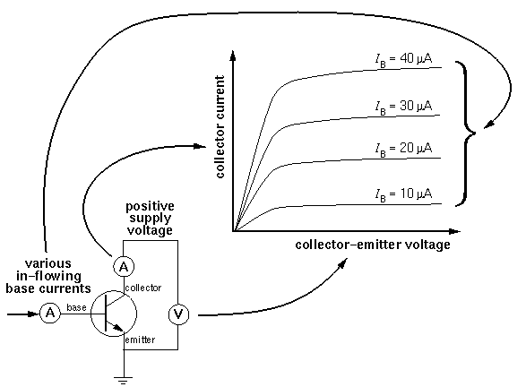
NPN Characteristic Curves

Slide 15
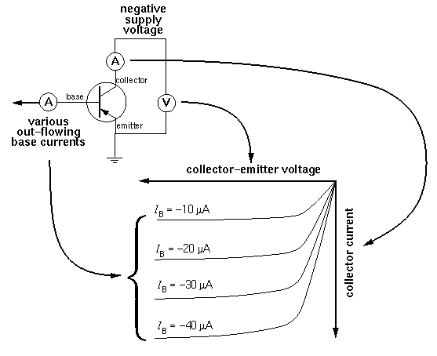
PNP Characteristic Curves

Slide 16
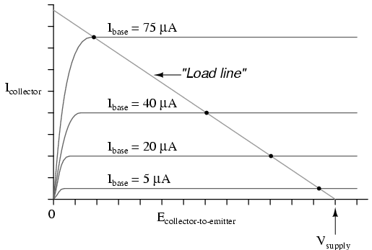
Load Line
Slope of the load line is 1/R_{L}
For a constant load, stepping I_{B} gives different currents (I_{C}) predicted by where the load line crosses the characteristic curve. I_{C} = bI_{B}works so long as the load line intersects on the plateau region of the curve.

Slide 17
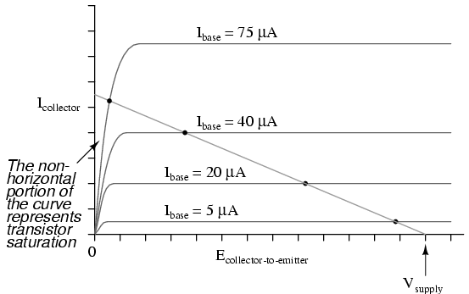
Saturation and Cut-off
Cut-off
Note that the load line intersects the 75 mA curve below the plateau region. This is saturation and I_{C} = βI_{B} doesn’t work in this region.

Slide 18
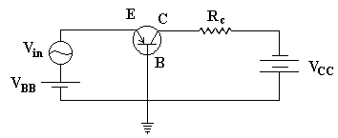
Voltage Amplifiers
Common Base PNP
Now we have added an ac source
The biasing of the junctions are:
BE is forward biased by V_{BB} - thus a small resistance
BC is reverse biased by V_{CC} – and a large resistance
Since I_{B} is small, I_{C}  I_{E}

Slide 19
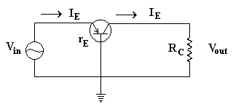
Equivalent ac Circuit
r_{E} = internal ac emitter
resistance
I_{E} = V_{in}/r_{E} (Ohm’s Law)
V_{out} = I_{C}R_{C}  I_{E}R_{C}
Recall the name – transfer resistor

Slide 20
Current Gains
Common Base
α = I_{C}/I_{E} < 1
Common Emitter
β = I_{C}/I_{B}

Slide 21
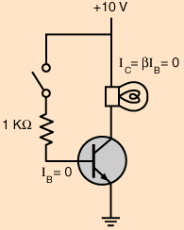
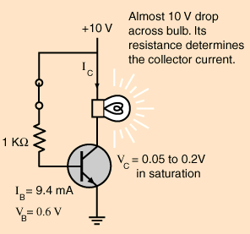
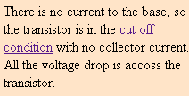
Transistors as Switches

Slide 22
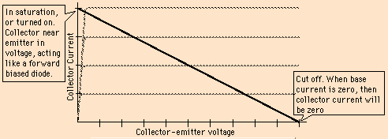
The operating points
We can control the base current using V_{BB} (we don’t actually use a physical switch). The circuit then acts as a high speed switch.

Slide 23
Details
In Cut-off
All currents are zero and V_{CE} = V_{CC}
In Saturation
I_{B} big enough to produce I_{C(sat)}  βI_{B}
Using Kirchhoff’s Voltage Law through the ground loop
V_{CC} = V_{CE(sat)} + I_{C(sat)}R_{C}
but V_{CE(sat)} is very small (few tenths), so
I_{C(sat)} V_{CC}/R_{C}

Slide 24
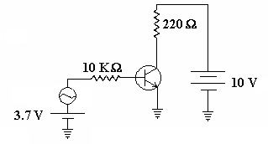
Transistors with ac Input
Assume that β is such that I_{C} varies between 20 and 40 mA. The transistor is constantly changing curves along the load line.

Slide 25
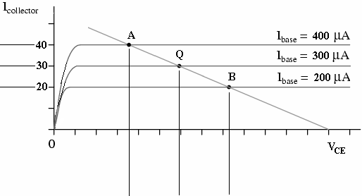
Pt. A corresponds to the positive peak. Pt. B corresponds to the negative peak. This graph shows ideal operation.

Slide 26
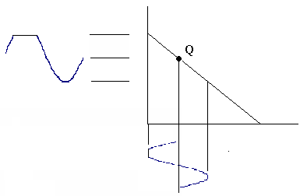
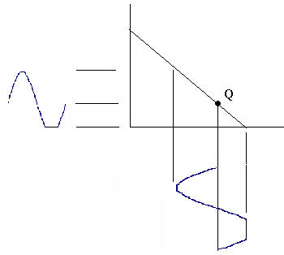
Distortion
The location of the point Q (size of the dc source on input) may cause an operating point to lie outside of the active range.
Driven to saturation
Driven into Cutoff

Slide 27
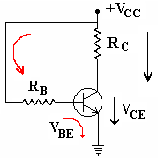
Base Biasing
It is usually not necessary to provide two sources for biasing the transistor.
The red arrows follow the base-emitter part of the circuit, which contains the resistor R_{B}. The voltage drop across R_{B} is V_{CC} – V_{BE} (Kirchhoff’s Voltage Law). The base current is then…
and I_{C} = βI_{B}

Slide 28
Base Biasing
Use Kirchhoff’s Voltage Law on the black arrowed loop of the circuit
V_{CC} = I_{C}R_{C} + V_{CE}
So, V_{CE} = V_{CC} – I_{C}R_{C}
V_{CE} = V_{CC} – βI_{B}R_{C}
Disadvantge
β occurs in the equation for both V_{CE} and I_{C}
But β varies – thus so do V_{CE} and I_{C}
This shifts the Q-point (β-dpendent)

Slide 29
Transistor Amplifiers
Amplification
The process of increasing the strength of a signal.
The result of controlling a relatively large quantity of current (output) with a small quantity of current (input).
Amplifier
Device use to increase the current, voltage, or power of the input signal without appreciably altering the essential quality.

Slide 30
Class A
Entire input waveform is faithfully reproduced.
Transistor spends its entire time in the active mode
Never reaches either cutoff or saturation.
Drive the transistor exactly halfway between cutoff and saturation.
Transistor is always on – always dissipating power – can be quite inefficient

Slide 31
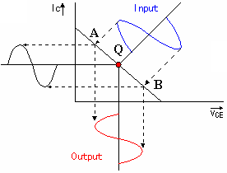
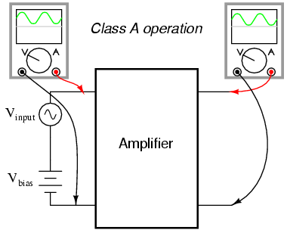
Class A

Slide 32
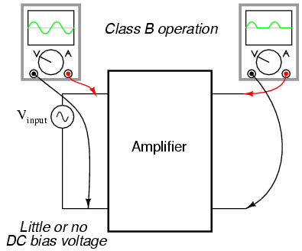
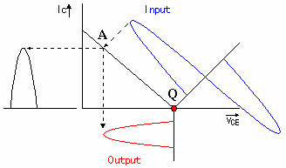
Class B
No DC bias voltage
The transistor spends half its time in active mode and the other half in cutoff

Slide 33
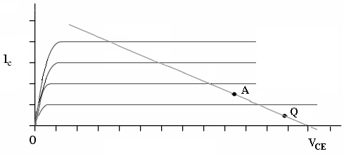
Class AB
Between Class A (100% operation) and Class B (50% operation).

Slide 34
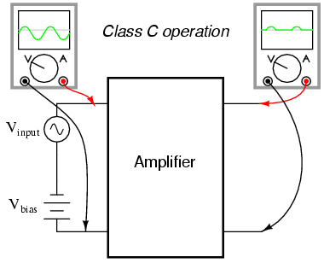
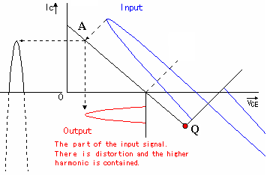
Class C
I_{C} flows for less than half then cycle. Usually get more gain in Class B and C, but more distortion

Slide 35
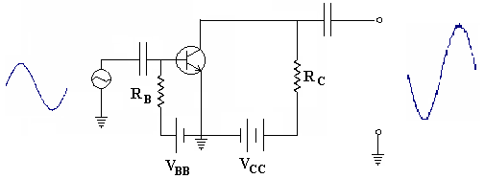
Common Emitter Transistor Amplifier
Notice that V_{BB} forward biases the emitter-base junction and dc current flows through the circuit at all times
The class of the amplifier is determined by V_{BB} with respect to the input signal.
Signal that adds to V_{BB} causes transistor current to increase
Signal that subtracts from V_{BB} causes transistor current to decrease

Slide 36
Details
At positive peak of input, V_{BB} is adding to the input
Resistance in the transistor is reduced
Current in the circuit increases
Larger current means more voltage drop across R_{C} (V_{RC} = IR_{C})
Larger voltage drop across R_{C} leaves less voltage to be dropped across the transistor
We take the output V_{CE} – as input increases, V_{CE} decreases.

Slide 37
More details
As the input goes to the negative peak
Transistor resistance increases
Less current flows
Less voltage is dropped across R_{C}
More voltage can be dropped across C-E
The result is a phase reversal
Feature of the common emitter amplifier
The closer V_{BB} is to V_{CC}, the larger the transistor current.

Slide 38
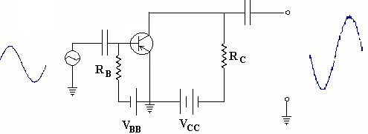
PNP Common Emitter Amplifier

Slide 39
NPN Common Base Transistor Amplifier
Signal that adds to V_{BB} causes transistor current to increase
Signal that subtracts from V_{BB} causes transistor current to decrease
At positive peak of input, V_{BB} is adding to the input
Resistance in the transistor is reduced
Current in the circuit increases
Larger current means more voltage drop across R_{C} (V_{RC} = IR_{C})
Collector current increases
No phase reversal

Slide 40
PNP Common Base Amplifier

Slide 41
NPN Common Collector Transistor Amplifier
Also called an Emitter Follower circuit – output on emitter is almost a replica of the input
Input is across the C-B junction – this is reversed biased and the impedance is high
Output is across the B-E junction – this is forward biased and the impedance is low.
Current gain is high but voltage gain is low.

Slide 42
PNP Common Collector Transistor Amplifier

Slide 43
Gain Factors
Usually given for common base amplifier
Usually given for common emitter amplifier
Usually given for common collector amplifier

Slide 44
Gamma
Recall from Kirchhoff’s Current Law
I_{B} + I_{C} = I_{E}
Ex. For β = 100 α = β/(1+β) = 0.99
γ = 1 + β = 101

Slide 45
Bringing it Together
Type | Common Base | Common Emitter | Common Collector
Relation between input/output phase | 0° | 180° | 0°
Voltage Gain | High | Medium | Low
Current Gain | Low (α) | Medium (β) | High (γ)
Power Gain | Low | High | Medium
Input Z | Low | Medium | High
Output Z | High | Medium | Low

Slide 46
Various Forms
 | Common Emitter (e) | Common Base (b) | Common Collector (c)
h_{i} (ohms) | V_{B}/I_{B} | V_{E}/I_{B} | V_{B}/I_{B}
h_{r} (unitless) | V_{B}/V_{C} | V_{E}/V_{C} | V_{B}/V_{E}
h_{f} (unitless) | I_{C}/I_{B} | I_{C}/I_{E} | I_{E}/I_{B}
h_{o} (watts) | I_{C}V_{C} | I_{C}V_{C} | I_{E}V_{E}

Slide 47
Thank You

