Slide 1
DYNAMIC MEMORY ALLOCATION IN ‘C’ LANGUAGE
By - Dr. Ranju
Department of Computer Science
I.B.PG. College, Panipat

Slide 2
A VERY SINCERE THANKS TO
Our Principal Sir
Dr. Ajay Kumar Garg
For providing us Best Facilities & his Guidance

Slide 3
SPECIAL THANKS TO MY COLLEAGUES
Dr. Vikram Lamba (HOD)
Prof. Ashwani Gupta
Prof. Vinay Bharti

Slide 4
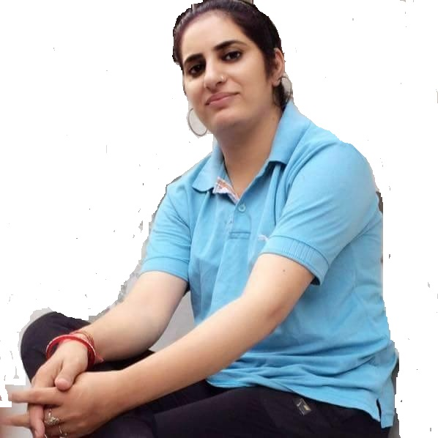
By - Dr. Ranju

Slide 5
TOPICS

