Slide 1
CLASS | BBA II (IV SEMESTER)
SUBJECT | MARKETING MANAGEMENT
TOPIC | DISTRIBUTION CHANNELS
PREPARED BY | Ms. MANEET KAUR (ASSISTANT PROFESSOR)
DEPARTMENT | COMMERCE & MANAGEMENT
I.B. (PG) COLLEGE, PANIPAT (AFFILIATED TO KURUKSHETRA UNIVERSITY, KURUKSHETRA)

Slide 2
INTRODUCTION
Distribution Channels are those channels which are used by various organizations for the flow of products from the point of production to the point of ultimate consumption. The channels of distribution are also known as “Trade Channels”
PRODUCER
INTERMEDIARIES
CONSUMERS

Slide 3
DISTRIBUTION CHANNELS
DEFINITION:
“Every producer seeks to link together the set of marketing intermediaries that best fulfill the firm’s objectives. The set of marketing intermediaries is called the marketing channel or trade channel or distribution channel.”
- Philip Kotler
“Channel of distribution is the structure of intra company organization units and extra company agents and dealers, wholesale and retail, through which a commodity, a product or service is marketed.”
-American Marketing Association

Slide 4
CHARACTERISTICS OF DISTRIBUTION CHANNEL
Route or Pathway
Flow of Goods
Functions
Merchantile Agents
Composition
Remuneration

Slide 5
ROLE OF DISTRIBUTION CHANNELS
Distribution channels reduces the cost of any transaction by making the route of purchasing decision.
Distribution channel act as communication agent often guided the consumers in the right direction to fulfill their wants.
Persuading and influencing the prospective buyers to favor a certain product and its manufacturer.
Participating actively in the creation and establishment of market for a new product .

Slide 6
CONTINUED…
Looking after all physical distribution functions.
Transferring of new technology to the users along with the supply of products and playing the role of change agents.
Offering pre-sale and after sale services to consumers
Providing feedback information , marketing intelligence and sale forecasting services for their regions to their manufacturers.

Slide 7
FUNCTIONS OF DITRIBUTION CHANNELS
Contact between Producer and Consumers.
Transferring the title.
Satisfaction to the consumers.
Performing promotional activities.
Creating time and place utilities.
Fixing prices.
Function of communication information.
Help in production function.

Slide 8
TYPES OF DISTRIBUTION CHANNELS
CONVENTIONAL DISTRIBUTION CHANNELS
↓ ↓
DIRECT INDIRECT
↓
(i) One level.
(ii) Two level.
(iii) Multi-level

Slide 9
TYPES OF DISTRIBUTION CHANNELS
NON-CONVENTIONAL DISTRIBUTION CHANNELS
↓ ↓
VERTICAL HORIZONTAL
↓
(i) Corporate.
(ii) Administrated.
(iii) Contractual.

Slide 10
CONVENTIONAL DISTRIBUTION CHANNELS
These are the traditional channels in which the participants operate on the basis of self interest, concerned only with the organization from where they buy and to whom they sell.
In conventional distribution channels, there are four channel designs such as:
Direct : (i) Zero level.
Indirect: (ii) One level.
(iii) Two level.
(iv) Multi-level.

Slide 11
CONVENTIONAL CHANNELS FOR CONSUMER PRODUCTS
Conventional channels are the fragmented networks in which producers and the consumers are loosely linked by middlemen in the process of exchange.
Conventional channels are of two types:
Direct Distribution Channel
Indirect Distribution Channel.

Slide 12
DIRECT DISTRIBUTION CHANNEL
In this channel, the producer directly sells his products to the ultimate consumers without involvement of any middlemen. That is why, it is called direct channel and zero-level distribution channel.
It can be illustrated as:-
MANUFACTURER
ULTIMATE CONSUMER

Slide 13
ADVANTAGES OF DIRECT DISTRIBUTION CHANNEL
Consumers get the products in their pure form.
It is economical method of selling.
The price of products remain low because of less cost.
Manufacturers directly estimate the demand of the consumers.
Close contact between producer and consumers.

Slide 14
DISADVANTAGES OF DIRECT DISTRIBUTION CHANNEL
The sales level remain low.
It is not suitable in case of mass production and sales at large scale.
All risks and losses lies with the manufacturers.
It is not suitable when consumers are widely scattered.
Consumers has to pay a price which is fixed by the manufacturer.

Slide 15
INDIRECT DISTRIBUTION CHANNELS
Indirect distribution channels are those channels in which manufacturer sells his products with the help of the middlemen in process of exchange.
The whole process of indirect distribution channel looks like a chain.
ONE LEVEL
MANUFACTURER→→RETAILER→→CONSUMER
TWO LEVEL
MANUFACTURER→WHOLESALER→RETAILER→CONSUMER
MULTI LEVEL:
MANUFACTURER→SELLINGAGENTS→WHOLESALERS→ →RETAILERS→ →CONSUMERS

Slide 16
ONE LEVEL CHANNEL OF DISTRIBUTION
Under this system, manufacturer sell their product to retailers and retailers sell them in turn to ultimate consumers.
In this, manufacturer allows the retailers or wholesalers to have direct access to him.
It can be illustrated as under:
MANUFACTURER→→RETAILERS→→CONSUMER
MANUFACTURER→→WHOLESALERS→→CONSUMER

Slide 17
TWO LEVEL CHANNEL OF DISTRIBUTION
This is traditional channel of distribution in which producer sell his products with the help of two middlemen for sale of consumer products.
There are two types of middlemen i.e., wholesalers and retailers.
The wholesalers distribute the products to retailers as per their requirements and in turn retailers finally sells the same to the ultimate consumers.
It can be illustrated as under:
MANUFACTURER→WHOLESALERS→RETAILERS→CONSUMER

Slide 18
MULTI-LEVEL CHANNEL OF DISTRIBUTION
This is the longest channel of distribution.
A company with diversified product may find it more appropriate to adopt a variety of distribution channels.
This channel is used where the wholesalers are scattered throughout the country and selling agents undertake marketing on the behalf of the manufacturers.
It can be illustrated as under:
MANUFACTURER→ SELLING AGENTS→WHOLESALERS→ →RETAILERS→ →CONSUMERS

Slide 19
VERTICAL DISTRIBUTION CHANNEL SYSTEM
A vertical marketing system is the result of failure of conventional channels where each channel participant works with independent separate identity, seeking to achieve its own objectives.
Vertical distribution channels are professionally managed and centrally programmed networks, pre-engineered to achieve operating economies and maximum market impact.
There are three types of vertically integrated marketing channels:
Corporate System.
Administrated Vertical System.
Contractual Marketing System.

Slide 20
NON-CONVENTIONAL CHANNELS OF DISTRIBUTION
These are the networks in which channel components participate in a full co-ordination and cohesion manner rather than working in a loose manner.
This is also known as integrated channels of distribution.
The non-conventional channel are of two types:
Vertical Distribution Channel System.
Horizontal Distribution Channel System.

Slide 21
TYPES OF VERTICALLY INTEGRATED DISTRIBUTION CHANNELS
CORPORATE SYSTEM/CHANNEL: In corporate vertical distribution system, a single firm owns both production and distribution facilities like Bata, Tata, Modi, Godrej, etc. with their own production units and retail outlets are the best examples of this system.
ADMINISTRATED VERTICAL SYSTEM/CHANNEL:
In this, there is full coordination in all the functions of production and distribution by using well developed programme in one or more number of limited firms throughout the whole marketing system.
CONTRACTUAL MARKETING SYSTEM/CHANNEL:
Under this system, independent channel components manufacturer, wholesalers and retailers are employed on a voluntary basis to develop a more efficient system on a contractual basis, so as to obtain economies of scale and increase market impact.

Slide 22
HORIZONTAL DISTRIBUTION CHANNEL/SYSTEM
It is a new trend in distribution channel in which one or more companies join hands to exploits a marketing opportunity either by themselves or by creating an independent unit.
The reasons for horizontal integration are the ever changing markets, cut throat competition, changing pace of technology, excess capacity, cyclical and seasonal changes in consumer demand and the incapacity to take financial risks single handed and so on.
Some examples of this kind of system are Maruti Udyog and HDFC Bank, Associated Cement Company, etc.

Slide 23
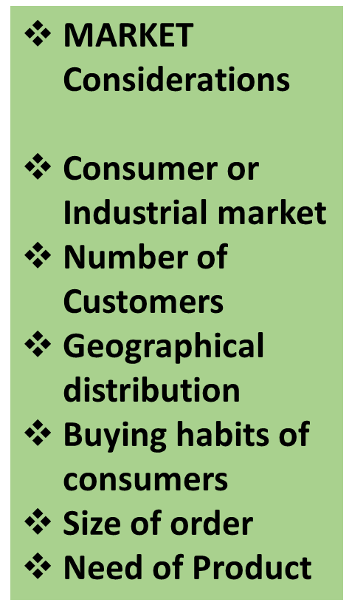
Factors Affecting Channel Choice

Slide 24
Factors Affecting Channel Choice
COMPANY Considerations
Financial strength
Size of the Company
Past channel experience
Reputation of the company
Product Mix
Marketing experience
MIDDLEMEN Considerations
Availability of middlemen
Attitude of middlemen
Services provided by middlemen
Cost of Channel
Sales volume potentials
Financial ability

Slide 25
THANK YOU
&
STAY SAFE

