Slide 1
I.B.(PG)COLLEGE, PANIPAT (AFFILIATED TO KURUKSHETRA UNIVERSITY, KURUKSHETRA)
CLASS | BBA-I (II SEMESTER)
SUBJECT | PRINCIPLES OF MANAGEMENT
TOPIC | SOCIAL RESPONSIBILITY OF BUSINESS
PREPARED BY | Ms. NISHA (ASSISTANT PROFESSOR)
DEPARTMENT | COMMERCE & MANAGEMENT

Slide 2
INTRODUCTION
Social responsibility of business is the ethical framework and the obligation of business towards various parties of society.
The parties of society include Employees, Consumers, Government, suppliers, Shareholders and other investors, community.
Notes:
2

Slide 3
Continued…..
“Corporate Social Responsibility is a hard edges business decision. Not because it is a nice thing to do or because people are forcing us to do it…..because it is good for our business”
(Niall Fitzgerald, former CEO, Unilver)

Slide 4
Examples of Corporate Social Responsibility
Rs. 500 crore donated by Reliance Industries and Rs. 1000 crore by Tata company for Covid-19 Prime Minister relief fund.
Maruti Suzuki donated Rs 2 crore towards the prime Minister National Relief fund for helping people who suffered during Kerala floods in 2018.

Slide 5
Importance of Corporate Social Responsibility OR Arguments in favour of social Responsibility of Business

Slide 6
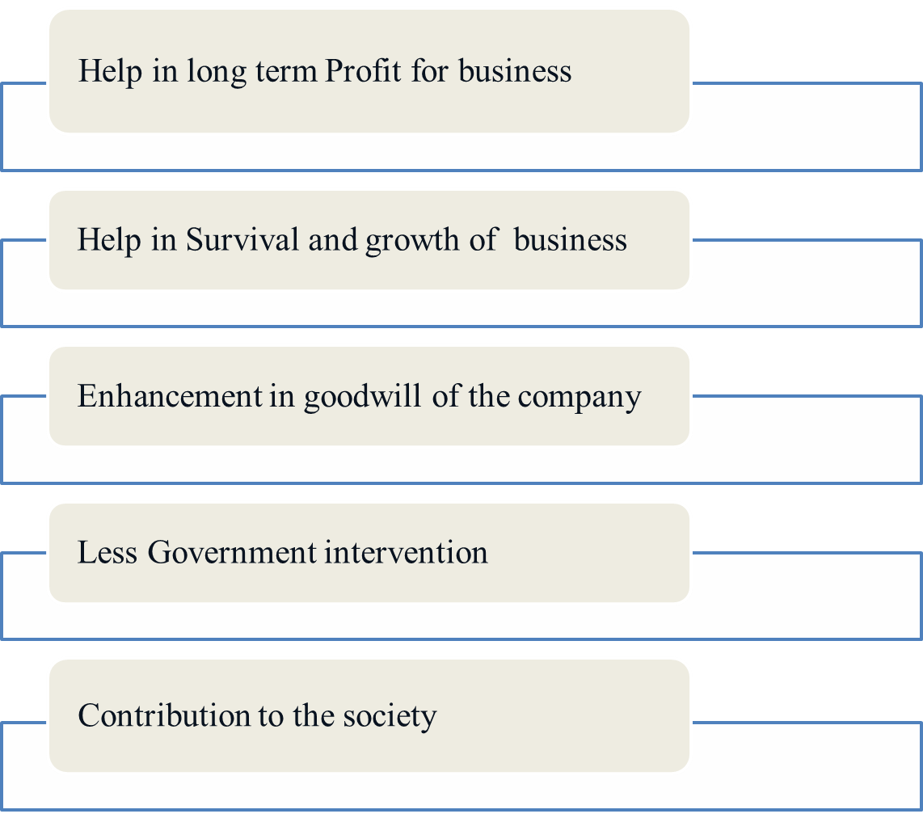

Slide 7
Continued…
The various benefits of social responsibility for business are as follows:
1.) Helping in long term profit for business: CSR helps in long term profit for business by developing goodwill of the company and developing positive attitude and response of potential clients in the company.
2.) Helps in Survival and Growth of the business: CSR activities being mandatory for some class o companies helps in survival of the business by avoiding any tax hassle. Also, growth is supported by inculcating feeling of oneness among people.

Slide 8
Continued…
3.) Enhancement in goodwill of the company: By fulfilling their social responsibility towards the country in which the company operates, goodwill of the company is enhanced.
4.) Less Government Intervention: Section 135 of Companies Act 2013 mandates some class of companies to mandatorily expend some percentage of profit towards CSR activities. Thus, following the same invites no government intervention.

Slide 9
Continued…
5.) Contribution to the Society: The company uses society’s resources and generates profit from the same. Thus by doing CSR, they contribute to the society towards many noble causes.

Slide 10
Arguments against Corporate Social Responsibility

Slide 11
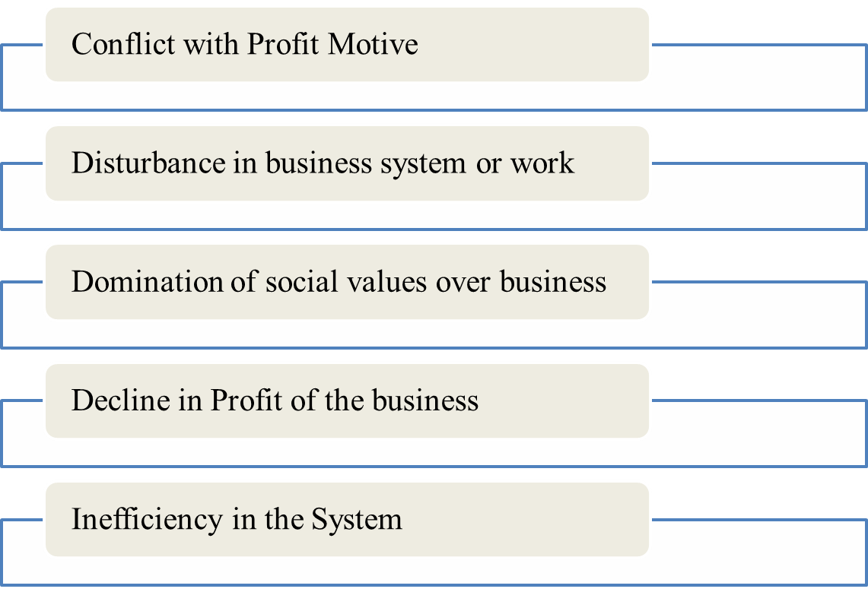

Slide 12
Continued……..
The various arguments against CSR activities are as follows:
1.) Conflict with Profit Motive: Every business thrive to generate profit. By indulging in CSR activities which include outflow of resources hamper the main motive of the company.
2.) Disturbance in business system or work:CSR activities include allocation of economic and physical resources of the company, thus hampers day to day work.
Notes:
12

Slide 13
Continued…
3.) Domination of Social Values over Business: While business lacks emotion, imposition of social values by imposing CSR activities leads to imposition of Social values on business.
4.) Decline in Profit of the company: CSR activities involve outflow of huge amount of funds from the company. Same leads to dip in profit which further impacts stakeholders of the business.

Slide 14
Continued…
5.) Inefficiency in the system: Social Responsibility brings inefficiency in the system. There is no substitute for the power of self- interest in people to act.

Slide 15
SOCIAL RESPONSIBILITY OF BUSINESS TOWARDS DIFFFERNT PARTIES
1.) TOWARDS EMPLOYEES:
Provide fair remuneration
Treat them respectfully
Provide job security
Provide them opportunity for growth
Give them participation in Management
Solve their problems timely
Provide them right working environment
Maintain good incentive system for employees
Notes:
15

Slide 16
Continued…
2.) TOWARDS SHAREHOLDERS/INVESTORS:
Use of their money at right place
Provide them right and updated information time to time
Timely and proper payment of dividend
Treat different types of investors equally
Ensure safety of their investment

Slide 17
Continued…
3.) TOWARDS CONSUMERS:
Avoid adulteration
Show reality in advertisement
Be polite and honest to consumers
Sought out their problems in time
Provide them good quality products at right price
Provide them goods according to their taste & preferences
Notes:
17

Slide 18
Continued…
4.) TOWARDS SUPPLIERS:
To pay them in time
To provide right information to suppliers at right time
To work with honesty and transparency

Slide 19
Continued…
5.) Towards Government:
Follow the rules framed by Government
Not to indulge in unethical and illegal activities
Pat tax honestly and in time to the Government
Not to offer bribe to government officials for the benefit of their business
Provide advice and support to Government when -ever required
Notes:
19

Slide 20
Continued…
6.) TOWARDS COMMUNITY:
Not to harm environment
Make eco-friendly products
Provide employment opportunities
Provide charity and donations to charitable trust, NGOs etc.
Maintain standard of people by providing goods at low price.

Slide 21
THANK YOU

