Slide 1
I. B. (PG) College, Panipat

Slide 2
Presented by
Sheela Malik
Assistant Professor
Department of English
I. B. PG College, Panipat

Slide 3


Slide 4


Slide 5
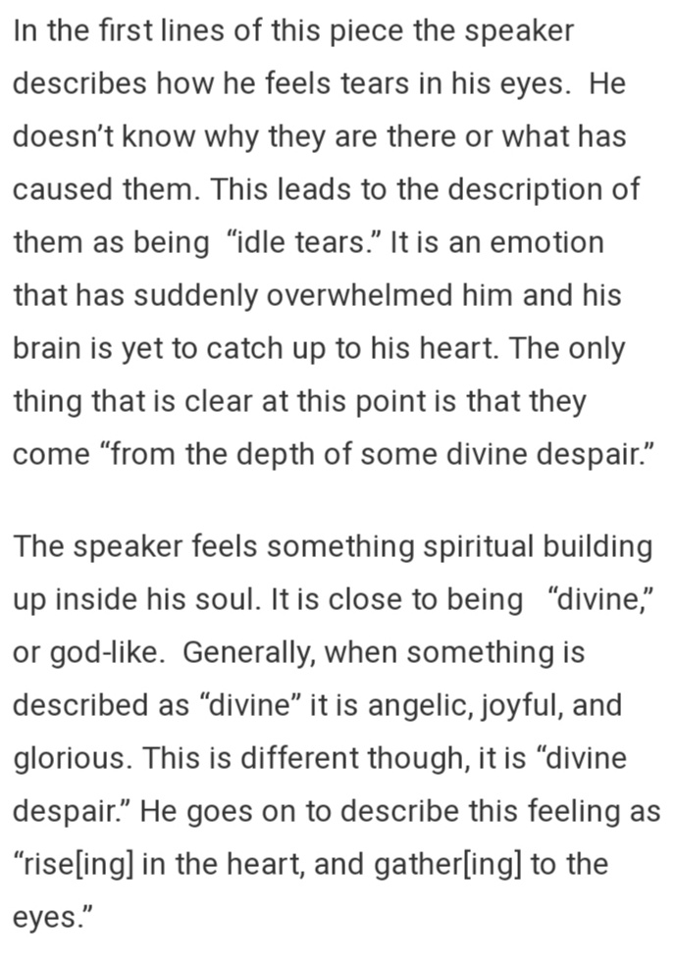

Slide 6
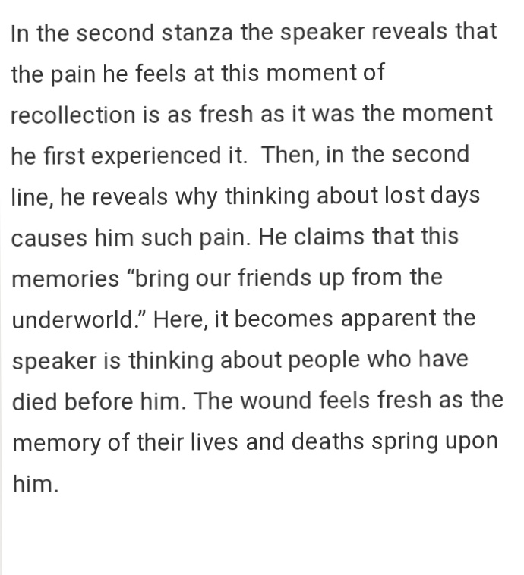

Slide 7
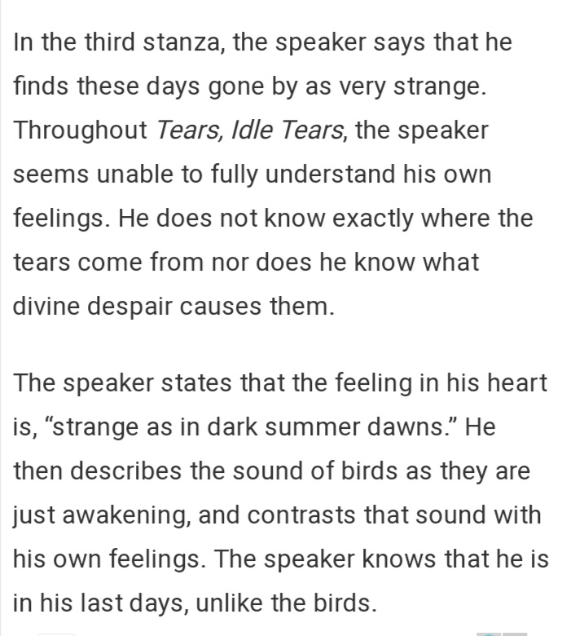

Slide 8


Slide 9
Thank you

