Slide 1
I.B.(PG) College, Panipat class: B.A. Second Year Gen.English Topic : Tenses

Slide 2
SINCERE THANKS TO:
DR.AJAY KUMAR GARG
PRINCIPAL , I.B. (PG) COLLEGE,PANIPAT
DR.MADHU SHARMA (H.O.D.)ENGLISH DEPARTMENT

Slide 3
PRESENTED BY : REKHA SHARMA ASSISTANT PROFESSOR ENGLISH DEPARTMENT

Slide 4
ENGLISH GRAMMAR
(TENSES)

Slide 5
HOME
TENSES
EXERCISES
What does tense indicate?
Exercise 1
Present Tense
Exercise 2
Past Tense
Exercise 3
Future Tense
Exercise 4
Table of English Tenses

Slide 6
WHAT DOES TENSE INDICATE?
Tense of a verb indicates the time of an action or any event. As we know, there are three universal times – present, past and future. Tenses cover the actions done in those times. The tense also refers to the continuation or completion of an action. However, everything is implied in the three time periods.

Slide 7
WHAT DOES TENSE INDICATE?
There are primarily three types of tenses of the verb. They are present tense, past tense and future tense. There are subcategories of the three tenses which indicate specific and acute timing of the verb actions.

Slide 8
PRESENT TENSE
Now read the following sentences:
I write. I am writing. I have written. I have been writing.
The verbs in all of these sentences refer to the present time, and are, therefore, said to be in the present tense.

Slide 9
PRESENT TENSE
In sentence 1, however, the verb simply talks about the action. It doesn’t state whether the action is complete or not. The verb is therefore said to be in the simple present tense.
In sentence 2, the verb shows that the action is incomplete or continuous. The verb is therefore said to be in the present continuous tense.

Slide 10
PRESENT TENSE
In sentence 3, the verb shows that the action is finished, complete or perfect at the time of speaking. The verb is therefore said to be in the present perfect tense.
In sentence 4, the verb is said to be in the present perfect continuous tense because it shows that the action which started at some point of time in the past is still continuing at the moment of speaking.

Slide 11
PAST TENSE
Just as the present tense has four forms, the past tense also has four forms.
I wrote. (Simple past tense) I was writing. (Past continuous tense) I had written. (Past perfect tense) I had been writing. (Past perfect continuous tense)

Slide 12
FUTURE TENSE
Similarly, the future tense has the following four forms.
I will/shall write. (Simple future tense) I will/shall be writing. (Future continuous tense) I will/shall have written. (Future perfect tense) I will/shall have been writing. (Future perfect continuous tense)

Slide 13
EXERCISE 1
SIMPLE PRESENT VS PRESENT PROGRESSIVE
Use either the simple present or the present progressive of the verbs in parentheses.
Diane can’t come to the phone because she(wash)________ her hair.
Diane (wash)_________ her hair every other day or so.
Kathy (sit, usually)___________ in the front row during class.
Please be quiet. I (try)_________ to concentrate.
(you, lock, always)_________ the door to your apartment when you leave?
I wrote to my friend last week. She hasn’t answered to my letter yet. I (wait, still)_________ for a reply.
After six days of rain, I’m glad that the sun (shine)_________ again today.
Every morning, the sun (shine)_________ in my bedroom window and (wake)________ me up.
A: Look! It (snow)_________.
B: It’s beautiful. This is the first time I’ve seen snow. It (not, snow)__________in my country.
ANSWERS

Slide 14
ANSWERS
SIMPLE PRESENT VS PRESENT PROGRESSIVE
Diane can’t come to the phone because she(wash)is washing her hair.
Diane (wash)washes her hair every other day or so.
Kathy (sit, usually)usually sits in the front row during class.
Please be quiet. I (try)am trying to concentrate.
(you, lock, always)Do you always lock the door to your apartment when you leave?
I wrote to my friend last week. She hasn’t answered to my letter yet. I (wait, still)am still waiting for a reply.
After six days of rain, I’m glad that the sun (shine)is shining again today.
Every morning, the sun (shine)shines in my bedroom window and (wake)wakes me up.
A: Look! It (snow)is snowing.
B: It’s beautiful. This is the first time I’ve seen snow. It (not, snow)does not snow in my country.

Slide 15
EXERCISE 2
Fill in each blank space with the correct future verb tense (simple future, future continuous, or future perfect):.
1) Tomorrow I ________ (paint) all day. A) will be painting B) will paint C) will be paint
2) By the time we get there, the store ________ (close). A) will close B) will have closed C) closed
3) I ________ (see) you tomorrow at 3:00 PM. A) will see B) see C) will be seeing

Slide 16
EXERCISE 2
Fill in each blank space with the correct future verb tense (simple future, future continuous, or future perfect):.
4) After we finish this video, I ________ (see) all of this director's movies. A) will see B) will be seeing C) will have seen
5) Can I come over in an hour? No, I ________ (clean) the house. A) will clean B) will be cleaning C) clean

Slide 17
EXERCISE 3
Instructions: Change the sentences below into the past tense.
He must be crazy. He is selling his car for just $10. He________crazy. He sold his car for just $10.
He might be able to do it. He_______to do it.
I know he'll be there. I_________there.
You should go to the doctor's. You_________to the doctor's.
My car won't start. My car_________start.
ANSWERS

Slide 18
ANSWERS
Instructions: Change the sentences below into the past tense.
He must be crazy. He is selling his car for just $10. He must have been crazy. He sold his car for just $10.
He might be able to do it. He might have been able to do it.
I know he'll be there. I knew he’d be there.
You should go to the doctor's. You should have gone to the doctor's.
My car won't start. My car wouldn’t start.

Slide 19
QUESTION 4
Instructions: Complete the sentences below by putting the verb in brackets into the past simple or past perfect.
While I was away on holiday, my sister (fall)______ ill and I had to come home.
By the time we reached Frankfurt I (already/be)________ very tired of driving.
There was a terrible atmosphere in the room. They (have)_______ an argument just before I came.
She (be)_________ a teacher before she became a journalist.
I gave my friend directions to my house, but later realized that I (forgot)________ to give her the exact address.
I got to work this morning and was angry when I saw that no one (arrive)__________ yet.
He awoke thinking he was in a prison and that he'd been arrested for robbery. He then realized that it (all/be)________just a bad dream.
Michael had a black eye. It looked as if he (be)_______ in a fight.
ANSWERS

Slide 20
ANSWERS
Instructions: Complete the sentences below by putting the verb in brackets into the past simple or past perfect.
While I was away on holiday, my sister (fall)fell ill and I had to come home.
By the time we reached Frankfurt I (already/be)was already very tired of driving.
There was a terrible atmosphere in the room. They (have)had had an argument just before I came.
She (be)was a teacher before she became a journalist.
I gave my friend directions to my house, but later realized that I (forgot)had forgotten to give her the exact address.
I got to work this morning and was angry when I saw that no one (arrive)had arrived yet.
He awoke thinking he was in a prison and that he'd been arrested for robbery. He then realized that it (all/be)had all been just a bad dream.
Michael had a black eye. It looked as if he (be)had been in a fight.

Slide 21
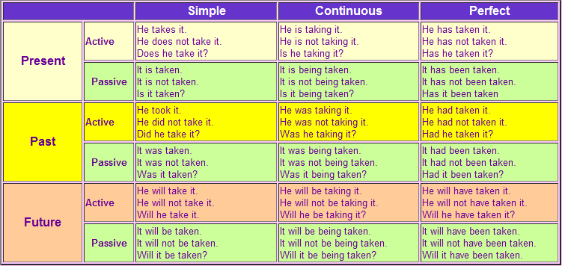
TABLE OF ENGLISH TENSES

