Slide 1
I. B. (PG) COLLEGE
PANIPAT

Slide 2
Presented By:
Professor Priya Bareja
Department of English
I. B. (PG) College

Slide 3
Class –B. A. (I), Sem-2
Subject – English
Topic – Type Of Tens

Slide 4
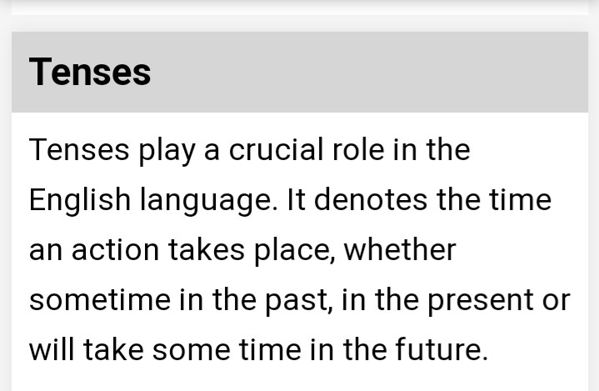

Slide 5
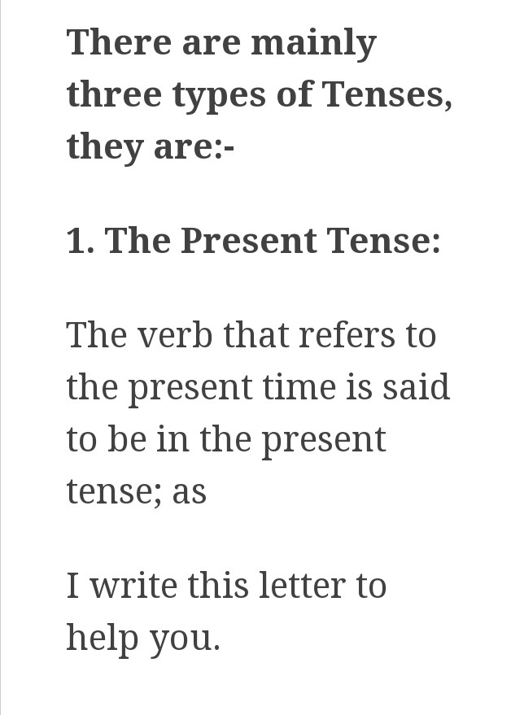

Slide 6
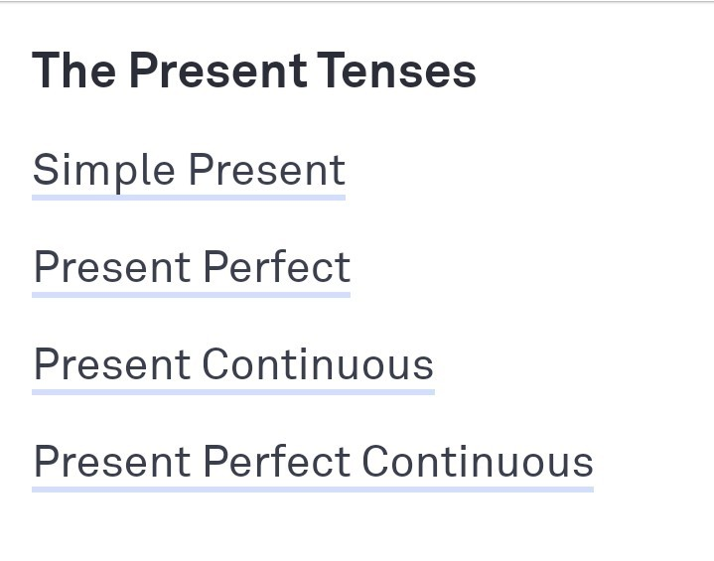

Slide 7
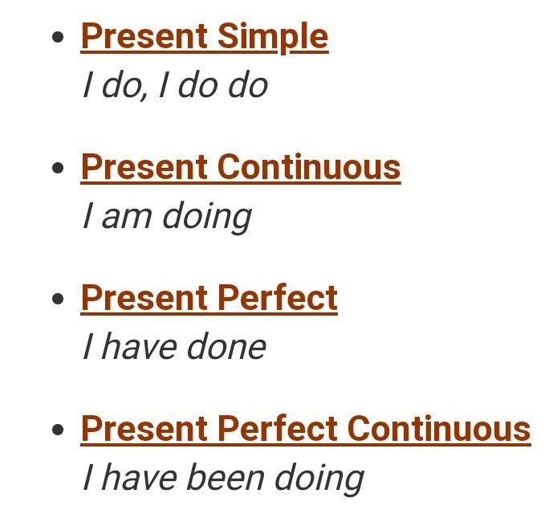

Slide 8
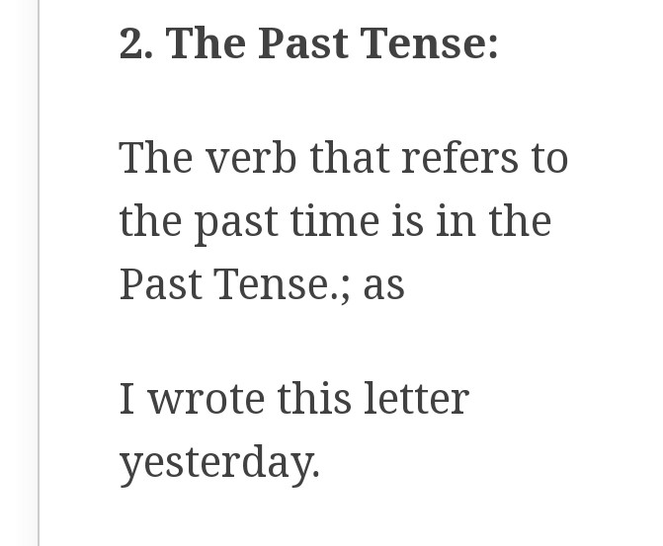

Slide 9
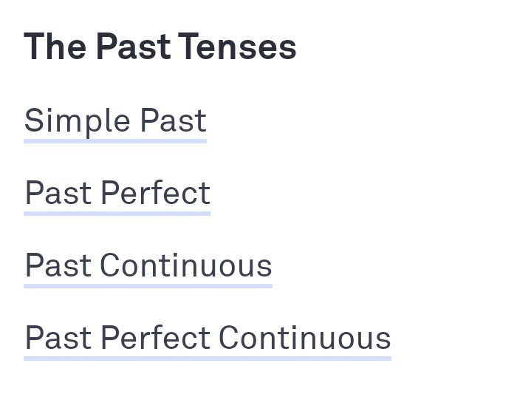

Slide 10
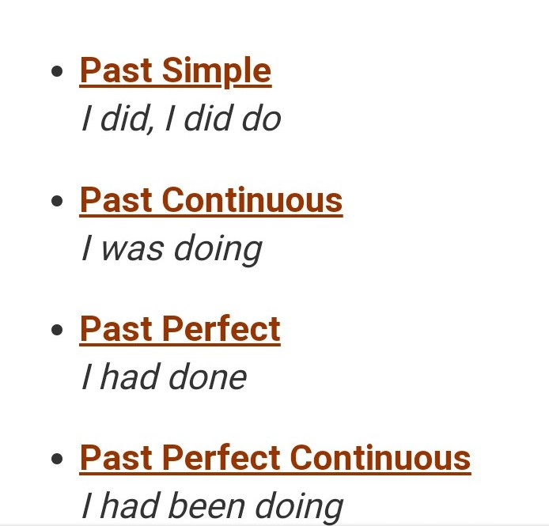

Slide 11
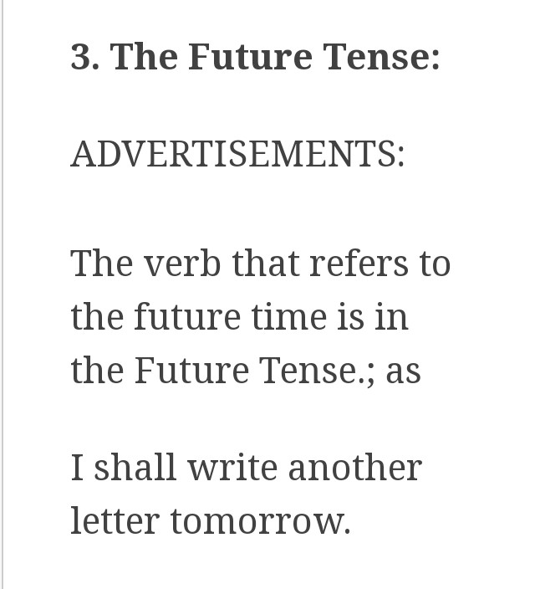

Slide 12
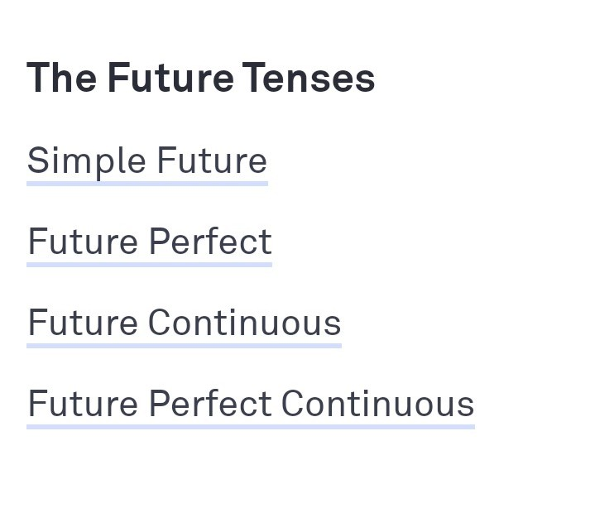

Slide 13
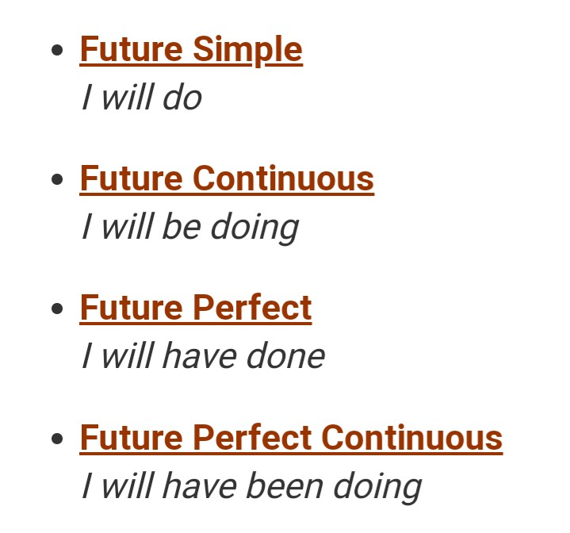

Slide 14
