Slide 1
TOPIC - WITTIG REACTION
CLASS- B.SC. 2ND YEAR, ORGANIC CHEMISTRY
I.B. (P.G.) COLLEGE, PANIPAT

Slide 2
The Wittig reaction or Wittig olefination is a chemical reaction of an aldehyde or ketone with a triphenyl phosphonium ylide (often called a Wittig reagent) to give an alkene and triphenylphosphine oxide. It is widely used in organic synthesis for the preparation of alkenes.
Phosphorus ylide alkylidenephoranes (C₆ H₅)₃=CRR’ etc are wittig reagent

Slide 3
Aldehyde reacts with ylide, gives substituted alkene

Slide 4
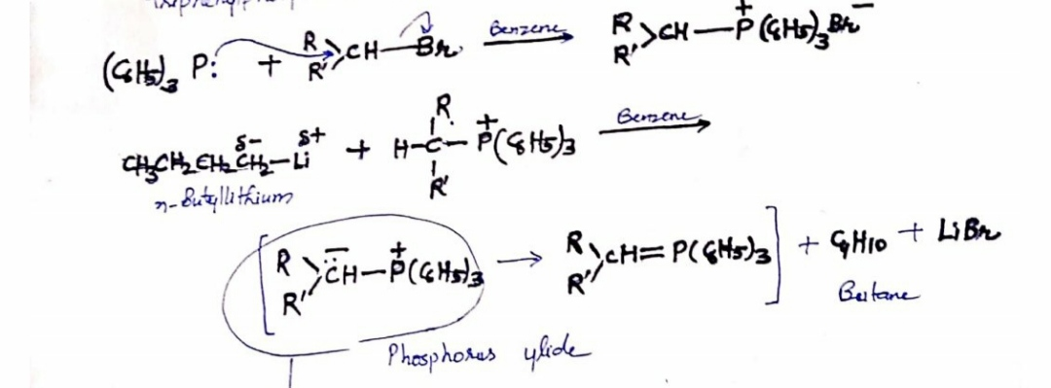
What are wittig reagent / phosohorus ylide?
Molecule bearing no overall charge has a negitive charged hetroatom (N, P, S)
prepared by reaction of alkyl halide or halide with triphenylphosphine and then treatment with a strong base
carbaniom character C atom is strongly nucleophile attacks carbonyl group of aldehyde and ketone

Slide 5
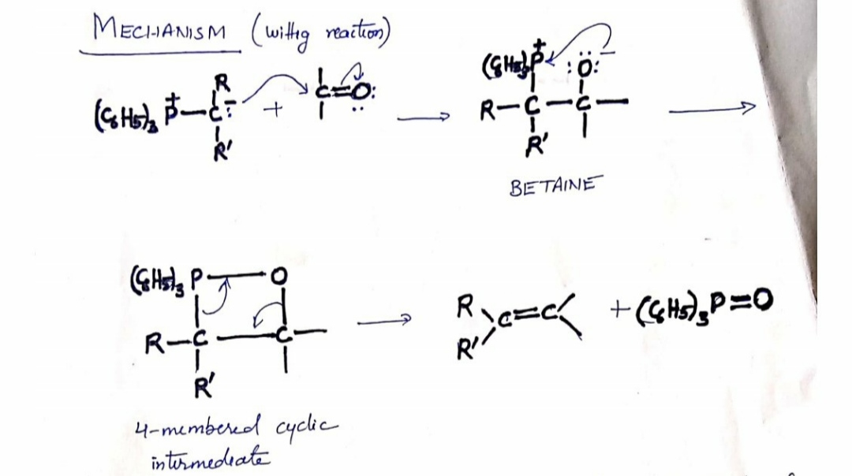
C-P band is weak, it is replaced by strong P-O bond . Also betaine is unstable , so the reaction to form four membered cyclic intermidate take place.

Slide 6
PREPARE 2-Methyl-2-pentene usng wittig synthesis
Choose reagent mentally dividing target molecule at the double bond

Slide 7
Merits / uses
It can be carried out on aldehyde and ketone containing other group like –OH, -COOR Etc. , grignard reagents not useful
complete regioselective

