Slide 1
B.Sc. Second Year
OXIDATION OF KETONS
BAEYER- VILLIGER OXIDATION

Slide 2
The Baeyer–Villiger oxidation is an organic reaction
that forms an esterfrom a ketone or a lactone from
a cyclic ketone, using peroxyacids or peroxides
as the oxidant.The reaction is named after Adolf
von Baeyer and Victor Villigerwho first reported the
reaction in 1899.

Slide 4
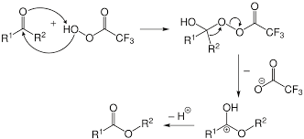
MECHANISM

Slide 5
MIGRATORY APTITUDE
Migratory aptitude of the groups to migrate from C to electron difficient O follows as
Tert-alkyl > sec-alkyl> phenyl> primary alkyl> methyl
The group which can more easily supply the electrons migrates . So product formed decided by migratory aptitude of groups.

Slide 6
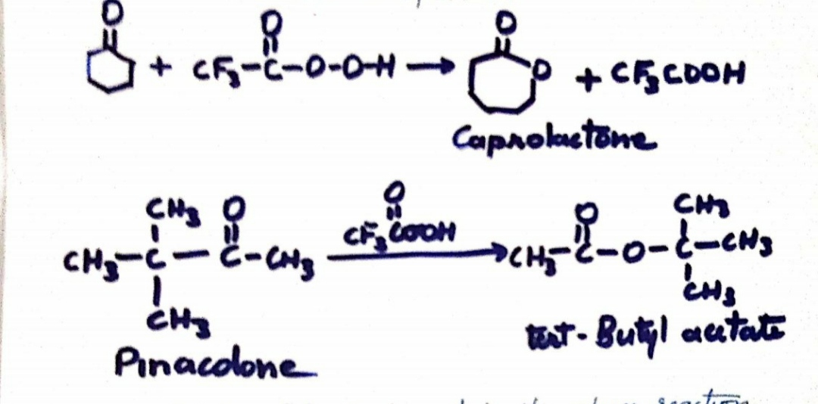
Trifluoroperacetic acid is most reactive because F3CCOO- ion is very good leaving group.
Cyclohexanone oxidises to caprolactone

Slide 7
Tert butyl acetate is formed in the above reaction and not methyl tert. Butyl acetate because migratory aptitude of tert. Butyl group is greater than that of methyl group

