Slide 1
CLASS:-B.Sc. Second year (IV SEM)
SUBJEST:-ORGANIC CHEMISTRY
TOPIC:-ALDEHYDES AND
KETONES
I.B(P.G)COLLEGE,PANIPAT

Slide 2
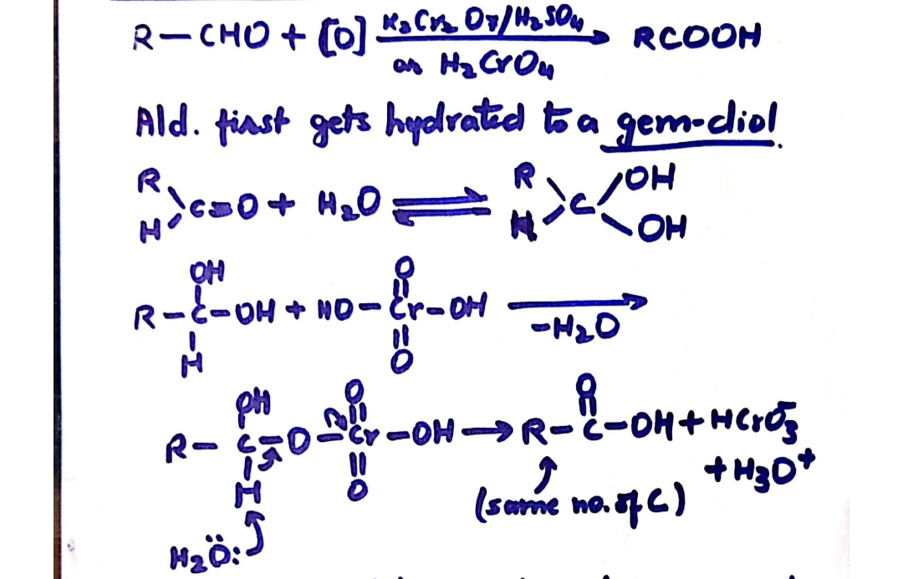
OXIDATION OF ALDEHYDES:-

Slide 3
easily oxidised by mild oxidising agent so they are strong reducing agents.
Readily reduced:-
1.Tollens reagent to Ag.
2.Fehling solution or Benedict solution to red ppt.of Cu₂O.

Slide 4
Aromatic aldehyde do not reduce fehling solution.
OXIDATION OF KETONES :-
C-C cleavage required so ketones are resistant to oxidation.

Slide 5
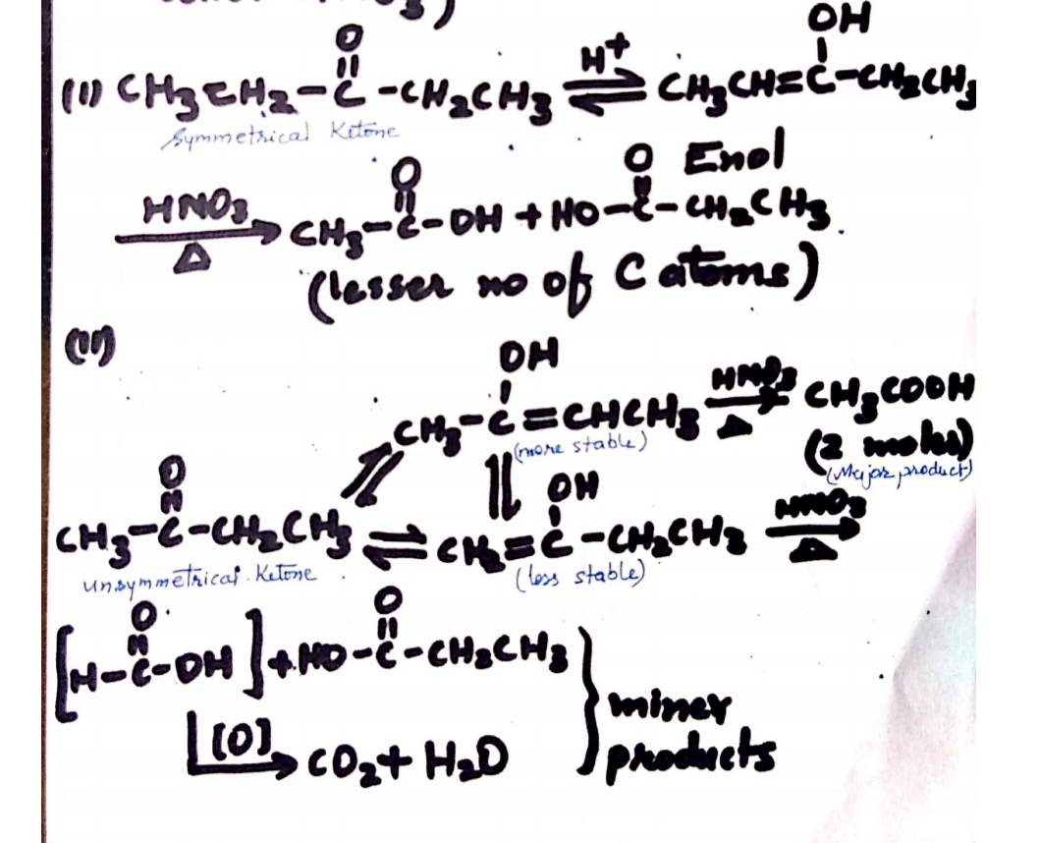
OXIDATION TO CARBOXYLIC ACID UNDER DRASTIC CONDITIONS:-
(Acidified K₂Cr₂O₇,Alk.KMnO₄,Conc. HNO₃)

Slide 6
THANKYOU

