Slide 1
IMPORTANT QUESTIONS OF ALDEHYDES AND KETONES
Q.1- Explain the facts that:
(i) Addition of certain nucleophilic reagents to aldehydes and ketones are catalysed by the presence of acids.
(ii) In nucleophilic addition reactions ketones are less reactive than aldehydes.

Slide 2
Q.2-(a) Explain the mechanism of : (i) Knoevenagel condensation (ii) Addition of NH3 derivative.
Q.3- Explain the mechanism of the following reactions:

Slide 3
Q.3-(a) Explain the mechanism of the following transformation:
(a)
(b) An organic compound having molecular formula C₆H₁₂O does not reduce tollens reagent but gives a crystalline derivative with 2,4-dinitrophenyl hydrazine. It also gives iodoform test and produce 3-methyl pentane on clemmensen reduction. Assign a structural formula to the organic compound and write the reactions involved.

Slide 4
Q.4- (a)Two equivalent of benzaldehyde react with hydrazine to give a compound with molecular formula C16H12N2.
Draw the structure of the compound and write the reaction.
(b) Explain the mechanism of wittig reaction.

Slide 5
Q.5- (a) Which of the following will undergo aldol condensation or cannizzaro reaction(with reasoning): (i)HCHO (ii) CH3CHO
(b) Which of the following will undergo haloform reaction(with reasoning):
(i) HCHO (ii)CH3CHO

Slide 6
Q.6- (a) What will happen when CH3CHO react with ethylene glycol in a slightly acidic medium? (b) What will happen the ethanol react with NH2NH2/KOH?
(C) Why are the aldehydes more reactive than ketones towards nucleophilic addition reaction?

Slide 7
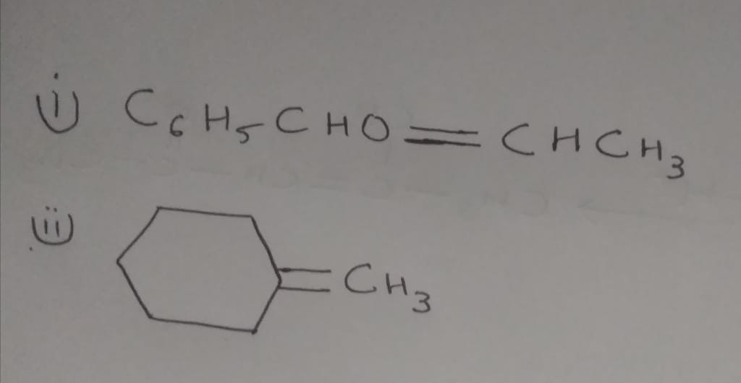
Q.7(a) Give the structure of the ylide and carbonyl compounds needed to prepare the following alkenes:
(b) Write a short note on the following
(i) MPV Reaction
(ii) Wolf Kishner Reduction

Slide 8
Q.8- (a) The combination of CrO3 and sulphuric acid is often reffered as jones reagent and the oxidation of alcohols with this reagent in alcohol is called jonnes oxidation. Jones oxidation Is not agood method to oxidise primary alcohols to aldehydes. Why?
(b) Give the chemical test to distinguish between:
Methanal and Propanone
Pentan-2-one and pentan-2-al

Slide 9
Q.9-(a)An organic compound with molecular formula C9H10O forms 2,4 DNP derivative , reduces tollen`sreagent and undergoes Cannizzaro reaction. On vigorous oxidation it gives 1,2-dicarboxylic acid. Identify the compound?
(b) Define Sarett`s reagent?

Slide 10
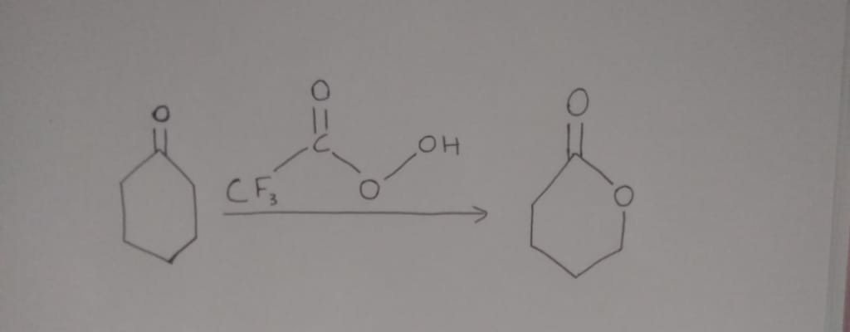
Q.10- Discuss the mechanism of the following transformation:
(b) What is the advantage of oxidation of alcohols with pyridinium dichromate(PDC) Or pyridinium chlorochromate(PCC)?

Slide 11
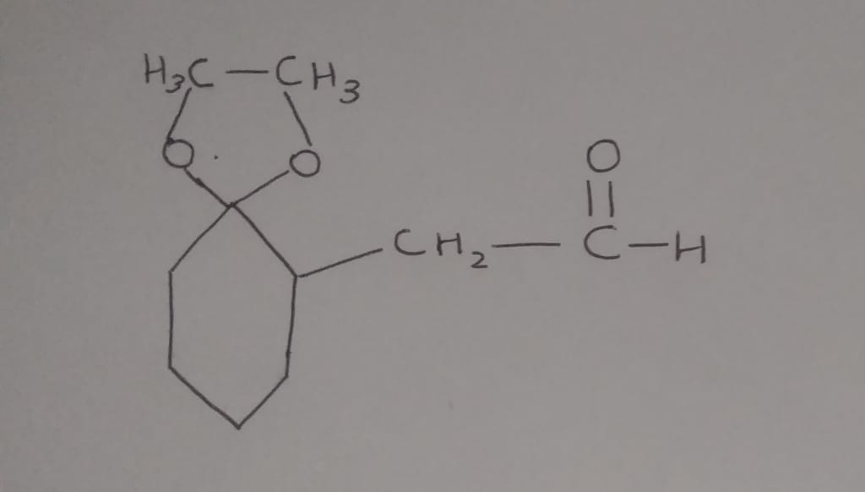
Q.11-(a) Reduction of the following compound by the wolf-kishner method gives C10H18O3 but the clemmensen reduces to give C10H20. Why do the products differ?
(b) For Cannizzro reaction, explain why the reaction cannot be used with aldehydes having alpha-hydrogen?

