Slide 1
CORPORATE ACCOUNTING
LIQUIDATION OF COMPANY
By SAKIRA ARORA (TANEJA)
Assistant Professor
I.B College Panipat

Slide 2
MEANING OF LIQUIDATION
The Legal Process of Winding up a Company is Designated as Liquidation.
A Person Appointed to Conduct the winding up Proceeding is called the LIQUIDATOR.

Slide 3
METHODS OF LIQUIDATION (Section 270)
Winding up by The Tribunal
Voluntary Winding-up

Slide 4
WINDING UP BY THE TRIBUNAL(Section 271)
When Company is Unable to Pay Its Debts.
If the affairs of The Company Conducted in a Fraudulent manner or unlawful Purpose.
When default is made in filing financial Statements or annual returns to the Registrar.
When the Tribunal is of the Opinion that liquidation is just and Equitable.

Slide 5
VOLUNTARY WINDING –UP (SECTION -304)
M
VOIUNTARY WINDING-UP
ME
CRE
BY- MEMBERS
BY-CREDITORS

Slide 6
MEMBERS VOLUNTARY WINDING-UP
This type of winding up takes place when company is solvent. Members appoint liquidator.
Liquidator should call annual general meeting
After final statement of account liquidator send a copy to registrar.
After 3months of Registration company is completely wound up.

Slide 7
CREDITORS VOLUNTARY WINDING UP
When company is insolvent then creditors do the processing of winding up.
Members and creditors both appoint liquidator.
Creditors call a meeting and in this meeting full statement of assets and liabilities of the company is placed.

Slide 8
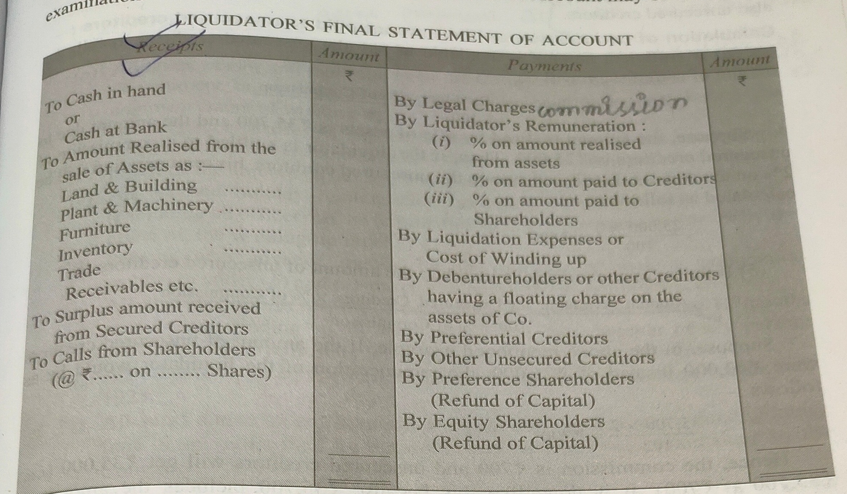
STATEMENT OF ACCOUNT

