Slide 1
I. B. (PG) College, Panipat

Slide 2
Presented by
Sheela Malik
Assistant Professor
Department of English
I. B(PG)College ,Panipat

Slide 3
Modal Auxiliaries

Slide 4
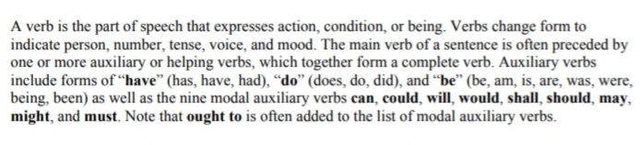

Slide 5
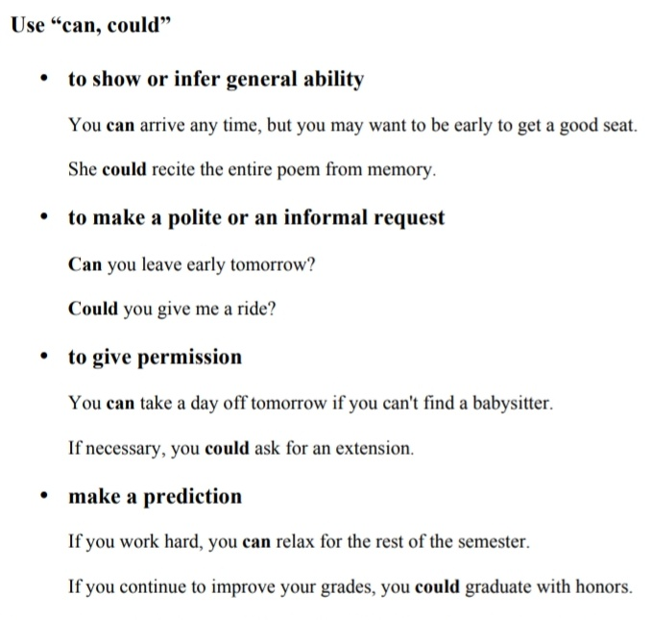

Slide 6
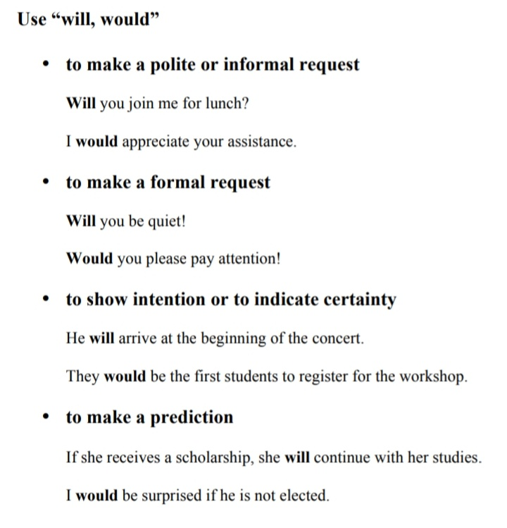

Slide 7
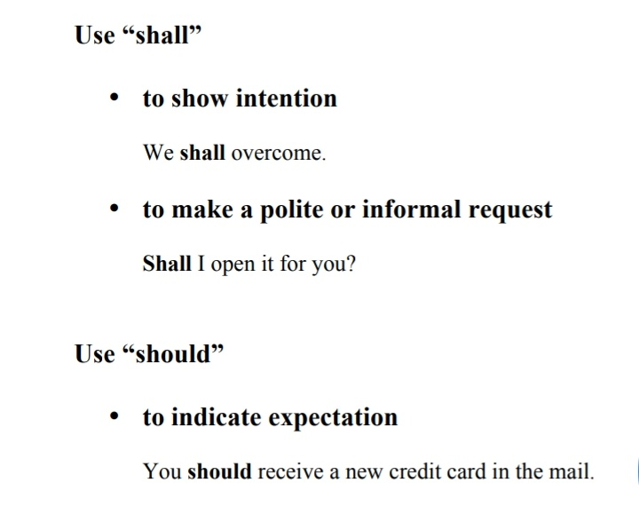

Slide 8
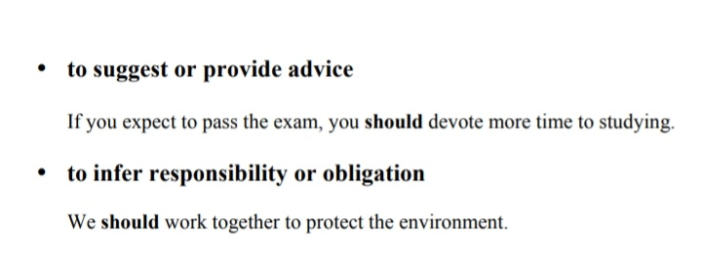

Slide 9
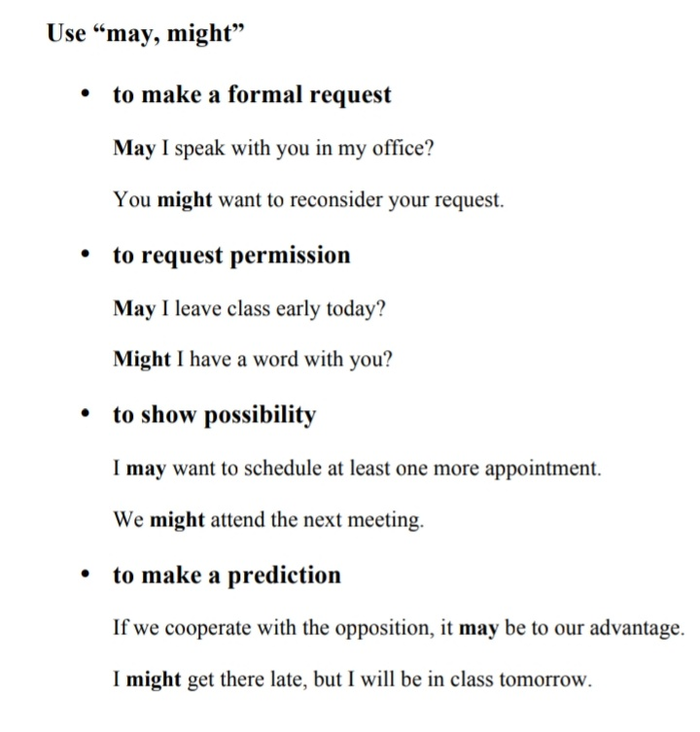

Slide 10
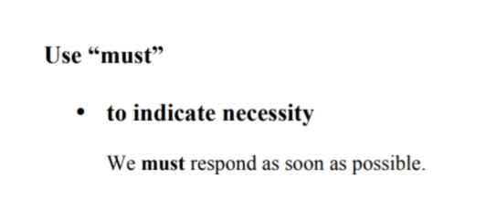

Slide 11
Thank you

