Slide 1
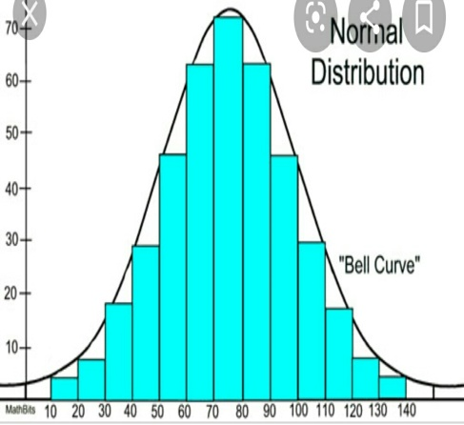
NORMAL DISTRIBUTION -
INTRODUCTION AND PROPERTIES
BCom 2nd year
Business statistics
I.B (P.G) college ,Panipat.
Affiliated to Kurukshetra University ,Kurukshetra

Slide 2
WHAT IS PROBABILITY DISTRIBUTION?
A probability distribution is a list describing all the possible outcomes of a random variable along with their corresponding probabilities of occurrence .
In simple terms , it shows the likelihood of different possible outcomes of variables.

Slide 3
For Example:
Let's take the case of flipping of two coins where a random variable X denotes the number of heads. Four possible outcomes are HH,HT ,TH,TT. The following tables showing values and probabilities is the probability distribution of x.
No. of heads(X ) Probability
0 1/4
1 2/4
2 1/4

Slide 4
TYPES OF PROBABILITY DISTRIBUTION
Discrete probability distribution
Continuous probability distribution
Binomial
Normal
Poisson

Slide 5
MEANING OF NORMAL DISTRIBUTION
*Normal distribution is a continuous probability distribution that is symmetric about the mean.
* It was discovered by an English mathematician Abraham de Moivre in 1733 and later applied by Laplace and Karl Gauss. it is also called "Gaussian Distribution" and "Bell curve".
* It represents the behaviour of continuous variable e.g height ,weight and blood pressure .
*It can be described completely by two main parameters: mean and standard deviation .
continued……

Slide 6
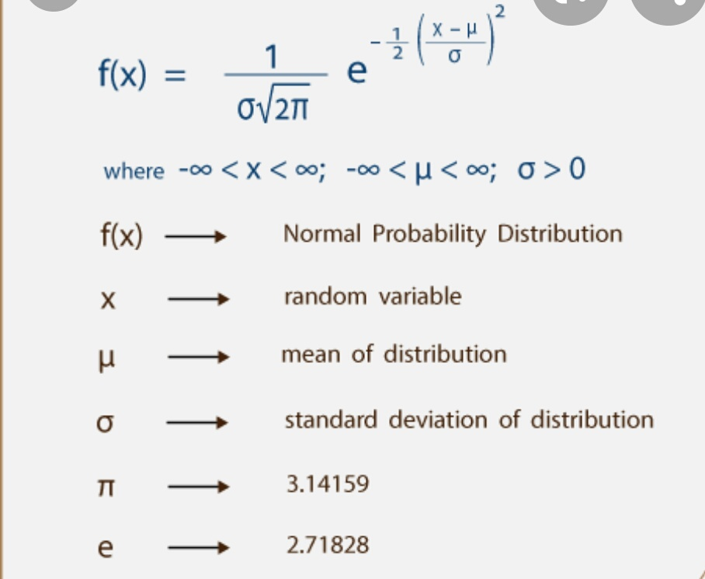
*Probability for a distribution is linked with the area under the normal curve for a particular range of values and the area under the entire normal curve that extends to positive and negative infinity is unity.
ALGEBRAIC EXPRESSION OF PROBABILITY

Slide 7
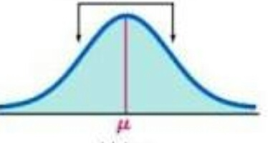
PROPERTIES
*Symmetrical and bell shaped in appearance with mean at peak.
*The distribution has only one mode.
continued........

Slide 8
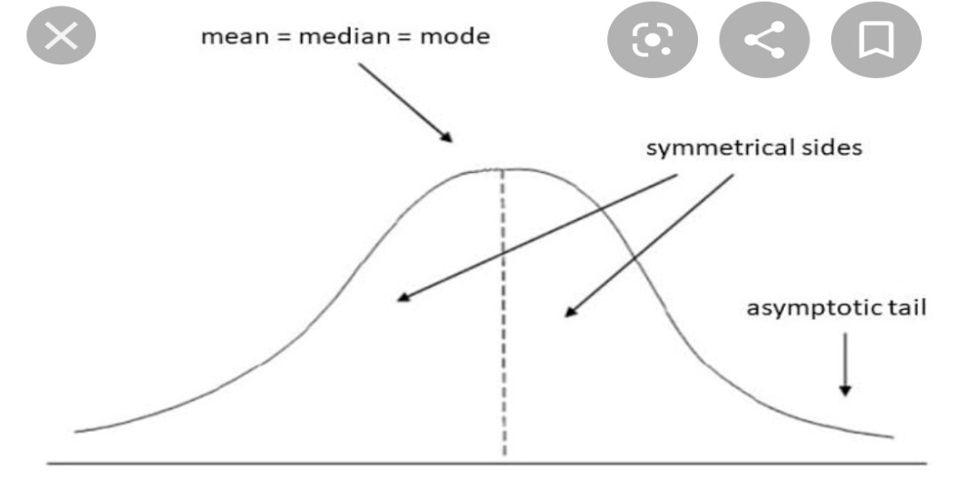
*Mean , median and mode are equal & located at the center of the distribution
X̄=M =Z
* The total area under the curve is 1out of which .5 is on left side and .5 is on right side.
*No matter how far the curve extends,it will never touch the axis because the curve represents the probability of observation which will not be zero (means tails are asymptotic).
continued........

Slide 9
*The curve extends from minus infinity to plus infinity.
*In a normally distributed curve both quartiles are equidistant from
the median.
This Means (Q3 – M) = (M – Q1).
*In a normal distribution ,the mean deviation is equal to 4/5 times the standard deviation and quartile deviation is 2 /3 times the standard deviation.
continued………

Slide 10
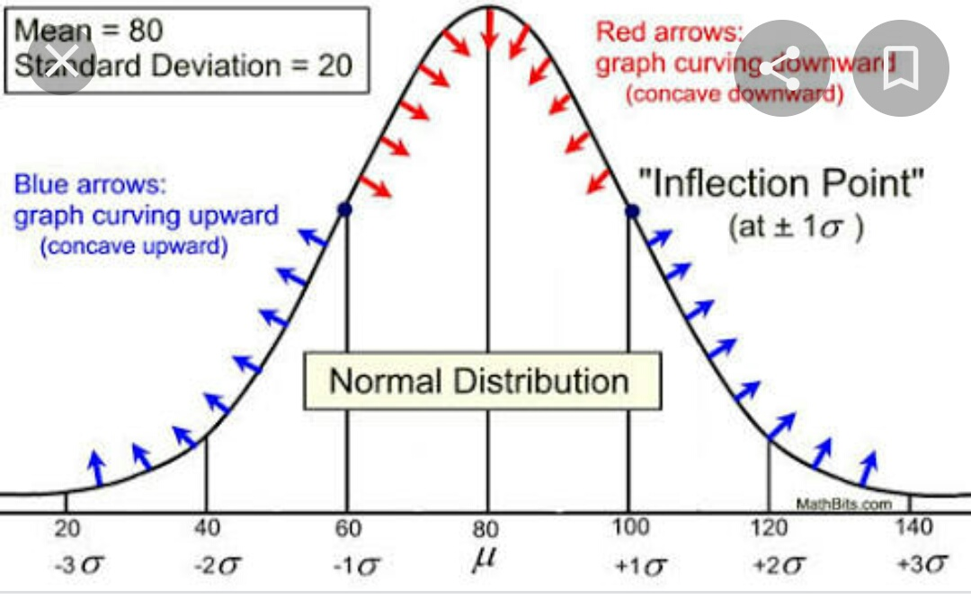
*Inflexion point
*Inflexion point refers to a point where concavity of a curve changes.
*Inflexion point of a normal distribution lies one standard deviation above the mean and one standard deviation below the mean.
continued………

Slide 11
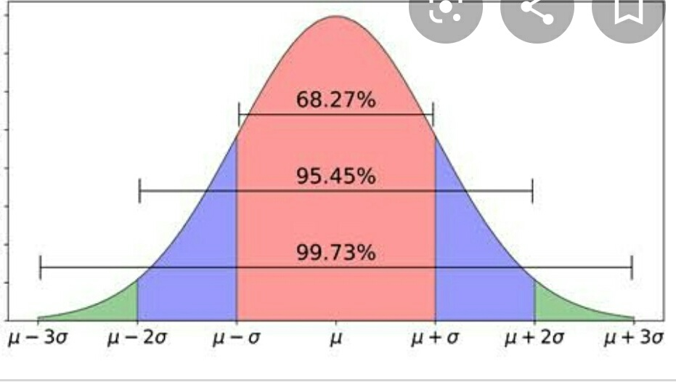
*Area relationship property/Empirical rule
This tells the percentage of values that lie within a range.around the mean in a normal distribution
68.27% of the data falls within one standard deviation of the mean
i.e μ + 1σ and μ - 1σ
95.45% of the data falls within two standard deviations of the mean
i.e μ + 2σ and μ - 2σ
99.73% of the data falls within three standard deviation of the mean
i.e μ + 3σ and μ-3σ
continued………

Slide 12
PRACTICAL APPLICATION OF THIS PROPERTY/RULE
With this rule we can study behaviour of important things in our life.
Suppose that average cooking time of a person is 35 minutes and a standard deviation of 7 minutes. According to this rule , we conclude that approx 68% of things are cooked between 28-42 minutes (35 +/- 1*7), 95% are prepared between 21-49 minutes (35 +/- 2*7), and 99.7% are between 14-56minutes (35 +/-3*7).
).

Slide 13
Conclusion:
Normal Distribution is a continuous probability distribution which is widely used .It is symmetric & bell shaped .Normal curve is its graphical representation and its shape depends on mean and standard deviation.
Using this we can study the behaviour of many natural phenomenon.It has huge significance in sampling theory and statistical quality control.It also serves as a good approximation to Binomial and poisson distribution in certain cases.

Slide 14
THANK YOU

